Slide 1


Algorithms and Software Systems
for Resource Management in Clouds
Adel Nadjaran Toosi
Faculty of Information Technology
Monash University
Email: adel.n.toosi@monash.edu
Homepage: http://adelnadjarantoosi.info
Notes:
Cloud Computing Market is Projected To Reach $411B By 2020.

Slide 2
Outline
Brief Biography
Geographical Load Balancing (GLB)
Resource Provisioning for Data-intensive Applications on Hybrid Clouds
A Low-Cost Micro Data Center for Software-Defined Cloud Computing
Summary
Notes:
Intro
High energy consumption in data centers
Renewable energy sources
Challenges of using renewable energy

Slide 3
Biography and Research Overview
PhD, University of Melbourne, 2010-2014
  Thesis: “On the Economics of Infrastructure as a Service Cloud Providers: Pricing, Markets, and Profit Maximisation”
Postdoctoral Research Fellow, University of Melbourne, 2014-2018
  Renewable Energy, Data intensive application Scheduling, Software-defined Clouds
Lecturer, Faculty of Information Technology, Monash University, May 2018
Research Interests
  Distributed Systems, Cloud Computing, Software-Defined Networking (SDN) and Network Function Virtualization (NFV), Energy Efficiency and Green Computing, Soft Computing
Publications
  29 publications, 17 Journal Articles (11 A/A* ERA Ranking, ACM CSUR,TCC, JCNA, FGCS, TAAS), 11 Conference papers (CloudCom, UCC, HPCC), 1 Book Chapter,
  h-index: 16 and 1200+ citations (SRC: Google Scholar)

Slide 4

Geographical
Load Balancing for Web Applications

Slide 5
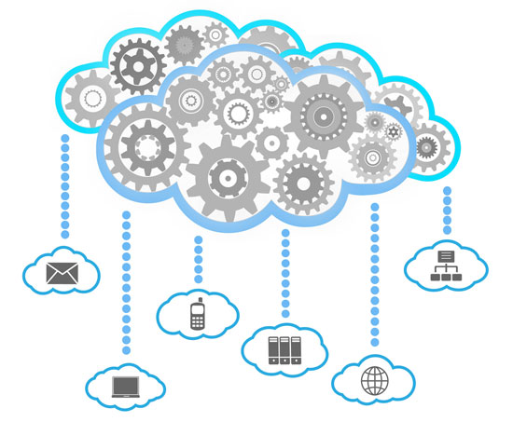









Cloud Computing
3.4 MILLION EMAILS
ARE EXCHANGEDª
6,000 TWEETS
ARE SENT ON TWITTER^{b}
250 SONGS
ARE DOWNLOADED VIA ITUNES^{f}
`
100,000 SEARCHES
ARE MADE ON GOOGLE^{c}
70,000 LIKES
ARE GENERATED ON FACEBOOK^{e}
600 ITEMS
ARE SOLD ON AMAZON^{d}
a https://www.lifewire.com/how-many-emails-are-sent-every-day-1171210
b http://www.internetlivestats.com/twitter-statistics/
c http://www.statisticbrain.com/google-searches/
d https://www.inc.com/tom-popomaronis/amazon-just-eclipsed-records-selling-over-600-items-per-second.html
e https://www.brandwatch.com/blog/47-facebook-statistics-2016/
f http://www.billboard.com/biz/articles/news/1538108/itunes-crosses-25-billion-songs-sold-now-sells-21-million-songs-a-day
Notes:
A city of one million will generate more than 200 Million Gigabytes of Data per day.
5G and Smart Phones 6B in 2020 (Ericsson)
Internet-of-Things (IoT) Devices 25B in 2020 (Gartner)

Slide 6

Power Hungry Clouds
Cloud data centres consume large amounts of electricity
  High operational cost for the cloud providers
  High carbon footprint on the environment
US Data Centres
  70 billion kilowatt-hours of electricity in 2014
  = Two-year power consumption of all households in New York
  = The amount consumed by about 6.4 million average American homes that year
  Projected nearly 50 million tons of carbon pollution per annum in 2020.
          Source: US Natural Resources Defense Council (NRDC)
Photo Source: http://nycyoungmen.tumblr.com/

Slide 7
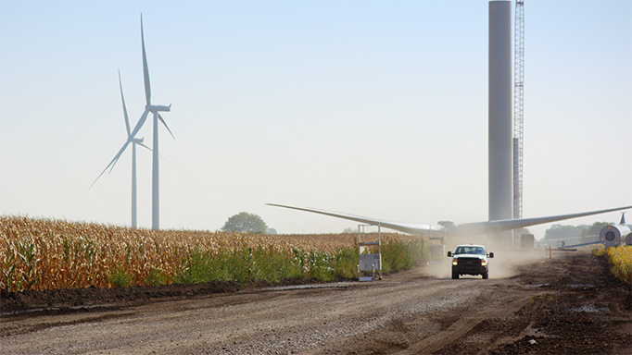
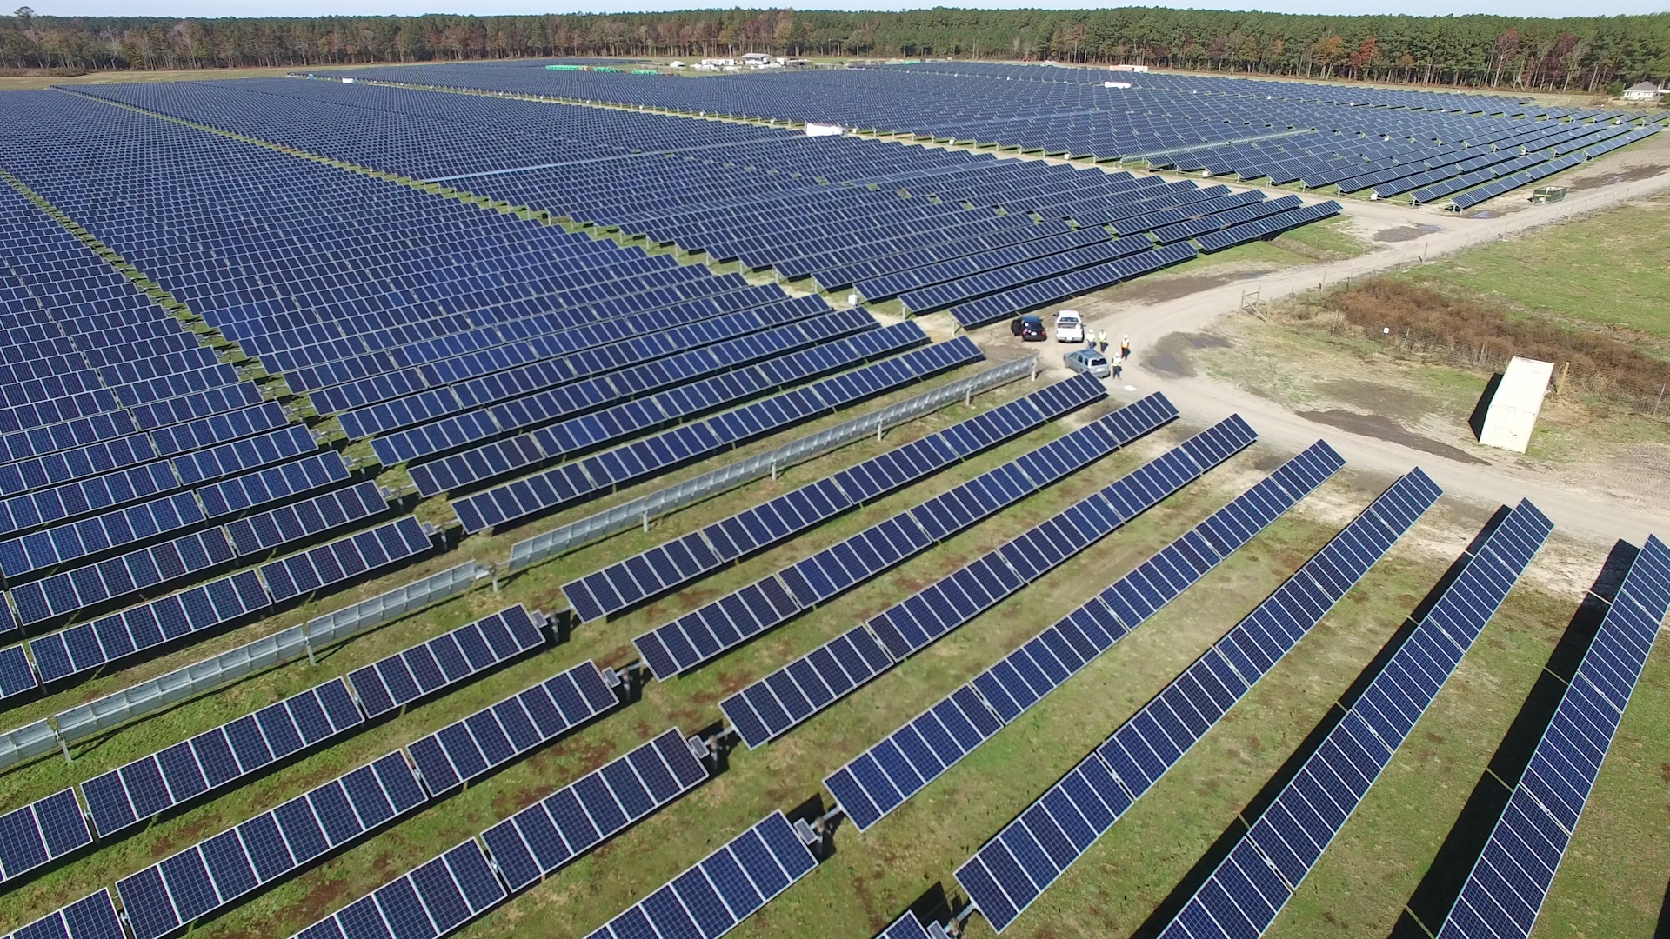
Renewable Energy and Challenges
Cloud providers aims
  Reduce energy consumption
  Abate dependence on brown energy
Renewable energy
  Google, Microsoft and Amazon
Challenges:
  Non-dispatchable, Intermittent and Unpredictable
  Powering data centres entirely with renewable energy sources is difficult
Mixed sources of energy for data centres:
  Grid power or brown energy
  Renewable energy sources or green energy
Challenges:
  Minimising brown energy usage
  Maximising renewable energy utilisation
Source: https://aws.amazon.com/about-aws/sustainability/

Slide 8
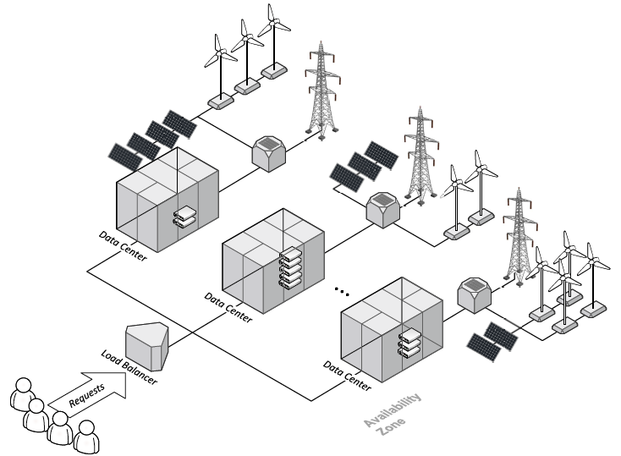
Geographical Load Balancing (GLB)
Geographical load balancing (GLB) potentials:
  Follow-the-renewables
GLB approach benefits cloud providers but it raises an interesting, and challenging question:
“With limited or even no a priori knowledge of the future workload and Dynamic and unpredictable nature of renewable energy sources, how to optimise the overall renewable energy use and cost?”

Slide 9
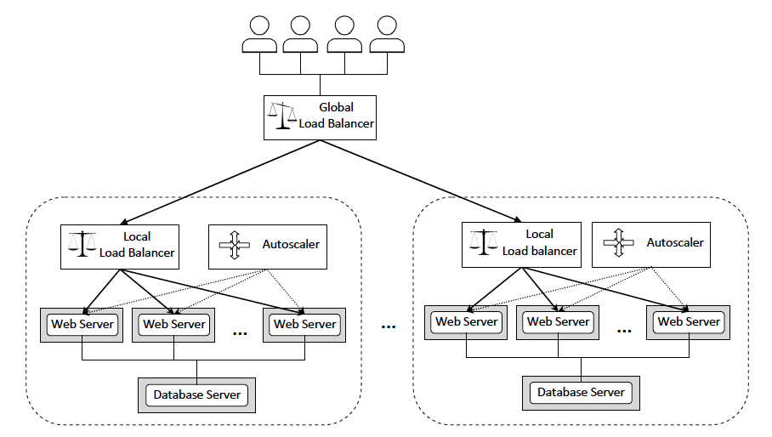
System Architecture for Web Applications

Slide 10
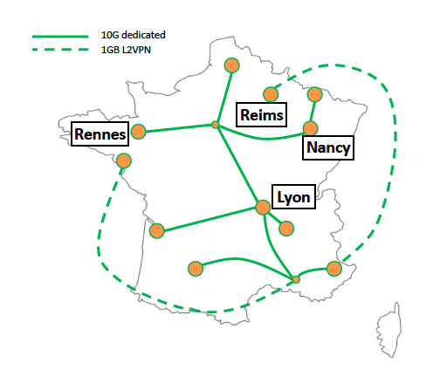
Grid’5000 Testbed

Slide 11
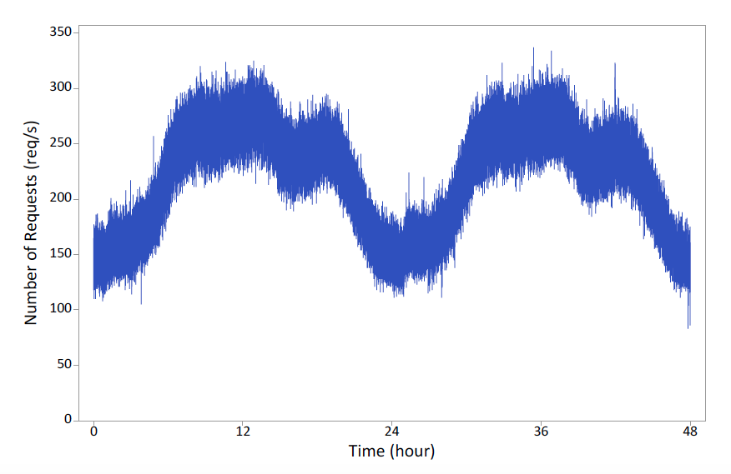
Workload Traces
Wikipedia
Notes:
The 5% of English Wikipedia Requests for 19th and 20th of September 2007

Slide 12
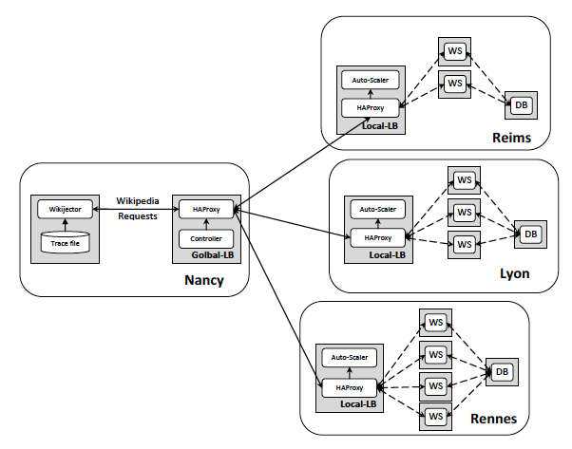
A Prototype System

Slide 13
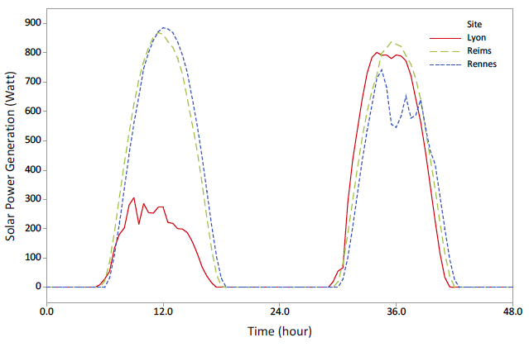
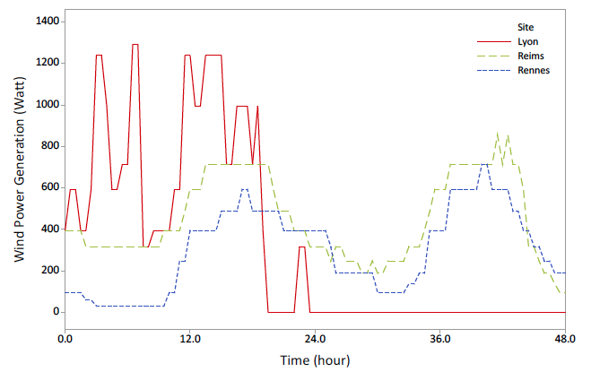
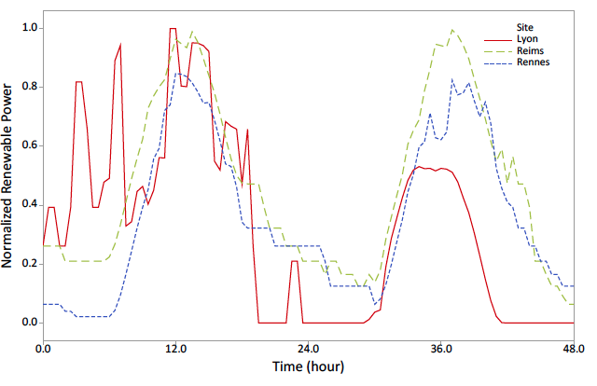
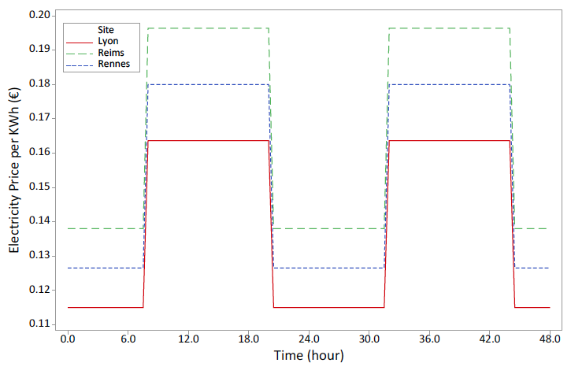
Renewable Power and Electricity Prices
Solar
Wind
Combined
Notes:
Meteorological data on the location of each site.
Wind speed and Global Horizontal Irradiation (sunlight)

Slide 14
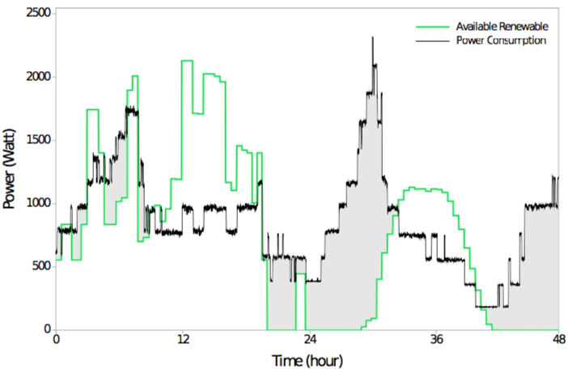
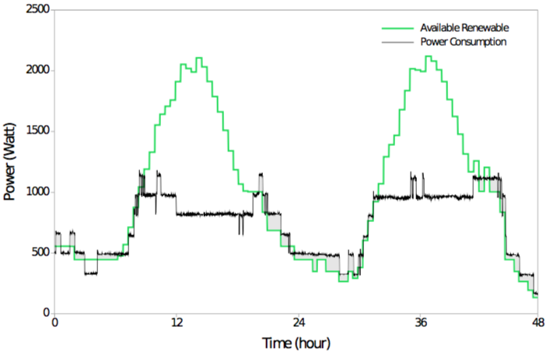
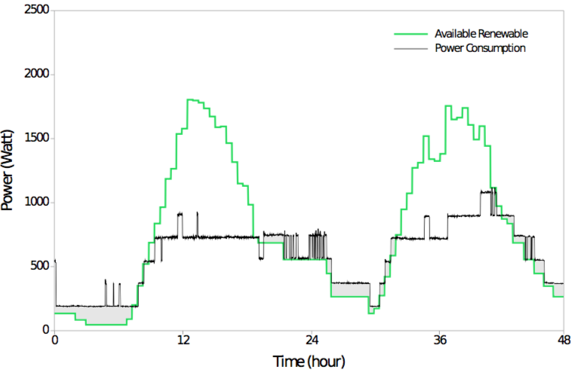
Results
Lyon
Reims
Rennes

Slide 15
Results
Site | Metric | RR | Capping | GreenLB
Lyon | Power Consumption (kWh) Brown Consumption (kWh) Cost (€) | 36.3 13.3 1.71 | 42.9 19.0 2.31 | 41.2 16.9 2.01
Reims | Power Consumption (kWh) Brown Consumption (kWh) Cost (€) | 32.5 2.1 0.42 | 32.5 1.1 0.15 | 35.4 1.9 0.27
Rennes | Power Consumption (kWh) Brown Consumption (kWh) Cost (€) | 36.4 9.3 1.23 | 29.7 2.9 0.39 | 28.3 2.6 0.35
Total | Power Consumption (kWh) Brown Consumption (kWh) Cost (€) | 105 25.7 3.36 | 105 23.0 2.85 | 105 21.4 2.63
Brown Energy:
17% and 7%
Cost Saving:
22% and 8%

Slide 16

Resource Provisioning for Data-intensive Applications on Hybrid Clouds

Slide 17
Background
Data-intensive applications
  Analysis of large datasets
  Explosive growth of data
    Smart cities, Social networks, Internet of Things (IoT), …
Cloud computing
  Preferred platform
Common Scenario
  Data is available in local IT infrastructure with limited processing capacity
Cloud bursting
  Hybrid Cloud (PaaS, Middleware)

Slide 18
Scheduling Problem
Locality
  Location of the data relative to the available computational resources
Network bandwidth
  Can become the bottleneck
Data transfer
  Not ideal to move the entire data set to the public cloud
Data-intensive application
  Data transfer time to the external cloud is often comparable to the computational time

Slide 19
Our Contribution
Data-aware provisioning and Scheduling algorithm
  Minimising cost while meeting the deadline requirements of applications
  Hybrid cloud environments.
  Data transfer time, available bandwidth, locality
Plugged into PaaS
  Aneka platform
  Support dynamic resource provisioning for Microsoft Azure
Experiments in actual hybrid cloud environment
  Local resources and Azure virtual machines
  Compared with existing approaches
  A real-world case study
    A data-intensive application in the smart cities context

Slide 20
Aneka

Slide 21
Walkability Index – Melbourne Neighbourhoods
Notes:
Bag-of-Tasks
Road connectivity, gross dwelling density and the land use mix in the area
AURIN project which supports nationwide urban and built environment research across Australia

Slide 22
Hybrid Cloud Testbed

Slide 23
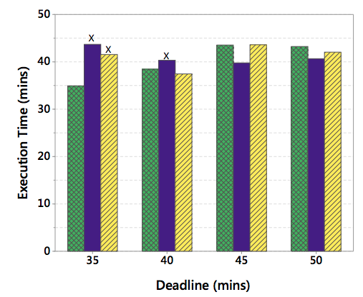
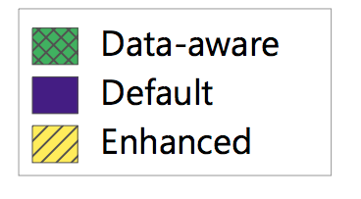
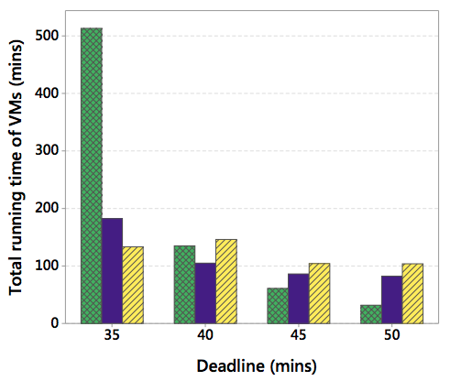
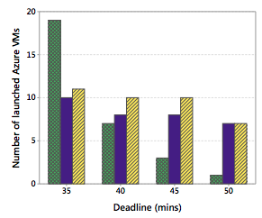
Some Experimental Results
Notes:
220 different neighborhoods in the city of Melbourne
130MB including the Java executable JAR file

Slide 24

A Low-Cost Micro Data Center for Software-Defined Cloud Computing

Slide 25
Software-Defined Networking
Separation of control plane from data forwarding plane
Platform is decoupled from infrastructure
Centralized controller, network-wide control by controller SW that performs routing and traffic engineering
Traditional Networking
Software-Defined Networking
Control Plane
Controller Software
Control Protocol
Data Forwarding Plane
Credit: Jungmin Son

Slide 26
Network Function Virtualization (NFV)
Migration of network functions to the software layer
  Firewalls, Network Address Translation (NAT), Intrusion Detection Systems (IDS)
Virtualized Network Function (VNF)
  deployable elements of NFV
Enables better interoperability of equipment and more advanced network functions

Slide 27
Software-defined clouds
Virtualization in networking
  Software-defined networking (SDN) and Network Functions Virtualization (NFV).
Software-defined Cloud Computing (SDC)
  Extending the concept of virtualization to all resources
    compute, storage, and network
Evaluation and Experimentation
  Complexity, scaling, accuracy, and efficiency.
A low-cost experimental testbed/infrastructure
  Conducting practical research in the domain of software defined clouds.

Slide 28


CLOUDS-Pi
Our recipe for constructing a platform for conducting empirical research in SDCs
  Easily Repeatable
  Low-cost (reusing existing servers and Raspberry Pis)
  Open Source Software
Hardware
  Small scale cloud datacenters (9 physical servers, Fat-tree network)
  Raspberry Pis as SDN Switches
  Managed enclosure Power Distribution Units (ePDUs)
Software
  OpenStack
  OpenDaylight (ODL)
  Open vSwitch

Slide 29
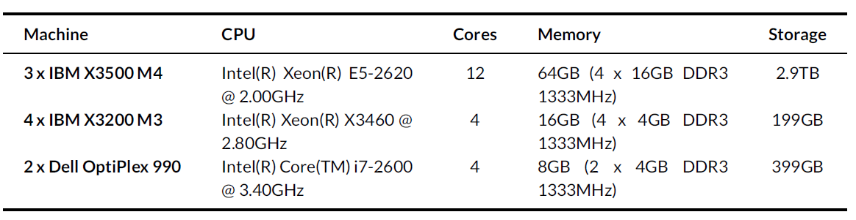
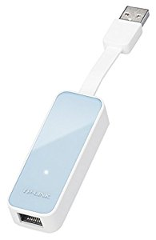
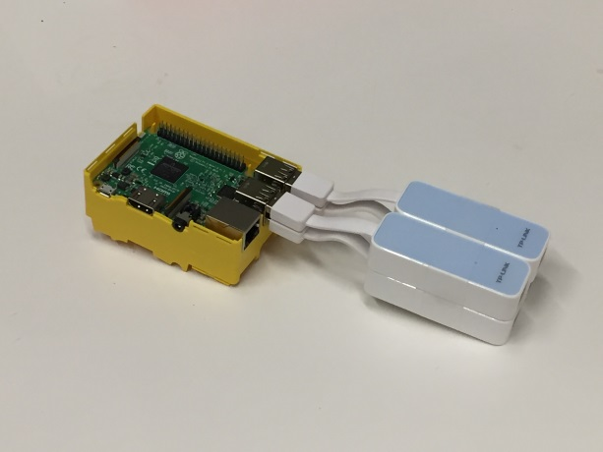
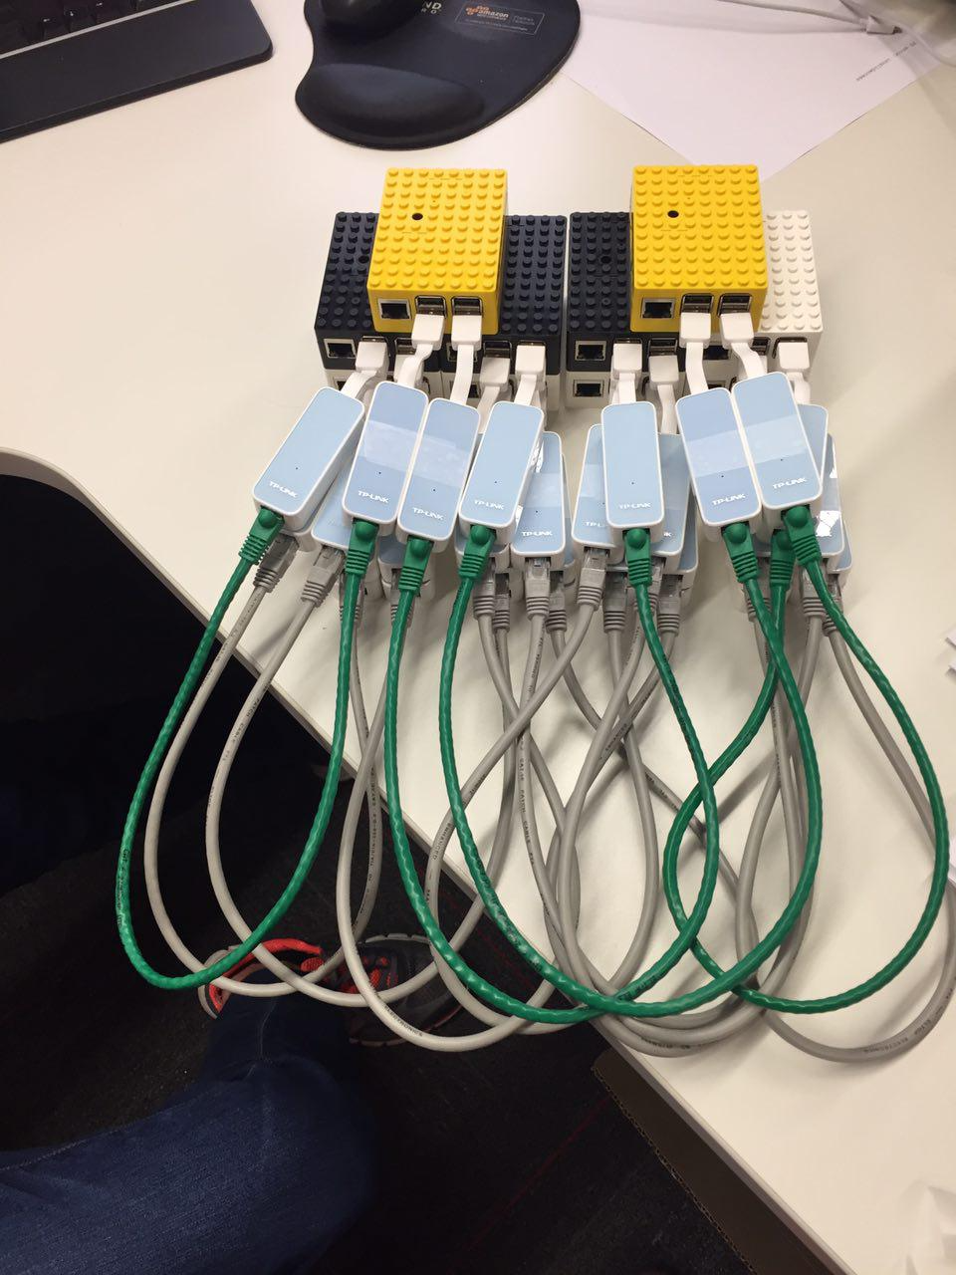
Hardware
Eaton Managed Enclosure Power Distribution Units (ePDUs)
USB 2.0 to 100Mbps
Ethernet adapters
Raspberry Pis
(Pi 3 MODEL B)

Slide 30
System Architecture

Slide 31
More Photos

Slide 32
Dynamic Flow Scheduling for Virtual Machine Migration
“Is it possible to reduce live VM migration time and overhead by dynamically scheduling flows in a cloud data center with multiple paths available between a given pair of physical hosts?”

Slide 33
Acinonyx: Proposed Algorithm
  When multiple shortest paths are available between the source and destination
  As long as the VM migration is in progress it exploit residual bandwidth on multiple available paths
  Redirect the live VM migration traffic on a path with the lowest load
  Find a path that has the highest residual bandwidth on its most utilized link
  Push appropriate flow rules into the switches to redirect traffic

Slide 34
Some Results
Migration time for two simultaneous migrations when Static and Acinonyx flow scheduling are used.

Slide 35
Summary
Cloud computing is a critical building block of many ICT applications.
Geographical load balancing for maximization of renewable energy usage.
  Real traces of web requests for English Wikipedia
  Meteorological data in the location of each data centre to model solar and wind power generation
  Uses 17% less brown energy and saves cost by almost 22% in comparison to round robin policy.

Slide 36
Summary
Deadline-aware Scheduling and Resource Provisioning Method for Data-intensive Applications on Hybrid Clouds
  The proposed method is able to meet strict deadlines for a sample data-intensive application to measure the walkability index
  It minimizes cost and the total number launched instances compared to other existing algorithms.
Recipe for constructing an economical testbed for Software Defined Clouds and conducting practical experiment
  Dynamic flow scheduling algorithm for live VM migration
  Migration time is reduced by 12% and network throughput is increased by 7%.

Slide 37
THANK YOU
Questions?

