Slide 1


On the Economics of IaaS Cloud Providers:
Pricing, Markets, and Profit Maximization
Cloud Computing and Distributed Systems (CLOUDS) Laboratory,
Department of Computer Science and Software Engineering
The University of Melbourne, Australia
Adel Nadjaran Toosi
Supervisor:
Prof. Rajkumar Buyya

Slide 2
Outline
Background
Motivations, Research Problem and Thesis Focus
Solutions
  Federation of Clouds
    Resource Provisioning Policies to Increase Profit
    Financial Option Market Model
  Single Cloud Provider
    Revenue Management with Optimal Capacity Control
    An Auction Mechanism for a Cloud Spot Market
    Spot instance pricing as a Service
Conclusions and Future Directions

Slide 3
Outline
Background
Motivations, Research Problem and Thesis Focus
Solutions
  Federation of Clouds
    Resource Provisioning Policies to Increase Profit
    Financial Option Market Model
  Single Cloud Provider
    Revenue Management with Optimal Capacity Control
    An Auction Mechanism for a Cloud Spot Market
    Spot instance pricing as a Service
Conclusions and Future Directions

Slide 4
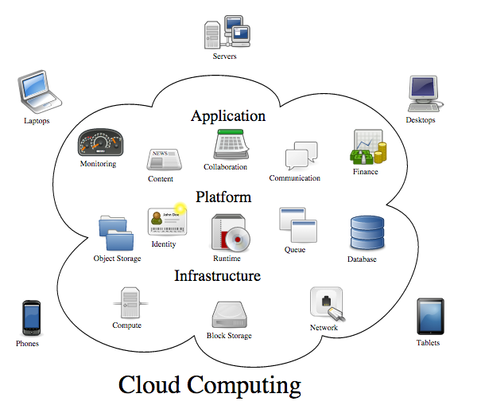
Cloud Computing
Allowing businesses to outsource their IT facilities to cloud providers
Avoid expensive up-front investments of establishing their own infrastructure
Long-held dream of computing as a utility
On-demand delivery of IT services
Customers pay for what they use
Virtualized resources
Figure: http://en.wikipedia.org/wiki/Cloud_computing

Slide 5
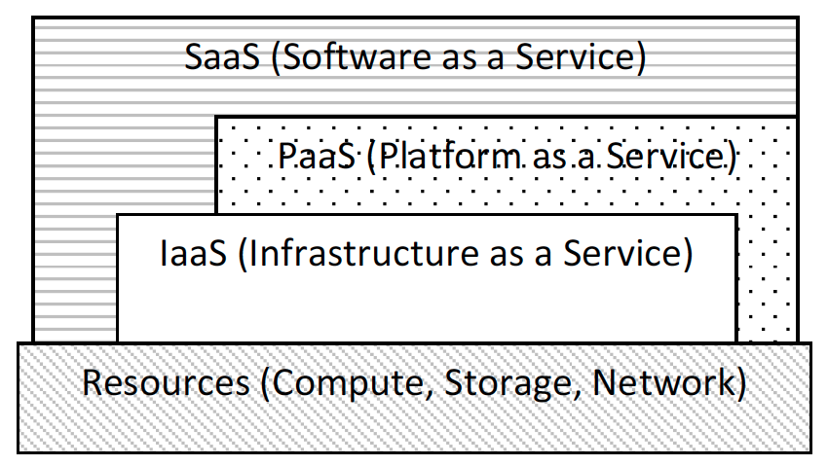
Types of Service Models
Software as a Service (SaaS)
  It provides applications and software to the customer in utility-based model
  Accessible from a thin client interface such as a Web browser
  Example: Salesforce.com
    Customer relationship management (CRM) as a service.
Platform as a Service (PaaS)
  It provides programming languages and tools to
  deploy application onto the cloud infrastructure
  Example: Google App Engine
    facilities to build an reliable and scalable application
Infrastructure as a Service (IaaS)
  It provides capabilities for the customers to provision computational resources such as processing, storage, network, and other fundamental computing resources
  Virtual Machines (VMs)
  Example: Amazon EC2/S3
Cloud Service Stack

Slide 6
Outline
Background
Motivations, Research Problem and Thesis Focus
Solutions
  Federation of Clouds
    Resource Provisioning Policies to Increase Profit
    Financial Option Market Model
  Single Cloud Provider
    Revenue Management with Optimal Capacity Control
    An Auction Mechanism for a Cloud Spot Market
    Spot instance pricing as a Service
Conclusions and Future Directions

Slide 7
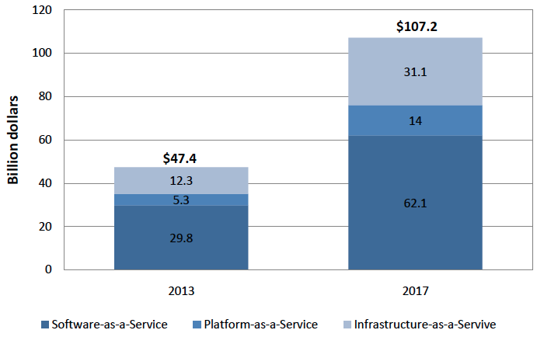
International Data Corporation (IDC) forecast
Worldwide public IT cloud services spending in billion dollars by service model

Slide 8
Motivation (1)
The primary focus of designers in traditional distributed system:
  Improving system performance in terms of response time, throughput system, and utilization;
  Extensively studied in Cluster and Grid Computing in the past 15 years.
Cloud Computing and Computational Economy
  New objective functions: price, cost, and budget
☑Money
This has shifted a traditional distributed system into a two-party computation:
  Cloud providers and Cloud customers
  Pricing and cost as the bridge

Slide 9
Motivation (2)
There is a large body of research devoted to
  Minimizing cost
  Cloud customers
Relatively less work has been done
  Maximizing profit
  The provider’s side
Techniques and mechanisms that help providers to maximize their profit while still selling their services competitively.

Slide 10
Research Problem
This thesis tackles the research challenges arising from the following topic:
“ Designing market and economics-inspired algorithms and resource allocation mechanisms to maximize IaaS cloud providers’ profit honoring the QoS constraints associated with SLA.”

Slide 11
Focus and Solution Classification
We focus on the
  profit maximization problem of IaaS cloud providers.
We develop techniques and mechanisms for two main different situations:
  When a provider acts solely using their in-house resources to serve customers
  When it participates in a cloud federation and benefits from outsourcing requests

Slide 12
Background (Pricing)
Pricing definition
  The process of determining the rate or fee the provider will receive in exchange for offering services or selling resources.
Pricing Strategies
  Marginal-cost pricing, Market-oriented pricing, etc.
Pricing Factors
  Cost of Service
  Market Competition
  Value to the Customers
Pricing Models
  Usage-based (Pay-as-you-go or consumption-based)
  Subscription-based (reservation contract or prepaid scheme)
  Demand-oriented

Slide 13
Background
Non-storable or perishable commodity
  Cloud services similar to many other services, are perishable in nature, and cannot be stored for future sale
IaaS providers offer computational services
  CPU cycles, network bandwidth, and memory space
  Virtual Machine (VM) instances
  VMs are non-storable (perishable)
    if not utilized at a specific point in time
    no value and waste associated underlying data center capacity
To maximize revenue, IaaS provider adopts differentiated pricing plans with different Quality of Service (QoS)
  Usage-based, subscription-based and demand-oriented

Slide 14
Background (Common Pricing Models)
On-demand pay-as-you-go instances (usage-based)
  Customers pays for instances based on actual usage
  No long-term commitments
  Billing cycle (e.g., hourly)
  Fixed-rate basis
Reserved instances (subscription-based)
  Also known as reservation plan
  Reservation fee (premium)
  After which the usage is either free (e.g., GoGrid) or heavily discounted (e.g., Amazon EC2)
  Guaranteed availability.
Spot instances (demand-oriented)
  Also known as spot market
  Customers submits their bids
  Providers reports a market-wide clearing price
  Terminated by the provider if spot market’s clearing price rises above the customer’s bid

Slide 15
Background (Cloud Federation)
Resources available in a single data center are limited
  A large demand may put pressure in the data center capacity
  One possible source for additional resources is idling resources from other providers
Cloud Federation is a collection of individual Cloud providers, which collaborate by trading resources (e.g. computing, storage)

Slide 16
Outline
Background
Motivations, Research Problem and Thesis Focus
  Background
    Pricing and Dynamic Pricing
    Cloud Federation
Solutions
  Federation of Clouds
    Resource Provisioning Policies to Increase Profit
    Financial Option Market Model
  Single Cloud Provider
    Revenue Management with Optimal Capacity Control
    An Auction Mechanism for a Cloud Spot Market
    Spot instance pricing as a Service
Conclusions and Future Directions

Slide 17
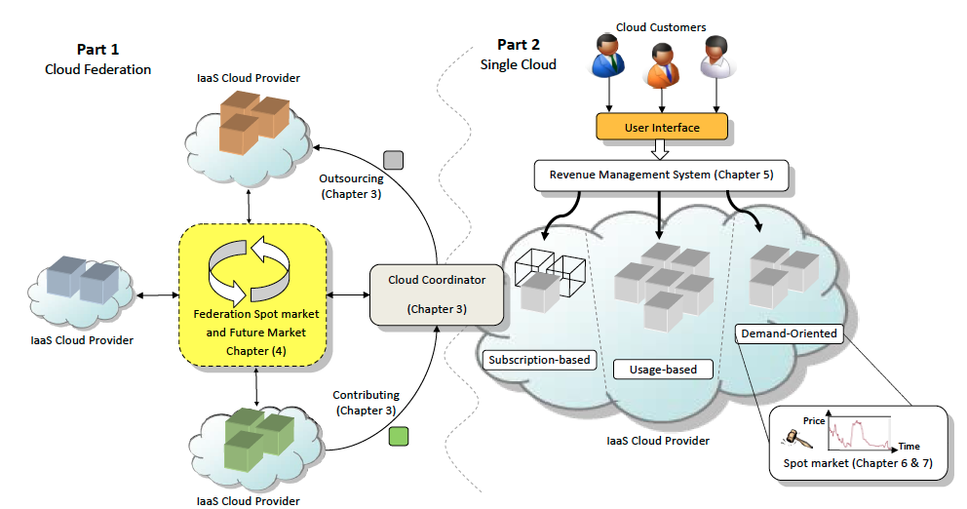
Solutions

Slide 18
Resource Provisioning Policies to Increase Profit
Derived from publication:
Adel Nadjaran Toosi, Rodrigo N. Calheiros, Ruppa K. Thulasiram, and Rajkumar Buyya, “Resource provisioning policies to increase IaaS provider’s profit in a federated cloud environment,” in Proceedings of the 13th IEEE International Conference on High Performance Computing and Communications (HPCC’11), Banff, Canada, Sep. 2011, pp. 279–287.

Slide 19
Resource Provisioning Policies in Cloud
Current resource management strategies hinder providers market potential by limiting the amount of resources allocated to requests
  QoS is met in a conservative way
  Over-provisioning of datacenter capacity
    average demand of the system is several times smaller than the peak demand
By exploiting cloud federation potentials, providers are able to dynamically increase the available resources to serve requests
Outsourcing requests or renting part of idling resources to other providers is not a trivial issue

Slide 20
Research Objectives
Study the impact of federation as a mechanism for maximizing cloud provider’s profit, utilization and reputation
Leverage federation potentials by creating resource provisioning mechanisms for Cloud providers
Investigate the effect of applying different resource trading paradigms to facilitate federation of providers

Slide 21






System Model
User Interface
Provider A
Cloud Coordinator
Cloud Coordinator
Provider B
Cloud Exchange Service
User Interface
Resource
Trading
User Interface
Cloud Coordinator
Provider C

Slide 22
Outsourcing decision scenario
Outsource or terminate Spot?
S
S
Cloud Coordinator
S
User Interface
1 On-demand
2 On-demand
3 Spot
Resource provisioning policies for federated-aware providers in the presence of terminable local VMs

Slide 23
Policies
Non Federated Totally In-house (NFTI)
  Termination of spot VMs with lowest bid
  If action does not release enough resources for the new on demand request the request will be rejected
Federation-Aware Outsourcing Oriented (FAOO)
  Fully utilized provider firstly checks the Cloud exchange service for available resources by other members
  It outsources the request to the provider that offers the cheapest price
Federation-Aware Profit Oriented (FAPO)
  Based on analytical analysis of instant profit, it decides between outsourcing and termination of spot VMs

Slide 24
Performance Evaluation - Setup
Simulation study with CloudSim
  CloudSim: A discrete simulator for modelling and simulation of Cloud Computing
The VM configuration is inspired by Amazon EC2 instances
  One VM type (Small Instances:1 CPU core, 1.7 GB RAM, 1 EC2 Compute Unit, and 160 GB of local storage)
Each datacenter 128 servers, and each one supports 8 VMs.
Due to lack of publicly available workload models and real traces of IaaS Clouds,
Lublin workload model (one week long simulation)
  Each experiment is carried out 20 times
  Average of the results is reported.
Bidding Algorithm:
  A uniformly-distributed random value between the minimum of bid $0.020 and maximum of $0.085(on-demand price)
  The minimum price is set in such a way that the value offered by customers is still enough to cover operational costs of serving the request

Slide 25
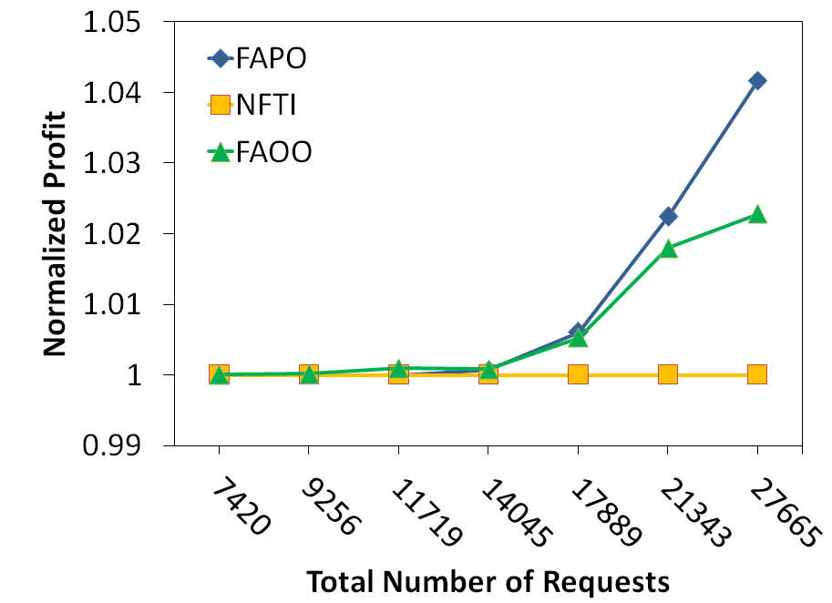
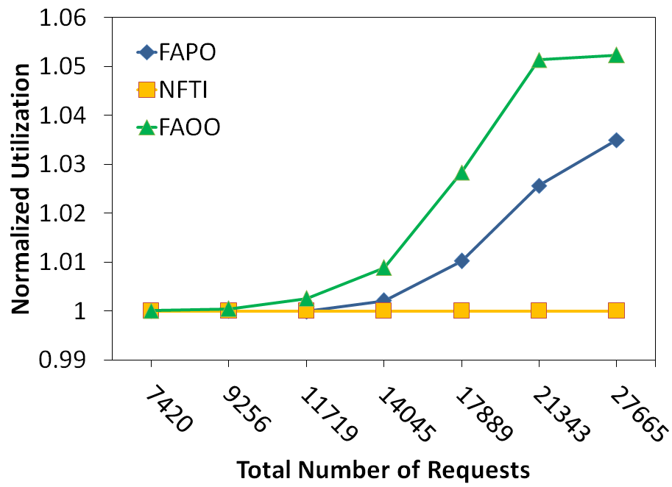
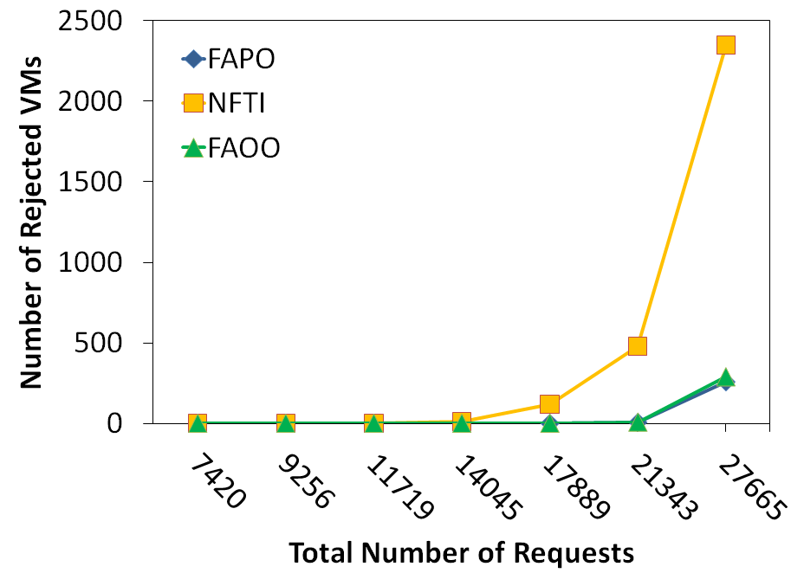
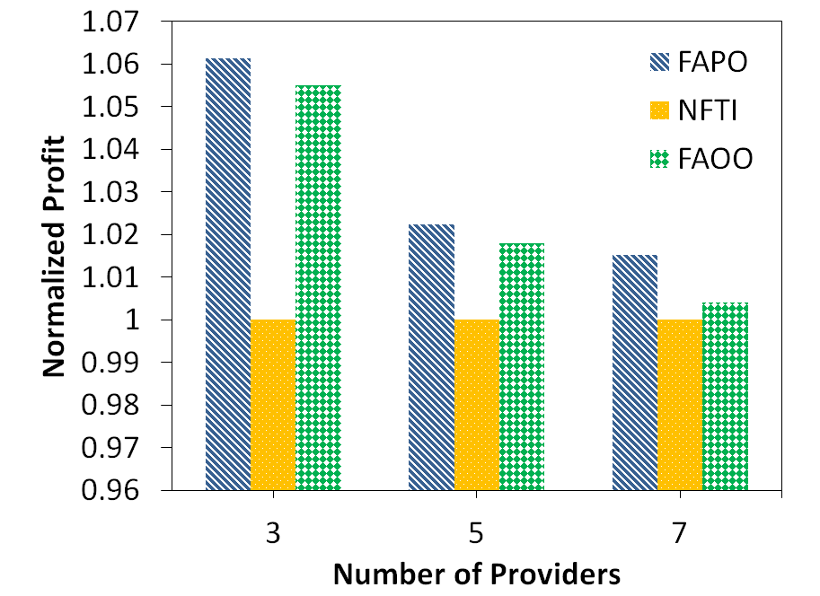
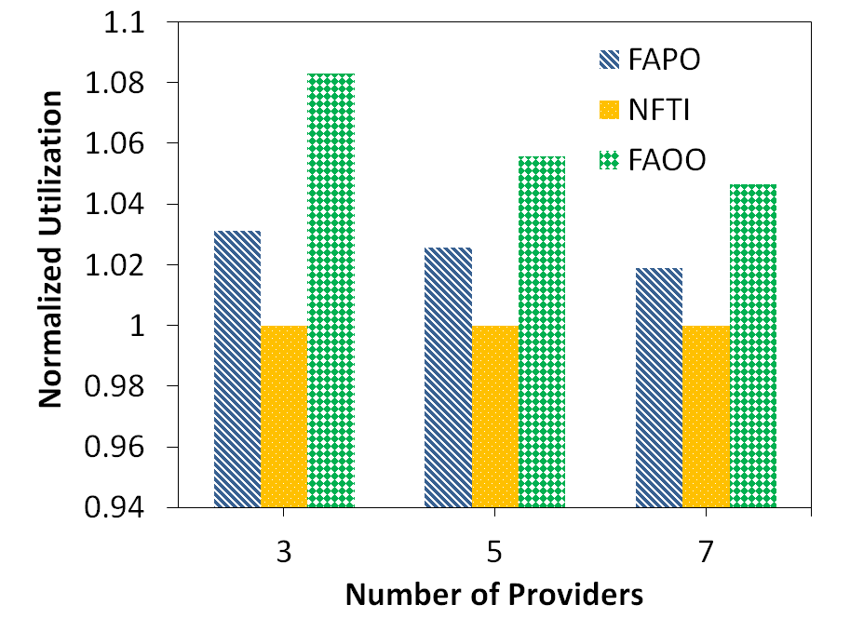
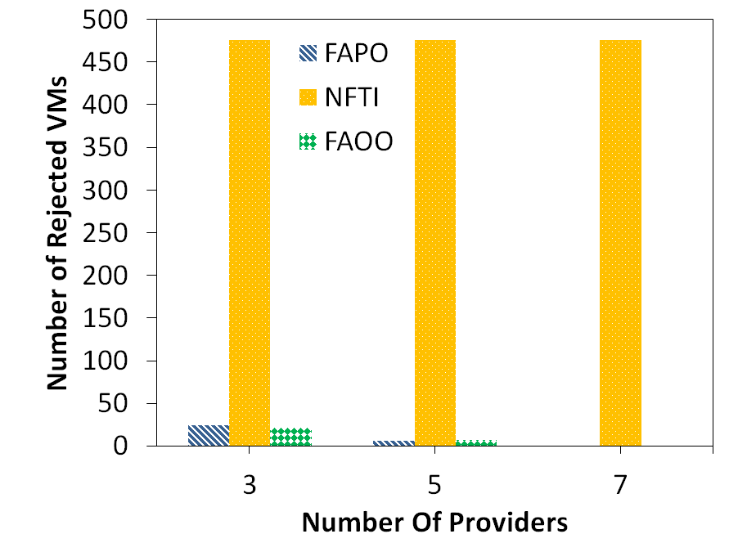
Results
Impact of load on (a) Profit (b) Utilization (c) Number of rejected on-demand VMs, for a provider with different policies.
Impact of number of providers on (a) Profit (b) Utilization (c) Number of rejected on-demand VMs for a provider with different policies.

Slide 26
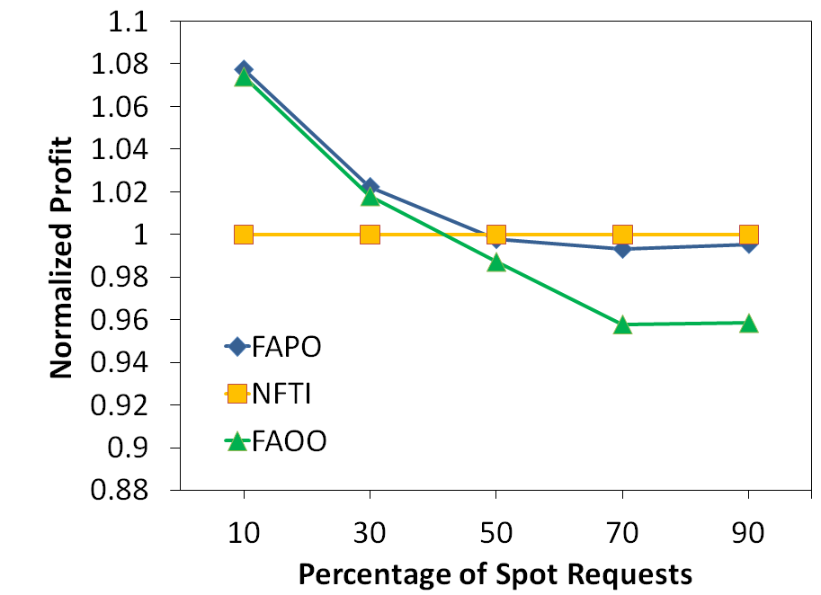
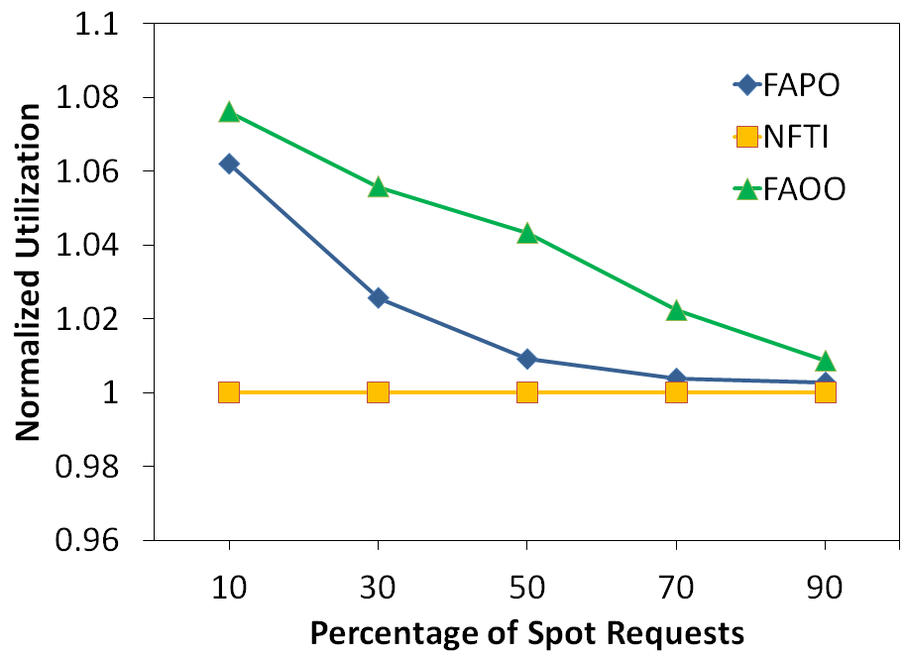
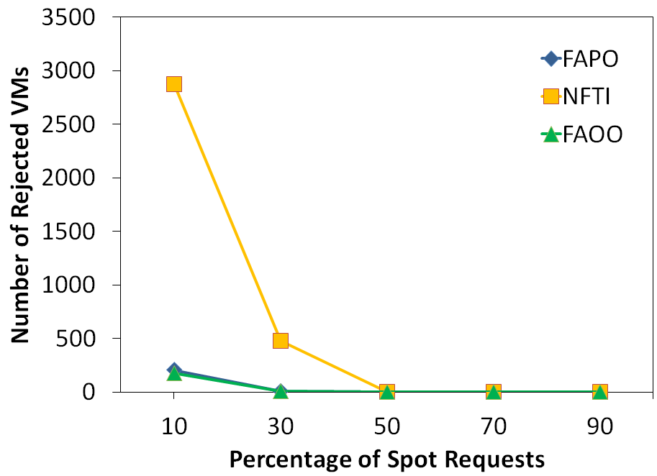
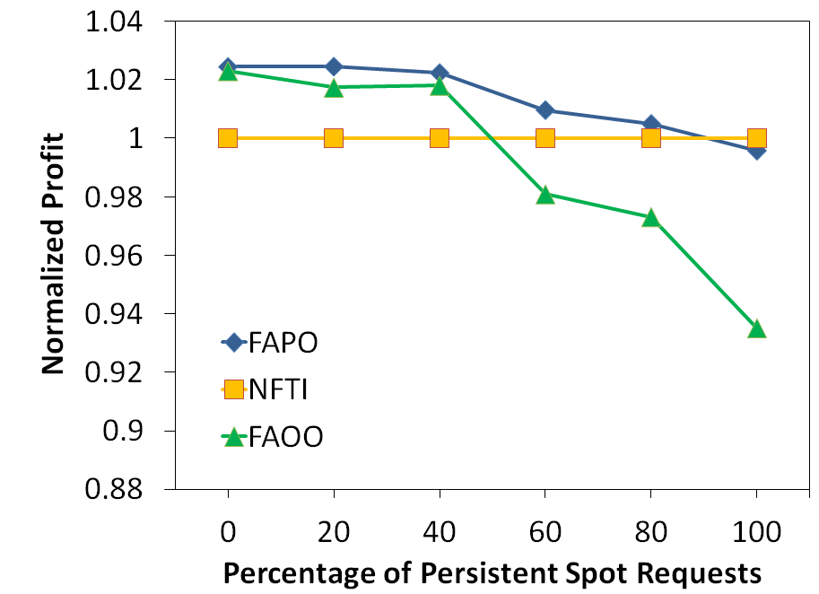
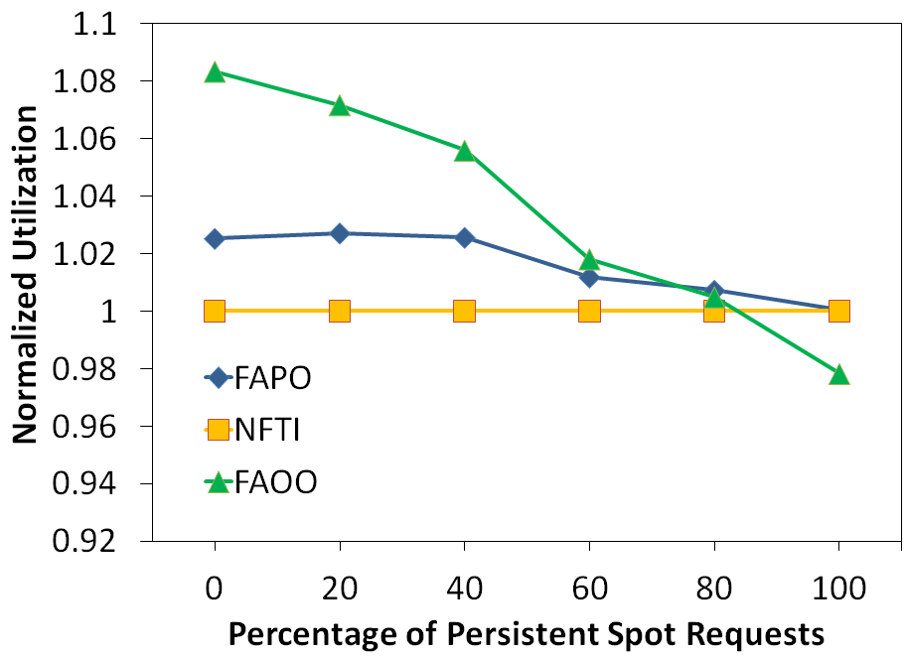
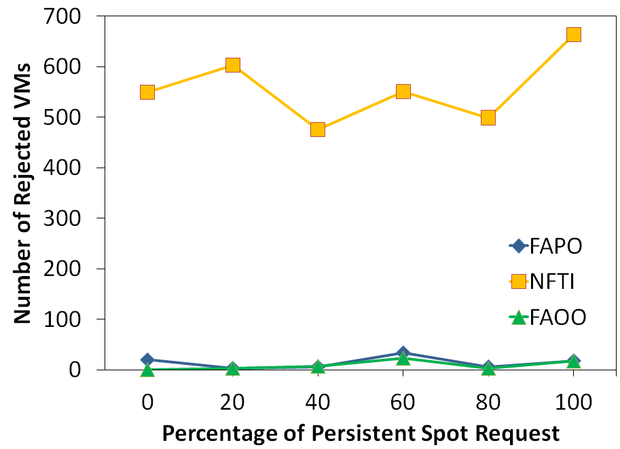
Results(cont.)
Impact of percentage of spot requests on (a) Profit (b) Utilization (c) Number of rejected on-demand VMs, for a provider with different policies.
Impact of percentage of persistent spot requests on (a) Profit (b) Utilization (c) Number of rejected on-demand VMs for a provider with different policies.

Slide 27
Solutions

Slide 28
Financial Option Market Model
Derived from publication:
Adel Nadjaran Toosi, Ruppa K. Thulasiram, and Rajkumar Buyya, “Financial option market model for federated cloud environments,” in Proceedings of the 5th IEEE/ACM International Conference on Utility and Cloud Computing (UCC’12), Chicago, Illinois, USA, Nov. 2012, pp. 3–12.

Slide 29
Reserved capacity is not fully utilized!
Huge and unpredictable variation in the load over time for Cloud applications, e.g. web applications.
Economic advantage of using Reserved Instances in comparison with On-Demand Instances, even if they are not fully utilize
  Amazon EC2: Using Heavy Utilization Reserved Instances, you can save up to 54% for a 1-year term and 71% for a 3-year term vs. running On-Demand Instances.
  Reserved Instance Marketplace
All together :
The pattern of utilization at user side causes reserved instances not to be deployed at all times

Slide 30
Using Reserved Capacity for On-demand Requests
We are interested to explore the opportunity:
  Additional cash flow by releasing underutilized capacity of the reserved instances to the on-demand requests.
  If the unreserved part of the data center experiences high utilization, providers are able to accommodate on-demand requests on the underutilized reserved capacity of the data center.
Risk of SLA violation!
Cloud cooperation is a possible solution

Slide 31
Risks in Cloud Federation Market
Two more risks:
  a risk of being unable to acquire required resources in the market.
    Short selling resources without having a good knowledge of usage loads and hence violating the QoS.
  Future price variations in the federation market using past price history
A financial option-based market model is introduced for a federation of Cloud providers
  which helps providers increase their profit and mitigate the risks (risks of violating QoS or paying extra money).

Slide 32
Financial Option Contract
A financial option is a contract for a future.
Transaction between two parties:
  Holder and seller of the contract.
A financial option gives the holder the right, but not the obligation, to buy (or to sell) an underlying asset at a certain price, called the strike price (exercise price), within a certain period of time, called maturity date (expiration date).
The seller is obligated to fulfill the transaction.
As a compensation the seller collects an upfront payment at the beginning of the contract, called premium.

Slide 33
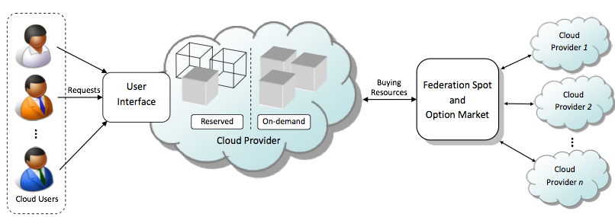
The System Model

Slide 34
When to buy option?
Cloud Exchange Service

Slide 35
Policies
Baseline In-house Isolated Pool Policy (IIP)
  Provider works independently, without participating in the federation.
  Isolated pools of physical nodes for on-demand and reserved instances .
Baseline Federated Isolated Pool Policy (FIP)
  If the provider is not able to serve on-demand requests locally it outsource them through federation spot market.
  To be always cost-effective, if the spot price in the federation market is higher than the local on-demand price then the provider rejects the on-demand request.
  The pool of physical nodes for reserved and on-demand instances are isolated to prevent rejection of reserved requests.
Federated Shared Pool Option-Enabled Policy (FSPO)
  The provider accommodates excess on-demand requests in the underutilized reserved capacity.
  The provider buys an option whenever he accommodates on-demand requests in the reserved capacity.
  If a reserved request comes in and the provider is not able to serve it locally, the option is exercised and the reserved request is outsourced at the strike price of the option.

Slide 36
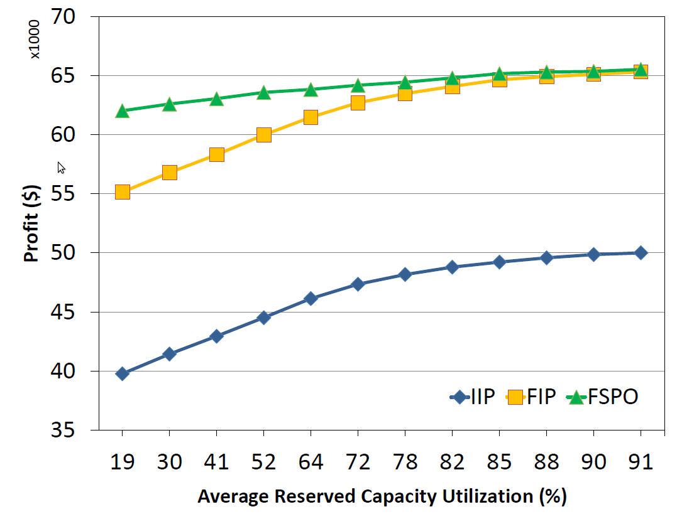
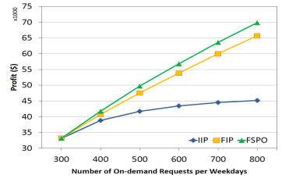
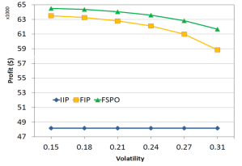
Experimental Results

Slide 37
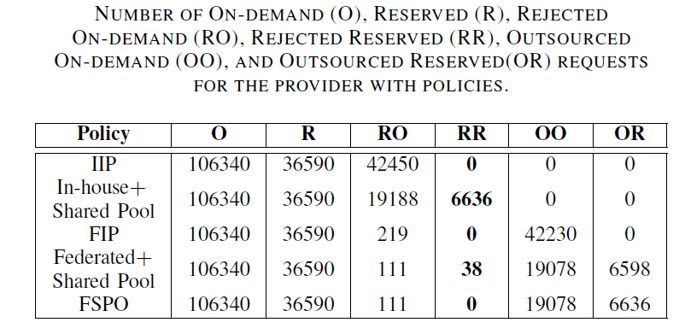
Number of Request Rejections

Slide 38
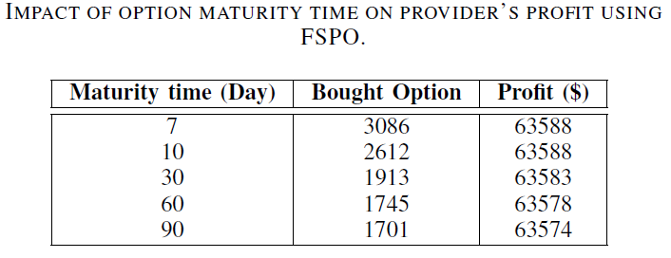
Effect of Maturity Time

Slide 39
Solutions

Slide 40
Revenue Management with Optimal Capacity Control
Derived from:
Adel Nadjaran Toosi, Kurt Vanmechelen, Ramamohanarao Kotagiri, and Rajkumar Buyya, “Revenue Maximization with Optimal Capacity Control in Infrastructure as a Service Cloud Markets,” IEEE Transactions on Cloud Computing (TCC), 2014, in review.

Slide 41


IaaS providers’ various pricing plans (or markets)
  on-demand pay-as-you-go
    Generates highest revenue per unit capacity
    Demand uncertainty
  Reservation (subscription)
    Risk-free income from reservations
    Guaranteed cash flow through long-term commitments
    Compensate for the demand uncertainty of on-demand pay-as-you-go
    Generates lower revenue per unit capacity
    The provider is liable to offer guaranteed availability to honor SLA
  Spot market
    Selling spare capacity in the data center
    Attract price-sensitive users that are capable of tolerating service interruptions
    Without being exposed to the risks resulting from overbooking capacity

Slide 42
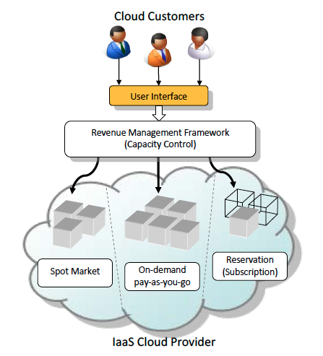
Problem definition
The use of multiple pricing plans introduces:
Non-trivial trade-offs in revenue maximization
Our main research question is the following:
“with limited resources available, and considering the dynamic and stochastic nature of customers’ demand, how can expected revenue be maximized through an optimal allocation of capacity to each pricing plan?”
Assumptions:
Customers do not fully utilize their reserved capacity in the reservation’s lifetime
We do not allow accommodating on-demand requests in underutilized reserved capacity
  Creates the risk of SLA violations.
Provider accommodates spot instances in the underutilized reserved capacity of the data center

Slide 43
Our Solution
We frame our algorithmic contributions
  Within a revenue management framework
  Supports the three presented pricing plans
  Incorporates an admission control system for requests of the reservation plan.
We formulate the optimal capacity control problem
  As a finite horizon Markov Decision Process (MDP)
  A stochastic dynamic programming technique
    To compute the maximum number of reservation contracts the provider must accept
    For a large capacity provider the stochastic dynamic programming technique is computationally prohibitive.
  We therefore present two algorithms to increase the scalability of our solution

Slide 44
Contributions
Proposed Algorithms
  Optimal Algorithm
    A stochastic dynamic programming technique
    As a finite horizon Markov Decision Process (MDP).
  Pseudo Optimal Algorithm
    Based on optimal algorithm
    Only increases the spatial and temporal granularity of the problem
    To solve it in a time suitable for practical online decision making
  Heuristic Algorithm
    Sacrifices accuracy to an acceptable extent to increase scalability
    Through a number of simplifying assumptions on
      Reserved capacity utilization and
      The lifetime of on-demand requests.

Slide 45
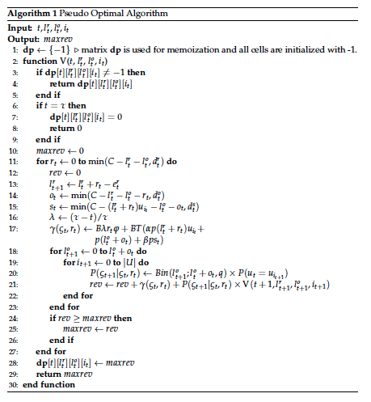

Pseudo Optimal
Details of Optimal Algorithm
  Computational Complexity
B: The number of VM instances per block of capacity
  e.g., B = 100 VMs
T: The number of billing cycles per time slot
  e.g., T = 168 hours.

Slide 46
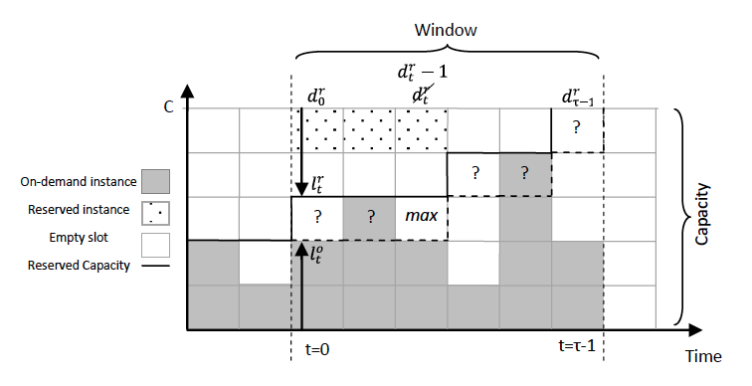

The heuristic algorithm
Computational Complexity:

Slide 47
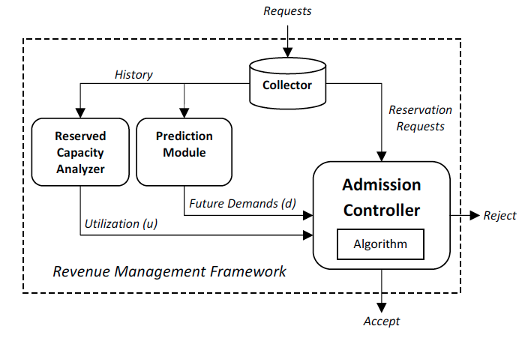
Key modules of the revenue management framework

Slide 48
Performance Evaluation
We evaluate our proposed framework through:
  Large-scale simulations (12 months)
  Driven by cluster-usage traces that are provided by Google.
No publicly available workload traces of real-world IaaS clouds:
  We propose a scheduling algorithm that generates VM requests based on the user resource usage in these traces.
Pricing conditions that are aligned with those of Amazon EC2
Benchmark Algorithm:
  no admission control referred to as no-control
Simulation Environment
  Extended CloudSim (pricing plans and the proposed revenue management framework)

Slide 49
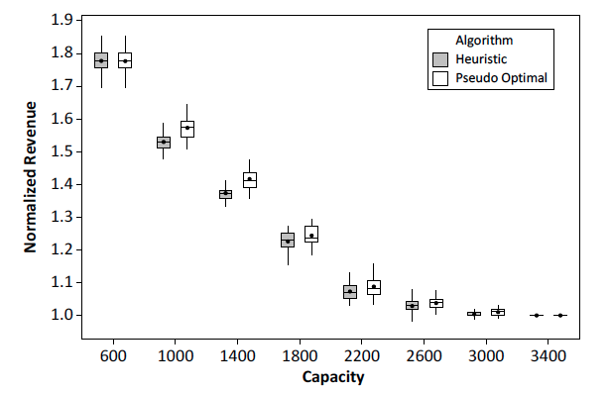
Experimental Results (1)
The revenue performance of the proposed revenue management framework under different algorithms normalized to the outcome of no-control algorithm
(B = 100 and T = 75).

Slide 50
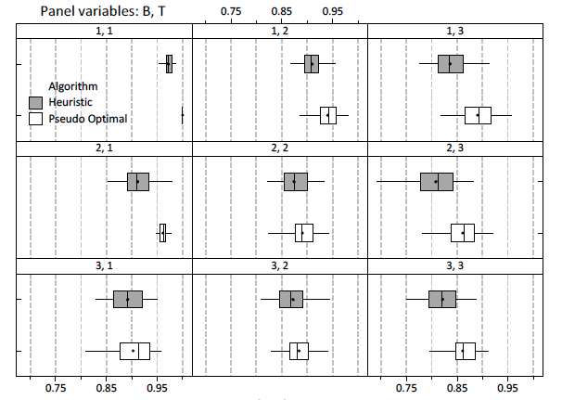
Experimental Results (2)
The revenue performance of the pseudo optimal and heuristic algorithms with different values of B and T. All values are normalized to the outcome of the optimal solution.

Slide 51
Solutions

Slide 52
An Auction Mechanism for Cloud Spot Markets
Derived from:
Adel Nadjaran Toosi, Kurt Vanmechelen, Farzad Khodadadi, and Rajkumar Buyya, “An Auction Mechanism for Cloud Spot Markets,” ACM Transactions on Autonomous and Adaptive Systems, Volume 11, Issue 1, 2016.

Slide 53
Motivation
Computational resources sold by a cloud provider can be characterized:
  As a non-storable or perishable commodity
Demand for computational resources is:
  non-uniform over time
These motivates the use of dynamic forms of pricing in order to optimize revenue
Well-designed auction mechanisms are particularly effective

Slide 54
Why Auctions?
Incentivize users to reveal their true valuation of the service (i.e., report the price they are willing to pay for resources)
Ensure resources are allocated to those who value them the most
Correctly price resources in line with supply and demand conditions by creating competition among buyers.

Slide 55
Background
Auction:
  A common market mechanism with a set of rules determining prices and resource allocations on basis of bids submitted from the market participants.
Auctions can be in assorted shapes and have different characteristics:
  Single dimensional (e.g., only bid price) or multi-dimensional (e.g., bid price plus quantity),
  Single-sided (e.g., only customers submit bids) or double-sided (e.g., double auction),
  Open-cry or sealed-bid,
  Single-unit (e.g., a single good or service) or multi-unit (e.g., multiple units of the good),
  Single item (e.g., one type of service) or multi-item (e.g., combinatorial auction).
Goals in designing auction:
  Truthfulness, Revenue maximization, Allocative efficiency, Fairness

Slide 56
Background
Optimal mechanism design
  When goal of mechanism is to maximize the profit or revenue for the seller (provider)
Optimal mechanism design can be categorized in
  Bayesian optimal mechanism design
    the valuations of the participants in the auction are drawn from a known prior distribution
    based on the seminal work by Myerson
  Prior free optimal mechanism
    Determining the prior distribution is not practical, convenient or even possible in advance
    Digital Goods: Competitive Framework by Goldberg and Hartline

Slide 57
Problem Definition and Goals
Amazon Web Services (AWS)
  Spot Instances (Auction-like mechanism)
    Customers communicate their bids a VM instance hour to AWS.
    AWS reports a market-wide spot price at which VM instance use is charged,
    while terminating any instances that are executing under a bid price that is lower than the market price.
AWS has revealed no detailed information regarding
  Their auction mechanism and
  The calculation of the spot price.
The design of an auction mechanism
  Efficient, fair, and profit-maximizing
  Open research challenge,
  Of great interest to cloud providers.

Slide 58
Contributions
We design an auction mechanism
  aimed at maximizing profit from selling the spare capacity of non-storable resources available in cloud data centers
A multi-unit, online recurrent auction, two-dimensional bid domain
Extension of Consensus Revenue Estimate (CORE) mechanism
  Work by Goldberg and Hartline
Envy-free, truthful with high probability and generates near optimal profit for the provider.

Slide 59
Contributions (cont.)
Benchmark Algorithm: An optimal auction mechanism (HTAOPT)
  Dynamic programming
  To quantify the efficiency loss caused by the lack of information on the amount of time a bidder wants to run a VM.
A method for dynamically computing
  A reserve price
    The lowest possible price that the provider accepts.
  Based on a coarse grained data center power usage model

Slide 60

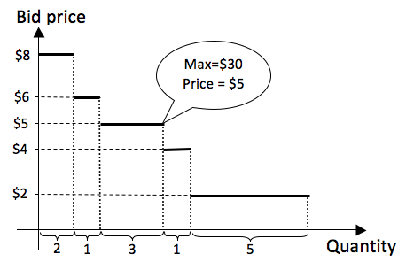

Research Problem
Optimal Single Price Auction:
The order-independent auction is truthful.
Optimal order-independent:
  Not single price (i.e., not envy-free)
  It is not fair
How to compute a single price for an order-independent auction while attaining the revenue of the optimal auction?

Slide 61
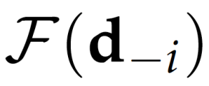
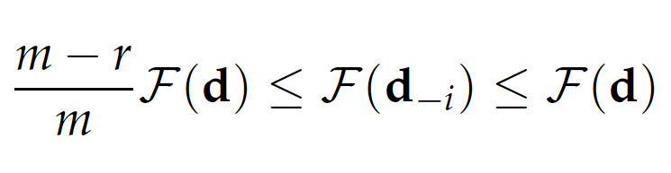
Consensus Revenue Estimate
We are interested in a mechanism that provides us with a sufficiently accurate estimate of
While the estimate is constant on d_{-i} for all i (i.e., it achieves consensus).
is limited by a constant fraction of
  it is possible to pick a good estimate
  We consider a limit on maximum quantity (r)
  Let r denote the supremum of the number of requested units in d
  Let m be the number of sold units in F
  We use Consensus Revenue Estimate

Slide 62
Revenue Extraction Mechanism
Cost sharing mechanism proposed by Moulin and Shenkar
Extracts a target revenue from the set of bidders if this is possible
It finds the k bidders with the highest bid values that allow for the extraction of R (target revenue)
Given a target revenue R, the revenue extraction mechanism is truthful for the price dimension but not for the quantity dimension.

Slide 63
Reserve Price
The reserve price for most perishable goods and services is considerably low at their expiration time
  The reserve price for flight seats is theoretically negligible.
A significant part of the service cost in cloud data centers is related to power consumption of physical servers.
We propose a method for calculating dynamic reserve prices based on a cost model that incorporates data center PUE (load, outside temperature), and electricity cost.

Slide 64
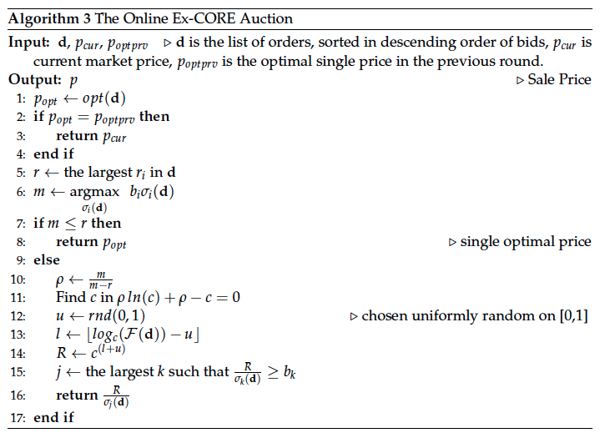
The Online Ex-CORE Auction

Slide 65
Benchmark Algorithms
Optimal Single Price Auction (OPT)
Holding Time Aware Optimal Auction (HTA-OPT)
Uniform Price Auction

Slide 66
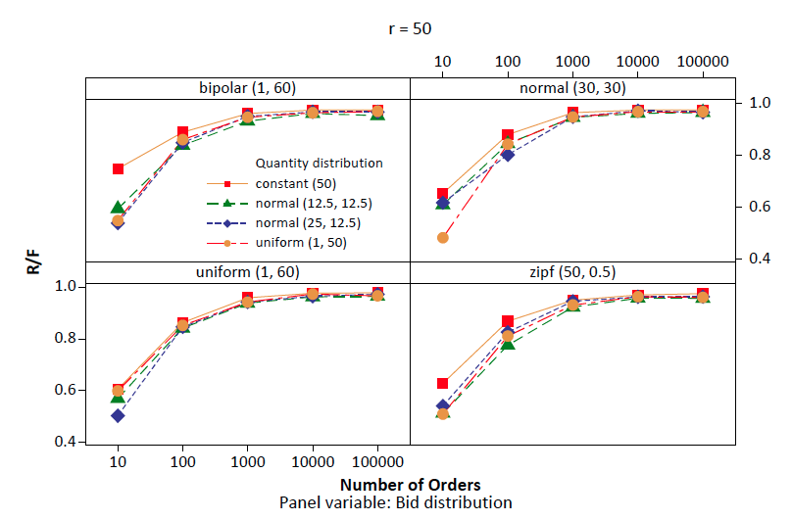
Performance Evaluation (Single Round)
Ratio of gained revenue by the Ex-CORE auction to optimal auction under different distribution of orders

Slide 67
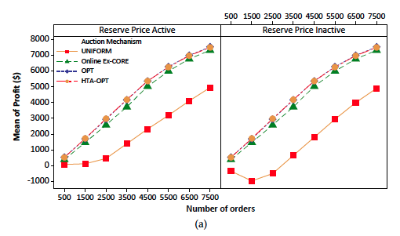
Performance Evaluation (Online)
Average profit gained and with different auction mechanisms.

Slide 68
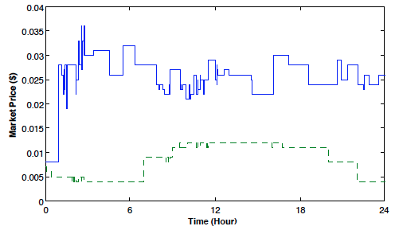
Results
Reserve price (green dashed line) and spot market price generated by online Ex-CORE (blue solid line) in a sample simulation run when the number of orders is 1500.

Slide 69
SipaaS: Spot instance pricing as a Service
Derived from:
Adel Nadjaran Toosi, Farzad Khodadadi, and Rajkumar Buyya, “SipaaS: Spot instance pricing as a Service and its Implementation in OpenStack,” Software Software: Practice and Experience, Wiley Press, 2014 (in preparation).

Slide 70
Spot instance pricing as a Service
The implementation of the proposed auction mechanism
  by identifying a framework called Spot instance pricing as a Service (SipaaS).
SipaaS:
  is an open source project offering a set of web services to price and sell VM instances in a spot market.
Utilizing SipaaS
  Cloud providers require installation of add-ons in their existing platform to make use of the framework.
  An extension to the Horizon –the OpenStack dashboard project
    To employ SipaaS web services and to add a spot market environment to OpenStack.

Slide 71
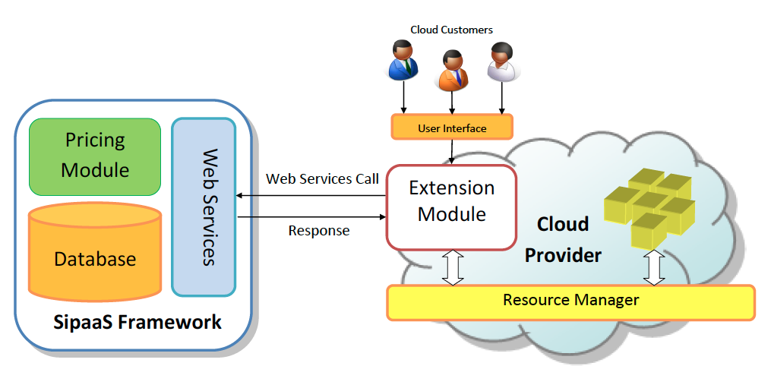
System Model

Slide 72
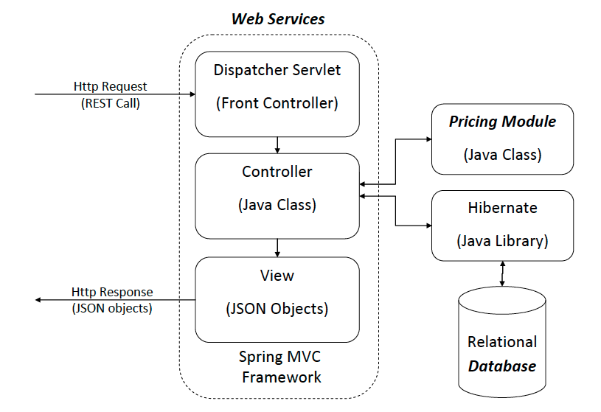
SipaaS Architecture

Slide 73
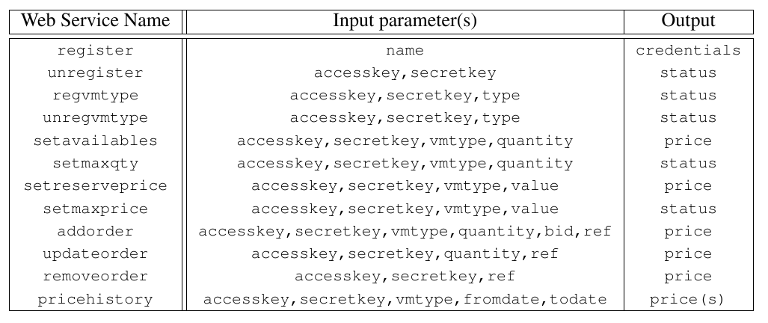
List web services

Slide 74
OpenStack and Horizon
OpenStack
  An open-source cloud management platform
  Developed to control large pools of compute, storage, and networking resources in a data center.
Horizon
  The OpenStack dashboard project
  A web based user interface to OpenStack services
  Provides administrators with management capabilities

Slide 75
Extensions for Horizon
To add spot market facilities to OpenStack,
  we extended Horizon to be capable of using the services provided by SipaaS.
We added a new panel through which system administrators are capable of enabling spot market support
  Maximum and minimum amount of bid price for users,
  Number of available VMs for allocation,
  Maximum number of VMs a user can request.
We added panels for requesting spot instances and viewing spot market price history

Slide 76
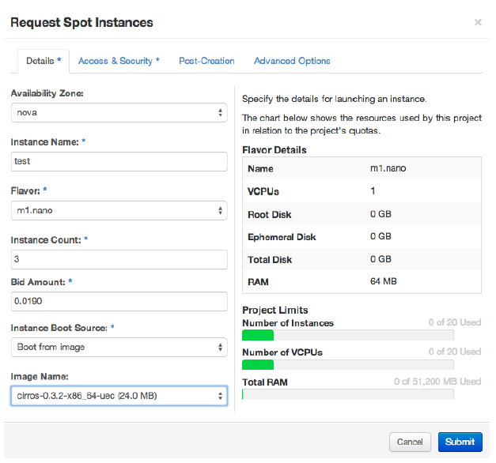
Requesting spot instances web page

Slide 77
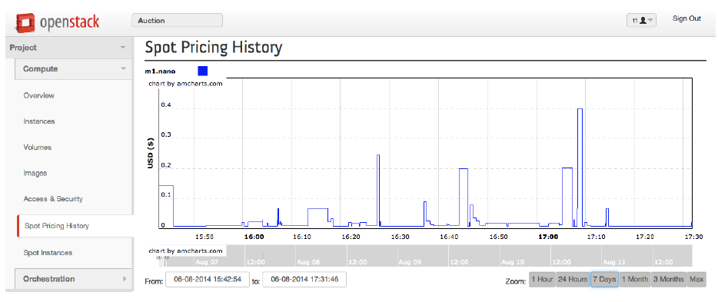
Spot Pricing History Webpage

Slide 78
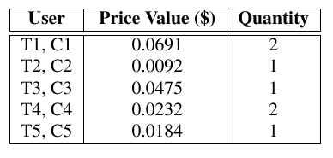
Evaluation and Validation
We conducted 20-minute experiment with 10 participants (i.e., spot market users).
  Participants are selected from a group of professional cloud users who have satisfactory level of knowledge about the spot market.
Participants are divided into two groups of five:
  (i) Group T or truthful bidders and
  (ii) Group C or counterpart bidders who have the freedom to misreport their true private values to maximize their utility

Slide 79
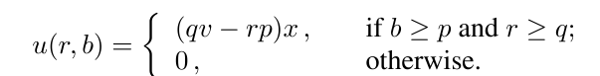
Utility Function
Utility function for one time slot instance usage, formulated as below:
r: requested number of instances
b: bid price value
q: true private quantity
v: true private price value
p: spot market price at the time of order submission
x: A Boolean value describing whether the order is accepted or not, respectively.

Slide 80
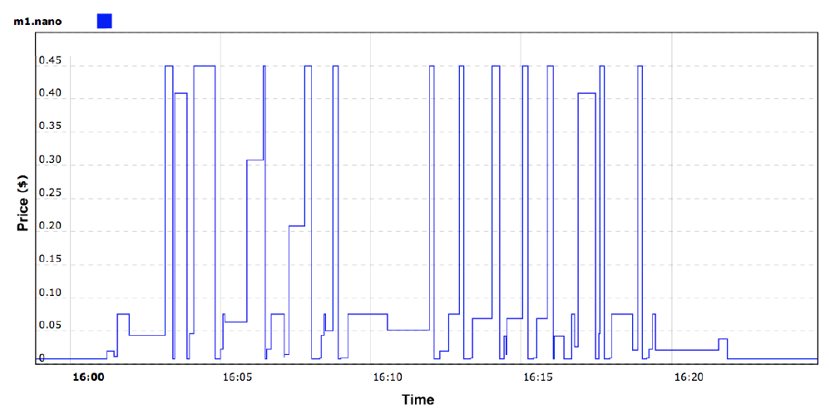
Results
Spot market price fluctuation during the experiment.

Slide 81
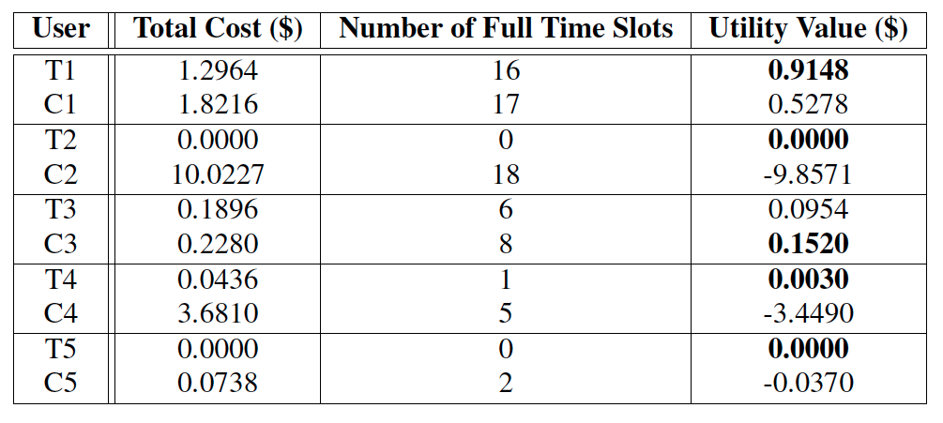
Results (Cont.)
Total cost, the number of full time slots usage, and utility value of experiment participants.

Slide 82
Outline
Background
Motivations, Research Problem and Thesis Focus
Solutions
  Federation of Clouds
    Resource Provisioning Policies to Increase Profit
    Financial Option Market Model
  Single Cloud Provider
    Revenue Management with Optimal Capacity Control
    An Auction Mechanism for a Cloud Spot Market
    Spot instance pricing as a Service
Conclusions and Future Directions

Slide 83
Conclusions
Using our resource provisioning policies federated cloud providers are able to increase their profit, utilization, and QoS.
It is important to utilize the underutilized reserved capacity of the datacenter and financial option contracts can be used in this regards.
The proposed revenue management can efficiently allocate capacity to different markets, i.e., reservation, on-demand pay-as-you and spot markets.

Slide 84
Conclusions (Cont.)
In a cloud spot market, it is important to maximize revenue when there is no prior knowledge on the bid distributions and lifetime of VM requests.
Our proposed envy-free auction that is truthful with high probability generates a near optimal profit for the cloud provider.
Spot instance pricing as a service (SipaaS) framework using the proposed auction algorithm can be used to run a spot market resembling the Amazon EC2 spot instances. The similar market reaction and similar market pricing behavior are expected.

Slide 85
Future directions
Advanced Resource Provisioning Policies
  Power Saving, Future load prediction
Option Trading Strategies
  Portfolio, Bulk trading, Selling options
Game Theoretical Analysis of Cloud Federation
  Selfish provider and its own profit, Social welfare
Customer Diversion in Revenue Management Framework
  Bumped by the admission control mechanism
Revenue Management with Overbooking
  Underutilized reserved capacity
Multi-dimensional Truthful Mechanism Design
  Two-dimensionally truthful (bid price and quantity)

Slide 86
Acknowledgments
Supervisor
  Prof. Rajkumar Buyya
Commitee Members
  Prof. Christopher Andrew Leckie
  Dr. Rodrigo N. Calheiros
Past and current members of the CLOUDS Lab.
Friends and colleagues from the CIS department
Collaborators
  Prof. Ruppa K. Thulasiram
  Prof. Kotagiri Ramamohanarao
  Dr. Kurt Vanmechelen

Slide 87
Complete List of Publications
Adel Nadjaran Toosi, Farzad Khodadadi, Rajkumar Buyya, “SipaaS: Spot instance as a pricing Service Freamework and its implementation in OpenStack”, Software: Practice and Experience (SPE), 2013 (in preparation)
Adel Nadjaran Toosi, Kurt Vanmechelen, Kotagiri Ramamohanarao Rajkumar Buyya, “Revenue Maximization with Optimal Capacity Control in Infrastructure as a Service Cloud Markets,” IEEE Transaction on Cloud computing (TCC), Feb. 2014. (in review)
Adel Nadjaran Toosi, Kurt Vanmechelen, Rajkumar Buyya, “An Auction Mechanism for a Cloud Spot Market,” IEEE Transaction on Computers (TC), May 2014. (in review)
Saurabh Kumar Garg, Adel Nadjaran Toosi, Srinivasa K. Gopalaiyengar, Rajkumar Buyyaa, “SLA-based Virtual Machine Management for Heterogeneous Workloads in a Cloud Datacenter,” 2014, Journal of Network and Computer Applications (JNCA), vol. 45, no. 10, pp. 108–120, ISSN: 1084-8045, Oct. 2014.
Adel Nadjaran Toosi, Rodrigo N. Calheiros, Rajkumar Buyya, “Interconnected cloud computing environments: Challenges, taxonomy, and survey,” ACM Computing Survey (ACM CSUR), vol. 47, no. 1, pp. 7:1–7:47, May 2014.
Mohsen Amini Salehi, Adel Nadjaran Toosi, Rajkumar Buyya, “Contention Management in Federated Virtualized Distributed Systems: Implementation and Evaluation,” Software: Practice and Experience (SPE) , vol. 44, no. 3, pp. 353-368, 2014.
Rodrigo N. Calheiros, Adel Nadjaran Toosi, Christian Vecchiola, Rajkumar Buyya “A Coordinator for Scaling Elastic Applications Across Multiple Clouds,” Journal of Future Generation Computer Systems (FGCS), vol. 28, no. 8, pp. 1350–1362, Mar. 2012.

Slide 88
Complete List of Publications (Cont.)
Yaser Mansouri, Adel Nadjaran Toosi, Rajkumar Buyya, “Brokering Algorithms for Optimizing the Availability and Cost of Cloud Storage Services,” Proceedings of IEEE International Conference on Cloud Computing Technology and Science (CLOUDCOM '13), Dec. 2013, Bristol, UK, pp. 581-589.
Adel Nadjaran Toosi, Ruppa K. Thulasiram and Rajkumar Buyya, “Financial Option Market Model for Federated Cloud Environments”, Proceedings of the Fifth IEEE International Conference on Utility and Cloud Computing (UCC'12), Nov. 2012, Chicago, USA, pp. 3-12.
Adel Nadjaran Toosi, Rodrigo N. Calheiros, Ruppa K. Thulasiram, Rajkumar Buyya, “Resource Provisioning Policies to Increase IaaS Provider's Profit in a Federated Cloud Environment”, Proceeding of 13th IEEE International Conference on High Performance Computing and Communications (HPCC’11), Sept. 2011, Banff, Canada, pp. 279 -287.

Slide 89
Thank you!
Questions?

