Slide 1


Geographical Load Balancing for
Sustainable Cloud Data Centres
Adel Nadjaran Toosi
Cloud Computing and Distributed Systems (CLOUDS) Laboratory,
School of Computing and Information Systems
The University of Melbourne, Australia
Email: anadjaran@unimelb.edu.au
Homepage: http://www.cloudbus.org/~adel/

Slide 2
Outline
Brief Biography
Backgrounds
Geographical Load Balancing (GLB)
Optimal offline algorithm and its intractability
A GLB framework for web applications
Results and Performance Evaluation
Summary and future directions
Notes:
Intro
High energy consumption in data centers
Renewable energy sources
Challenges of using renewable energy

Slide 3
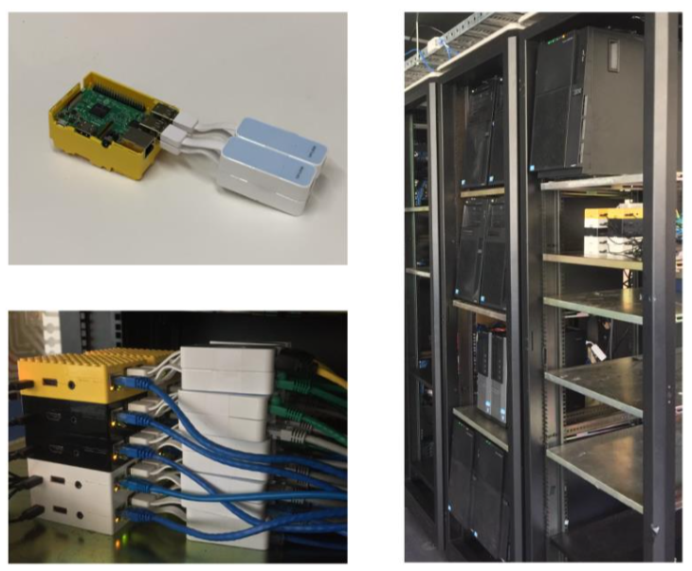
Biography and Research Overview
PhD, University of Melbourne, 2010-2014
  Thesis: “On the Economics of Infrastructure as a Service Cloud Providers: Pricing, Markets, and Profit Maximisation”
Postdoctoral Research Fellow, University of Melbourne, 2015-Present
  Algorithms and Software Systems for:
  Resource Provisioning of Data-intensive Applications in Hybrid Clouds [Completed]
  Renewable-aware and Green Clouds [Completed]
  Software-Defined Clouds [On-going]
Research Interests
  Distributed Systems, Cloud Computing, Software-Defined Networking (SDN) and Network Function Virtualization (NFV), Energy Efficiency and Green Computing, Soft Computing
  Software Systems and Algorithms for Resource Management in Cloud Computing and Distributed Systems
Publications
  27 publications, 15 Journal Articles (11 A/A* ERA Ranking, ACM CSUR,TCC, JCNA, FGCS, TAAS), 11 Conference papers (CloudCom, UCC, HPCC), 1 Book Chapter,
  h-index: 15 and 1200+ citations (SRC: Google Scholar)

Slide 4
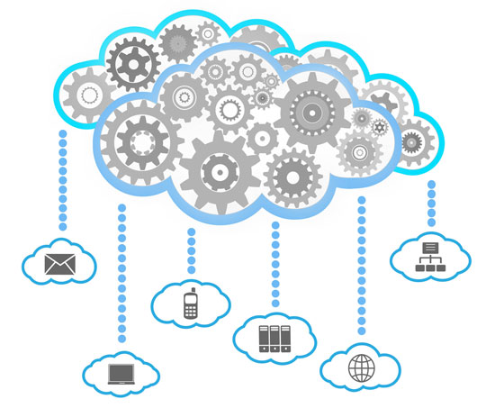









Cloud Computing
3.4 MILLION EMAILS
ARE EXCHANGEDª
6,000 TWEETS
ARE SENT ON TWITTER^{b}
250 SONGS
ARE DOWNLOADED VIA ITUNES^{f}
`
100,000 SEARCHES
ARE MADE ON GOOGLE^{c}
70,000 LIKES
ARE GENERATED ON FACEBOOK^{e}
600 ITEMS
ARE SOLD ON AMAZON^{d}
a https://www.lifewire.com/how-many-emails-are-sent-every-day-1171210
b http://www.internetlivestats.com/twitter-statistics/
c http://www.statisticbrain.com/google-searches/
d https://www.inc.com/tom-popomaronis/amazon-just-eclipsed-records-selling-over-600-items-per-second.html
e https://www.brandwatch.com/blog/47-facebook-statistics-2016/
f http://www.billboard.com/biz/articles/news/1538108/itunes-crosses-25-billion-songs-sold-now-sells-21-million-songs-a-day
Notes:
A city of one million will generate more than 200 Million Gigabytes of Data per day.
5G and Smart Phones 6B in 2020 (Ericsson)
Internet-of-Things (IoT) Devices 25B in 2020 (Gartner)

Slide 5

Power Hungry Clouds
Cloud data centres consume large amounts of electricity
  High operational cost for the cloud providers
  High carbon footprint on the environment
US Data Centres
  70 billion kilowatt-hours of electricity In 2014
  = Two-year power consumption of all households in New York
  = The amount consumed by about 6.4 million average American homes that year
  Projected nearly 50 million tons of carbon pollution per annum in 2020.
          Source: US Natural Resources Defense Council (NRDC)
Photo Source: http://nycyoungmen.tumblr.com/

Slide 6
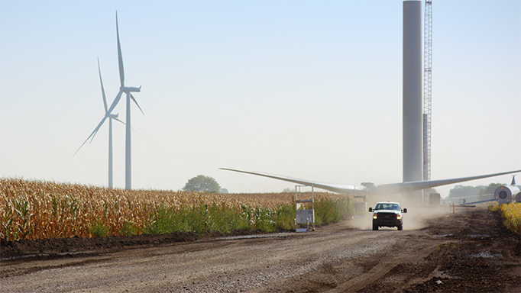
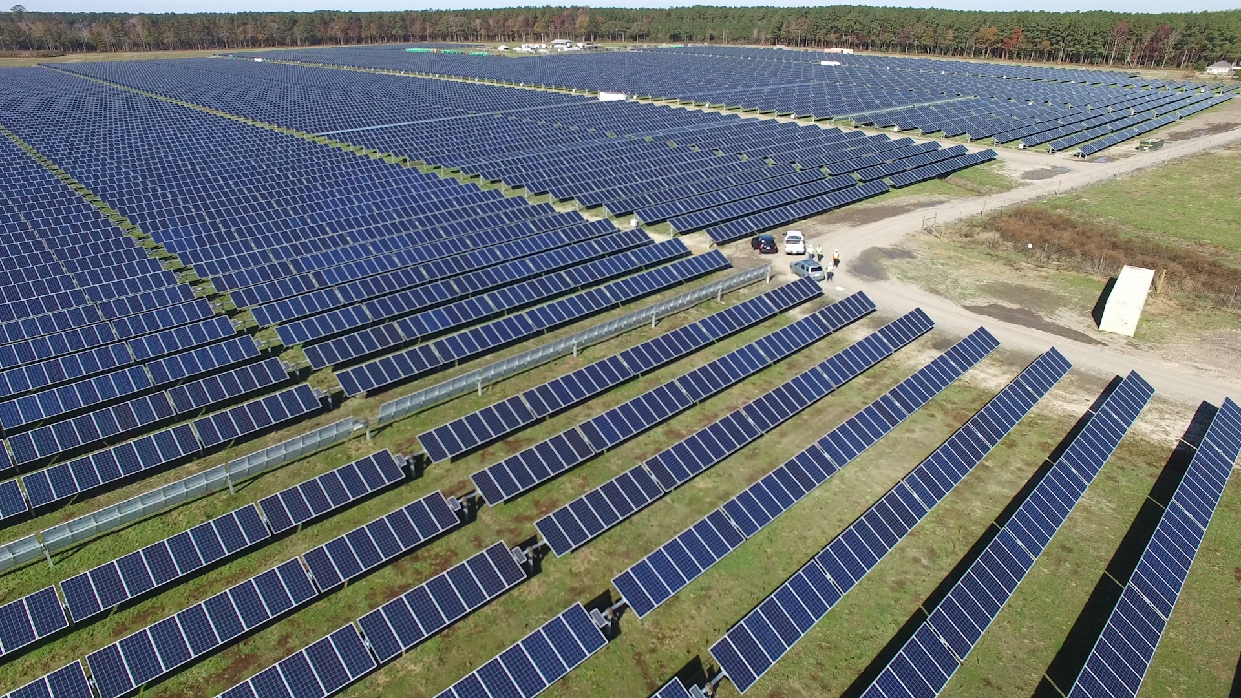
Renewable Energy
Cloud providers aims
  Reducing energy consumption
  Dependence on brown energy
Renewable energy
  On-site green power generation
  Google, Microsoft and Amazon
“Amazon Web Services (AWS) has built a wind farm in 2017 and exceeded the goal of 50% electrical usage from renewable energy sources”
Not only Data Centres
  Monash Net Zero Project, The University of Melbourne's Sustainability Plan
  Bitcoin Mining
Source: https://aws.amazon.com/about-aws/sustainability/

Slide 7
Challenges
Non-dispatchable, Intermittent and Unpredictable
  Renewable energy sources (Wind and Solar)
  Powering data centres entirely with renewable energy sources is difficult
Mixed sources of energy for data centres:
  Grid power or brown energy
  Renewable energy sources or green energy
Challenges:
  Minimising brown energy usage
  Maximising renewable energy utilisation

Slide 8
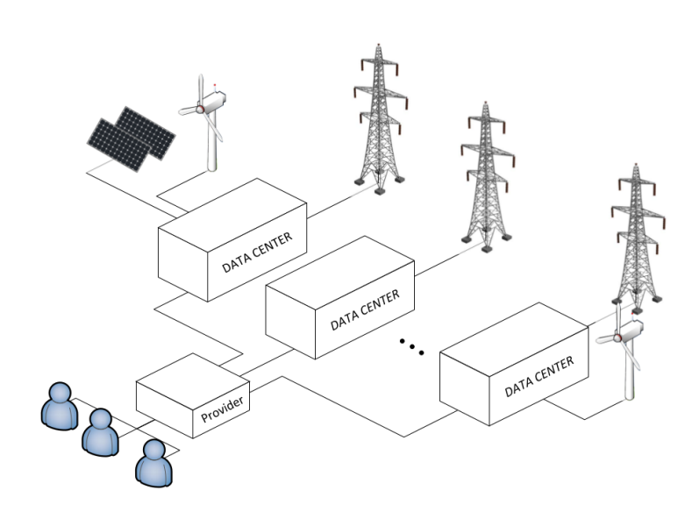
Geographical Load Balancing (GLB)
Geographical load balancing (GLB) potentials:
  Follow-the-renewables
GLB approach benefits cloud providers but it raises an interesting, and challenging question:
“With limited or even no a priori knowledge of the future workload and Dynamic and unpredictable nature of renewable energy sources, how to optimise the overall renewable energy use and cost?”

Slide 9
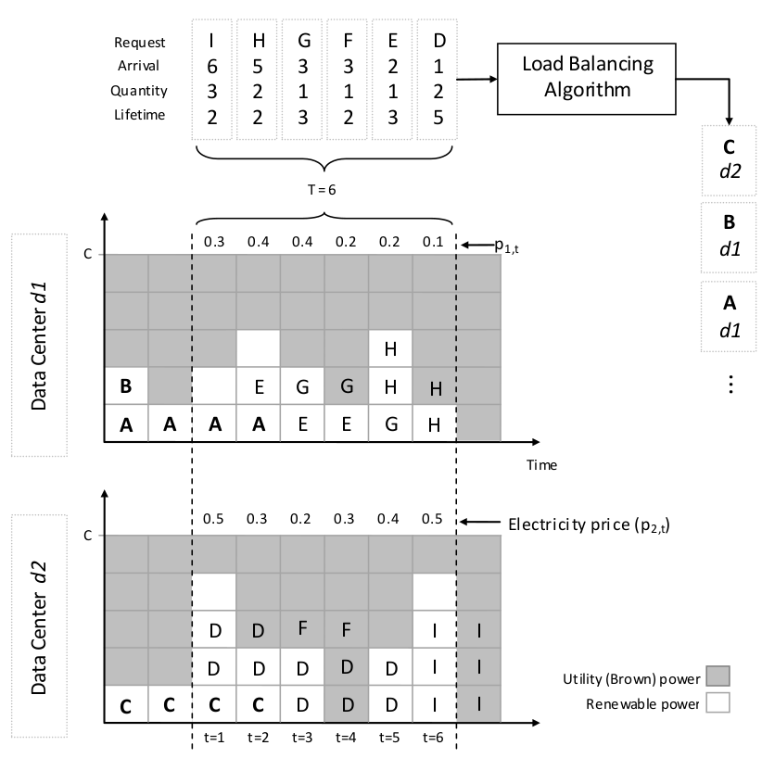
Example: Offline GLB Problem

Slide 10
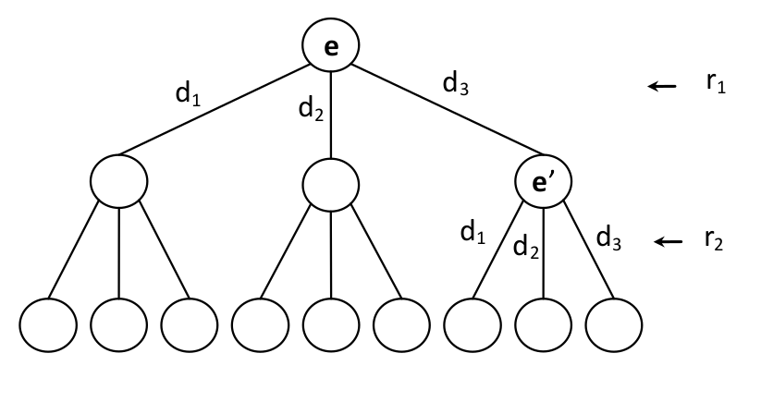
Optimal Offline Algorithm
Assuming the following information is known for a time window:
  Future knowledge of renewable energy availability
  Workload (i.e., number of requests, arrival time, and duration of requests)
We showed that the optimal strategy is computationally intractable
  Exponential time complexity
  Formal proof

Slide 11
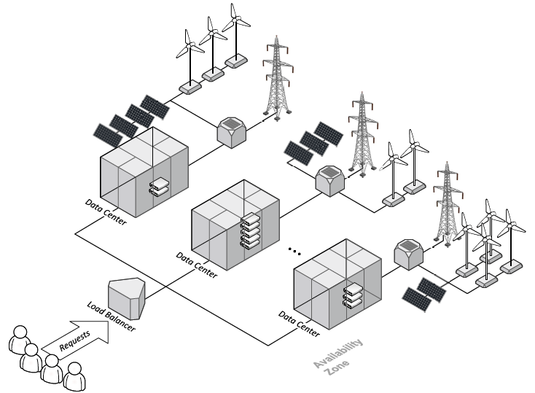
GLB for Web Applications

Slide 12
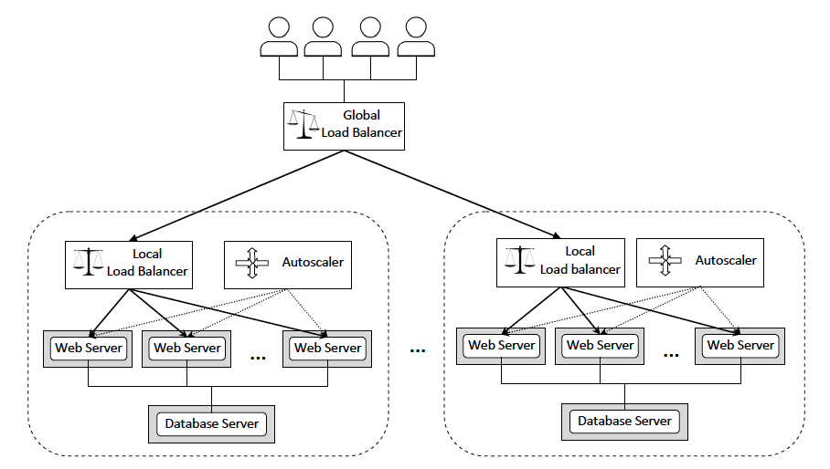
Overall System Architecture

Slide 13
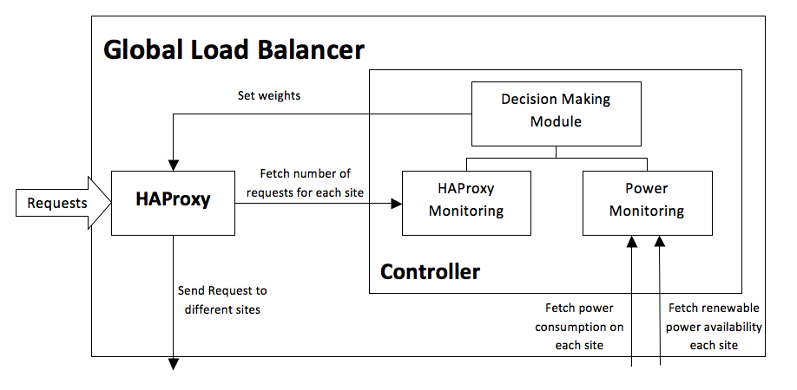
Global Load Balancer (GreenLB)

Slide 14
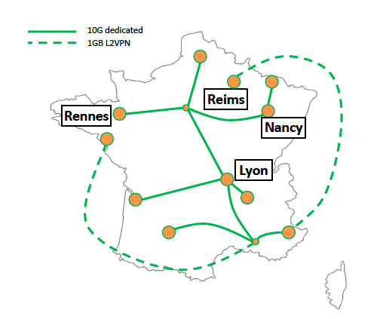
Grid’5000 Testbed

Slide 15
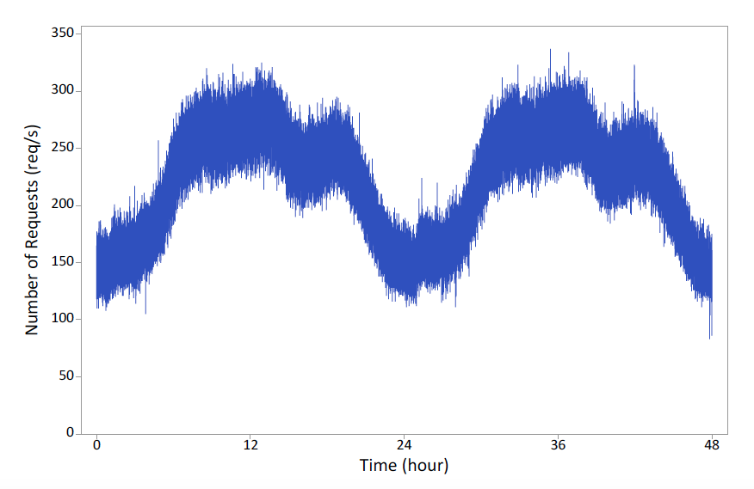
Workload Traces
Wikipedia
Notes:
The 5% of English Wikipedia Requests for 19th and 20th of September 2007

Slide 16
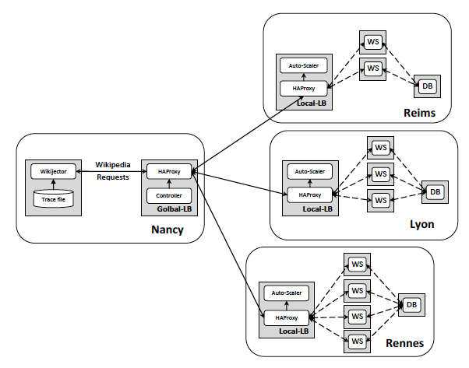
A Prototype System

Slide 17
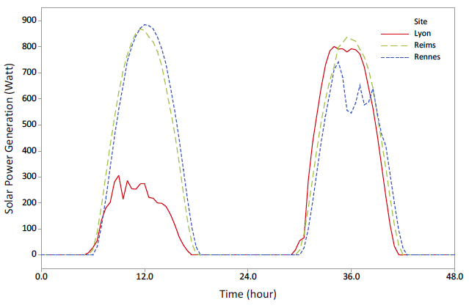
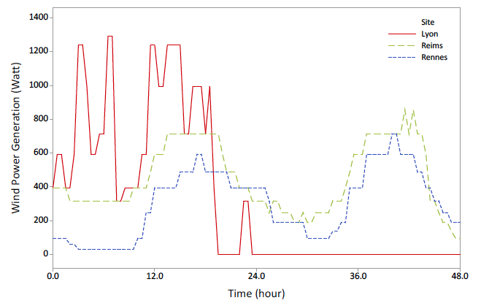
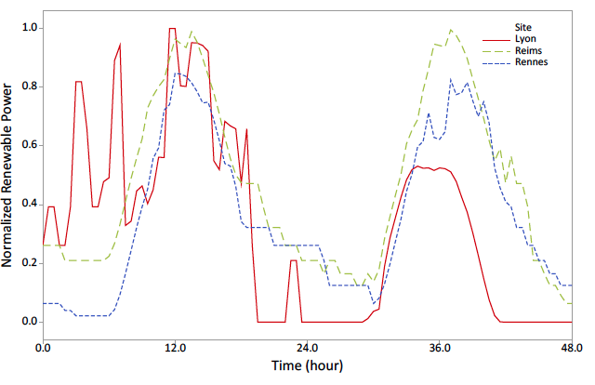
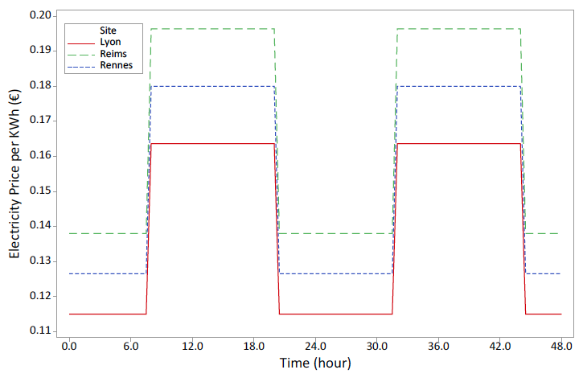
Renewable Power and Electricity Prices
Solar
Wind
Combined
Notes:
Meteorological data on the location of each site.
Wind speed and Global Horizontal Irradiation (sunlight)

Slide 18
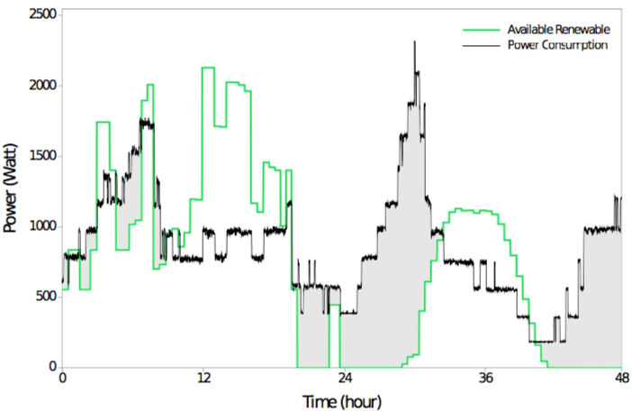
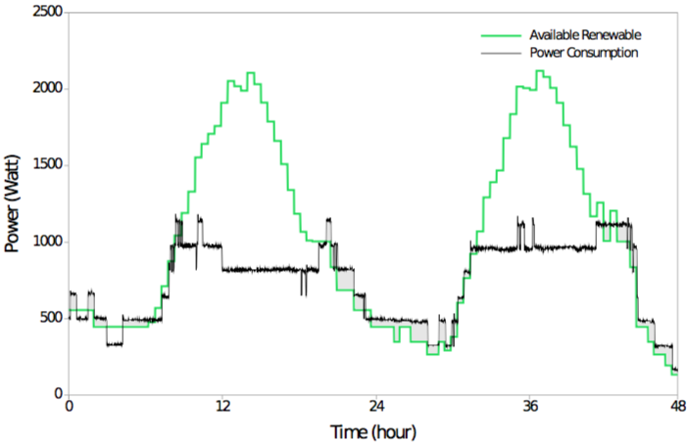
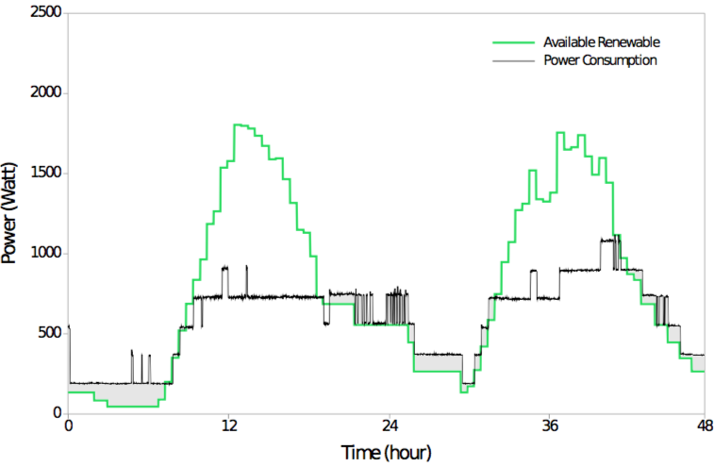
Results
Lyon
Reims
Rennes

Slide 19
Results
Site | Metric | RR | Capping | GreenLB
Lyon | Power Consumption (kWh) Brown Consumption (kWh) Cost (€) | 36.3 13.3 1.71 | 42.9 19.0 2.31 | 41.2 16.9 2.01
Reims | Power Consumption (kWh) Brown Consumption (kWh) Cost (€) | 32.5 2.1 0.42 | 32.5 1.1 0.15 | 35.4 1.9 0.27
Rennes | Power Consumption (kWh) Brown Consumption (kWh) Cost (€) | 36.4 9.3 1.23 | 29.7 2.9 0.39 | 28.3 2.6 0.35
Total | Power Consumption (kWh) Brown Consumption (kWh) Cost (€) | 105 25.7 3.36 | 105 23.0 2.85 | 105 21.4 2.63
Brown Energy:
17% and 7%
Cost Saving:
22% and 8%

Slide 20
Summary and Conclusion
A framework for cost and energy efficient load balancing
  Distributes web application requests among multiple cloud data centres
A prototype and experimental studies in a real testbed
  Real traces of web requests for English Wikipedia
  Meteorological data in the location of each data centre to model solar and wind power generation
Uses 17% less brown energy and saves cost by almost 22% in comparison to round robin policy.
Reduces cost by 8%, Brown energy by 7% in comparison a method by a group of researchers from Rutgers and Princeton universities.
  Linear Optimisation
  Workload and Renewable Energy Prediction

Slide 21
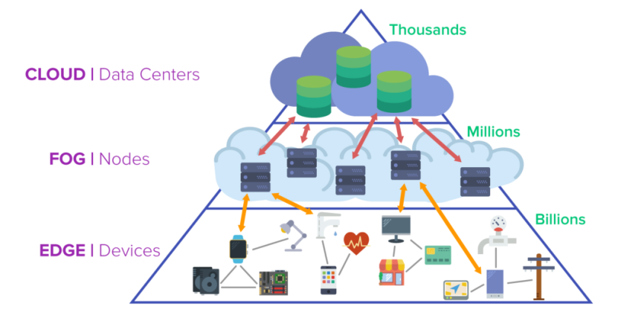
Future Works
GLB for other types of workloads/applications
  Scientific workflows, Map-Reduce
  Web Sticky Sessions
  Demand response
Internet of Things (IoT)
  Healthcare, Smart Vehicles
  Edge and Fog Computing
  Sustainability and Reliability
Challenge
  Shaping workload to match renewable power supply
    Offloading IoT tasks to the core clouds
    Trimming approximation analytics
    Scheduling deferral tasks
    Selective microservices power-off
    Orchestration of network slices
https://erpinnews.com/fog-computing-vs-edge-computing
Notes:
Stateless VS sticky
Edge computing is a cloud computing
If energy consumption concerns of these micro data centres will be deferred now it will become a bottleneck in the future.

Slide 22
THANK YOU
Questions?

Slide 23
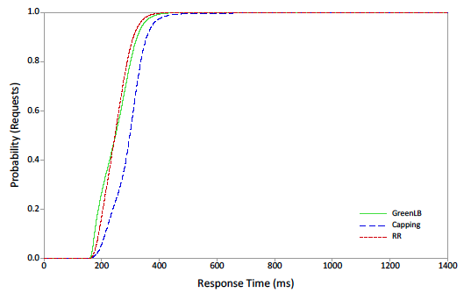
Results
CDF of average response time

