Slide 1


Geographical Load Balancing for
Sustainable Cloud Data Centers
Adel Nadjaran Toosi
Cloud Computing and Distributed Systems (CLOUDS) Laboratory,
School of Computing and Information Systems
The University of Melbourne, Australia
Email: anadjaran@unimelb.edu.au
Homepage: https://adelnadjarantoosi.info/

Slide 2
Biography
Postdoctoral Research Fellow, University of Melbourne, 2015-
PhD, Computer Science and Software Engineering, 2015
  CLOUDS lab, Computing and Information Systems, University of Melbourne
  Thesis: “On the Economics of Infrastructure as a Service Cloud Providers: Pricing, Markets, and Profit Maximization”
Research Interests
  Cloud Computing, Software-Defined Networking (SDN), Energy Efficiency and Green Computing, Soft Computing and Machine Learning
  Focused on Resource Provisioning and Scheduling in Distributed Systems
Publications
  Over 24 publications, 14 Journal Articles (9 A/A*, 2010 ERA Ranking), 10 Conference papers
  h-index: 15 and 1000+ citations (Src: Google Scholar)
Current Research
  Traffic engineering for energy efficient consolidation of virtual machines in SDN-enabled clouds

Slide 3
Outline
Introduction
  High energy consumption in data centers
  Renewable energy sources
  Challenges of using renewable energy
Geographical Load Balancing (GLB)
Optimal offline algorithm and its intractability
A GLB framework for web applications
Performance evaluation
  Experimental Setup
  Results
Summary and future directions

Slide 4
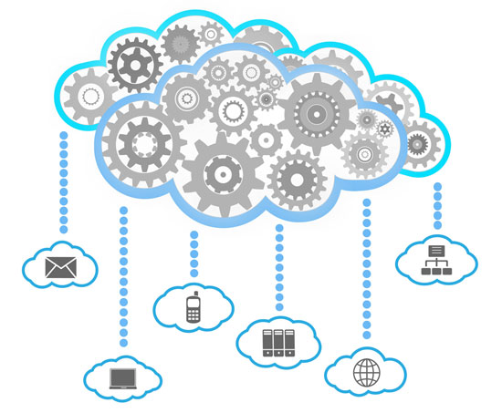






Online Activities Every Second
3.4 MILLION EMAILS
ARE EXCHANGEDª
250 SONGS
ARE DOWNLOADED VIA ITUNES^{f}
6,000 TWEETS
ARE SENT ON TWITTER^{b}
`
100,000 SEARCHES
ARE MADE ON GOOGLE^{c}
70,000 LIKES
ARE GENERATED ON FACEBOOK^{e}
600 ITEMS
ARE SOLD ON AMAZON^{d}
a https://www.lifewire.com/how-many-emails-are-sent-every-day-1171210
b http://www.internetlivestats.com/twitter-statistics/
c http://www.statisticbrain.com/google-searches/
d https://www.inc.com/tom-popomaronis/amazon-just-eclipsed-records-selling-over-600-items-per-second.html
e https://www.brandwatch.com/blog/47-facebook-statistics-2016/
f http://www.billboard.com/biz/articles/news/1538108/itunes-crosses-25-billion-songs-sold-now-sells-21-million-songs-a-day

Slide 5
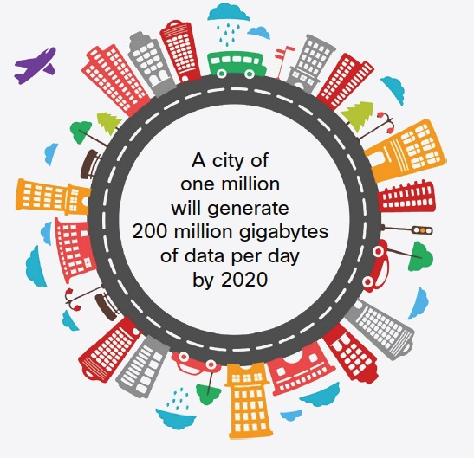
Digital Transformation
More Cloud Apps
More Data Centres
5G and Smart Phones
6B in 2020 (Ericsson)
Smart Cities
Big data analytics
Artificial Intelligence (AI)
Internet-of-Things (IoT) Devices
25B in 2020 (Gartner)
Source: Cisco Global Cloud Index: Forecast and Methodology, 2015–2020
Notes:
surpass global population in 2017 (Gartner)

Slide 6

Power Hungry Clouds
Data centers used for hosting cloud applications consume large amounts of electricity
  High operational cost for the cloud providers
  High carbon footprint on the environment
In 2014, US data centers alone consumed 70 billion kilowatt-hours of electricity
  = Two-year power consumption of all households in New York
  = The amount consumed by about 6.4 million average American homes that year
  This is projected to be responsible for the emission of nearly 50 million tons of carbon pollution per annum in 2020.
          Source: US Natural Resources Defense Council (NRDC)
Photo Source: http://nycyoungmen.tumblr.com/

Slide 7
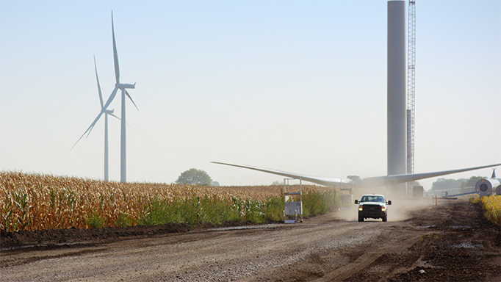
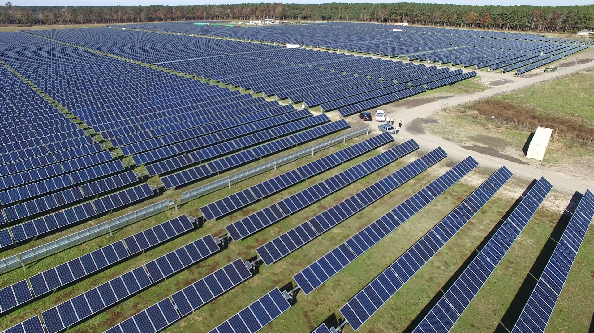
Renewable Energy
Cloud providers aims
  Reducing energy consumption
  Dependence on brown energy
Using renewable energy
  On-site green power generation
  Google, Microsoft and Amazon
“Amazon Web Services (AWS) has built a wind farm in 2016 to exceed the goal of 40% electrical usage from renewable energy sources”
Source: https://aws.amazon.com/about-aws/sustainability/

Slide 8
Challenges
Intermittency and unpredictability of renewable energy sources (Wind and Solar):
  Powering data centers entirely with renewable energy sources is difficult
  Mixed sources of energy for data centers:
    Grid power or brown energy
    Renewable energy sources or green energy
Challenges:
  Minimizing brown energy usage
  Maximizing renewable energy utilization

Slide 9
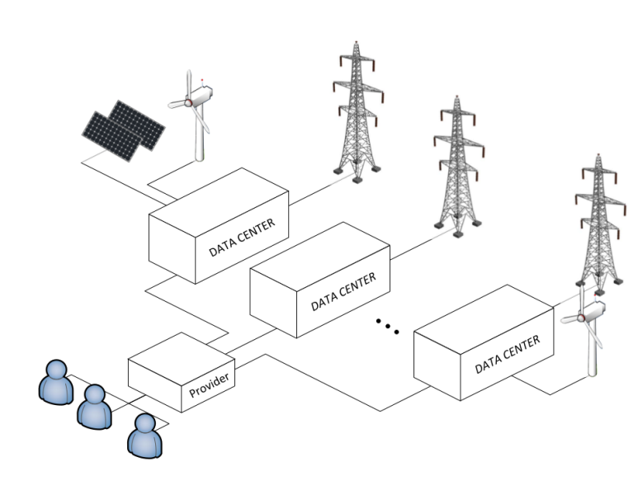
Geographical Load Balancing (GLB)
Geographical load balancing (GLB) potentials:
  Follow-the-renewables
GLB approach benefits cloud providers but it raises an interesting, and challenging question:
“With limited or even no a priori knowledge of the future workload, and the dynamic and unpredictable nature of renewable energy sources, how does one allocate requests to each data center such that the total cost of power consumption is minimized and the overall renewable energy utilization is maximized?”

Slide 10
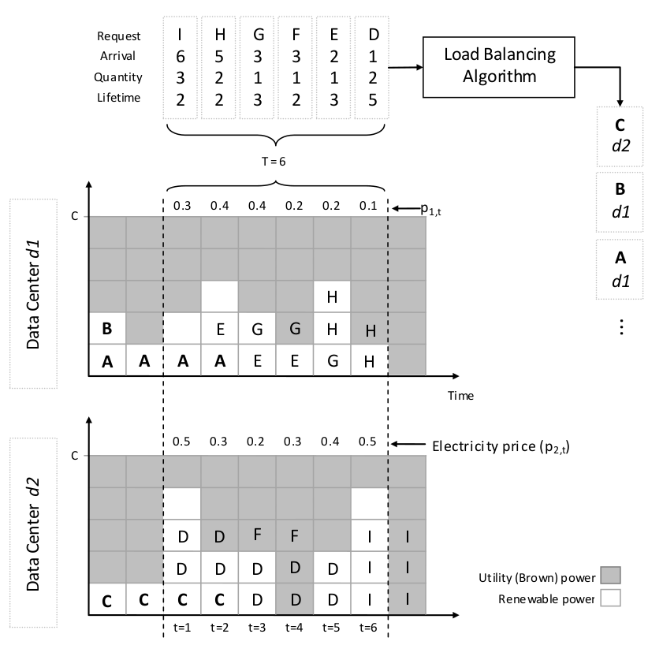
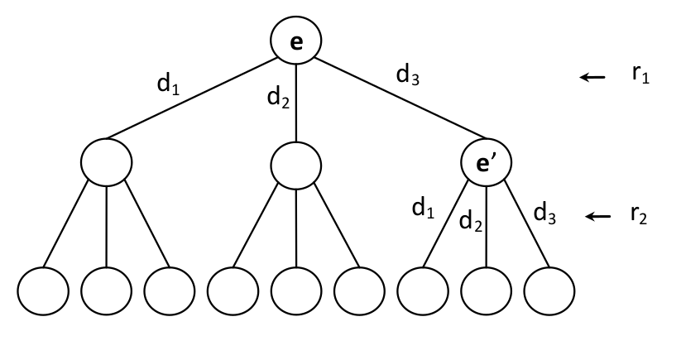
Example: Offline GLB Problem

Slide 11
Optimal Offline Algorithm
Assuming the following information is known for a time window:
  Future knowledge of renewable energy availability
  Workload (i.e., number of requests, arrival time, and duration of requests)
We showed that the optimal strategy is computationally intractable (Exponential time complexity)
  Formal proof can be found in our paper.
Adel Nadjaran Toosi and Rajkumar Buyya, A Fuzzy Logic-based Controller for Cost and Energy Efficient Load Balancing in Geo-Distributed Data Centers, In proceedings of the 8th IEEE/ACM International Conference on Utility and Cloud Computing (UCC'15), Limassol, Cyprus, Dec. 2015

Slide 12
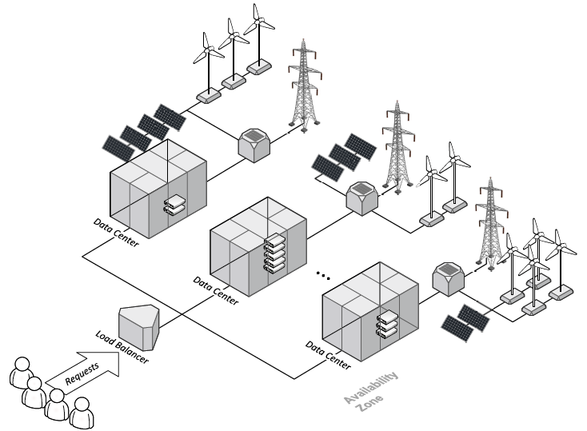
GLB for Web Applications
Adel Nadjaran Toosi, Chenhao Qu, Marcos Dias de Assuncao, and Rajkumar Buyya, Renewable-aware Geographical Load Balancing of Web Applications for Sustainable Data Centers, Journal of Network and Computer Applications (JNCA), Vol. 83, pp. 155-168, Apr. 2017.

Slide 13
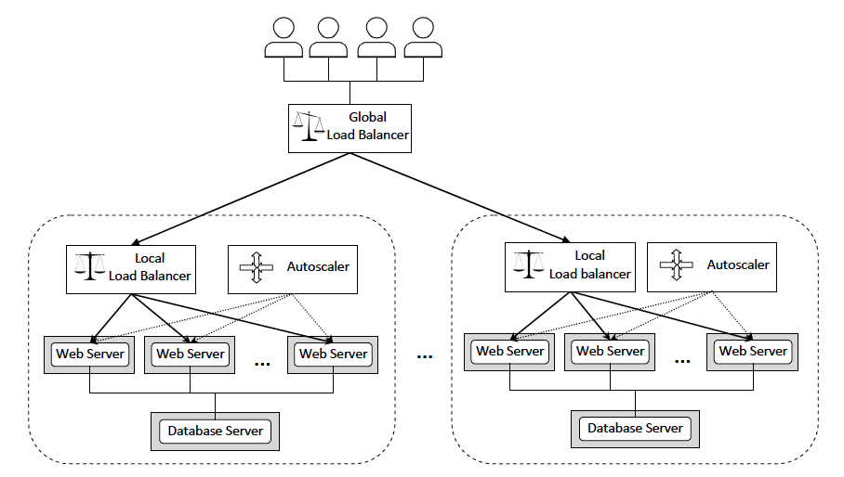
Overall System Architecture

Slide 14
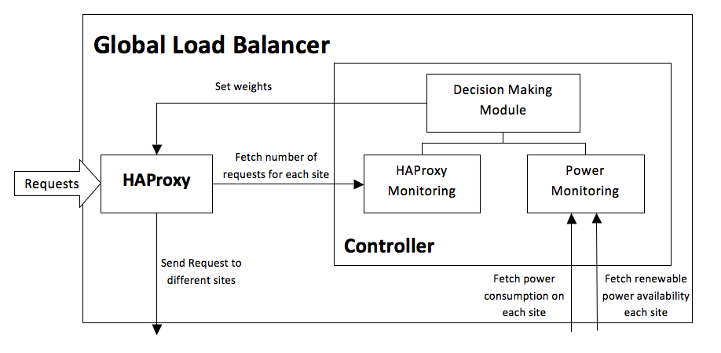
Global Load Balancer

Slide 15
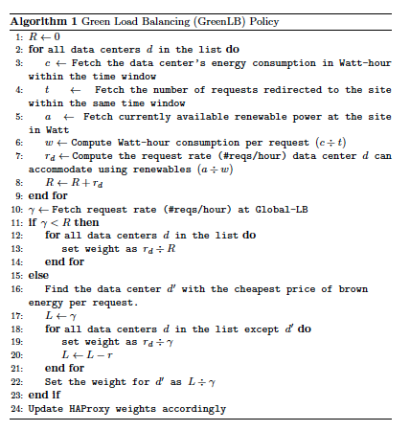
Green Load Balancer (GreenLB)

Slide 16
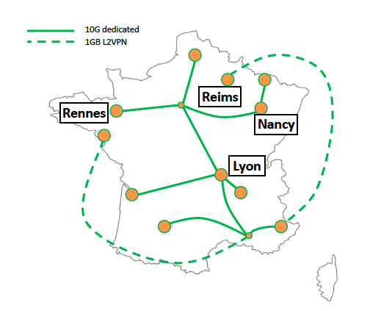
Grid’5000 Testbed

Slide 17
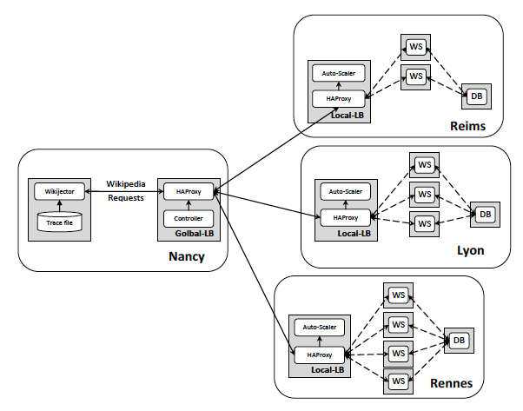
A Prototype System

Slide 18
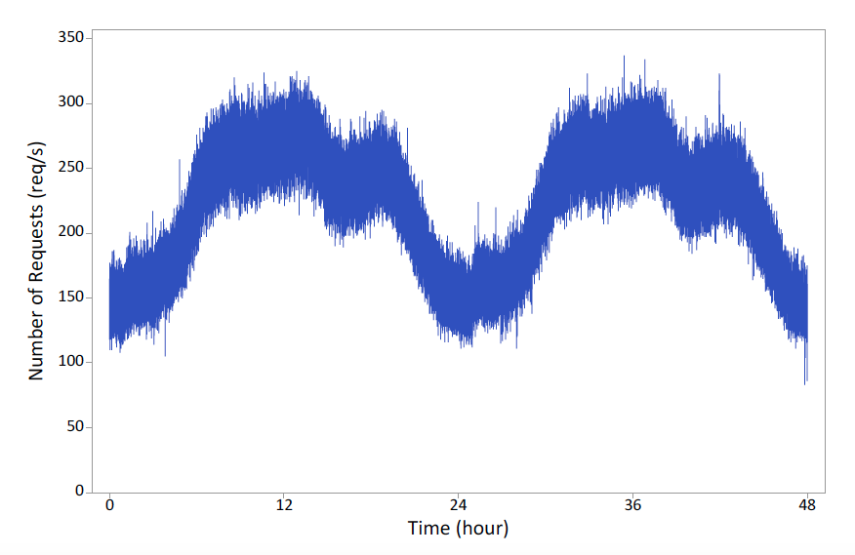
Workload Traces
The 5% of English Wikipedia Requests for 19th and 20th of September 2007
Notes:
The

Slide 19
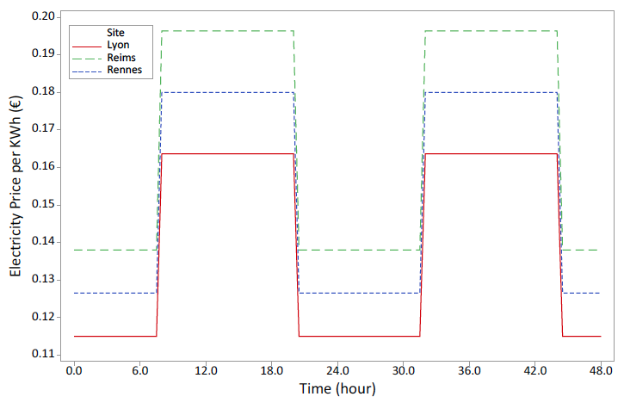
Electricity Prices
Notes:
Électricité de France S.A. (EDF; Electricity of France) is a French electric utility company

Slide 20
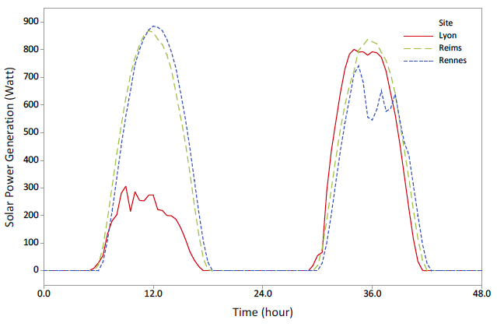
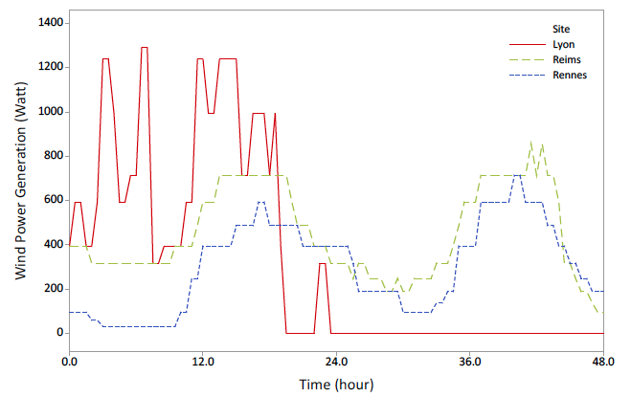
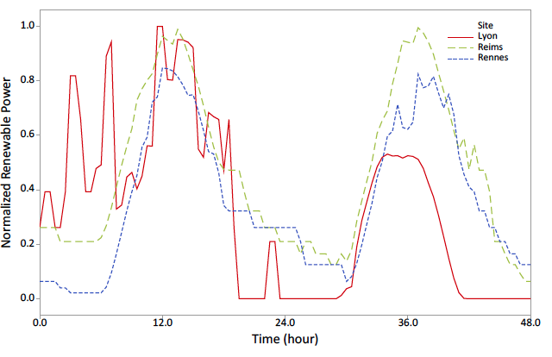
Renewable Power Generation
Solar
Wind
Combined
Notes:
Meteorological data on the location of each site.
Wind speed and Global Horizontal Irradiation (sunlight)

Slide 21
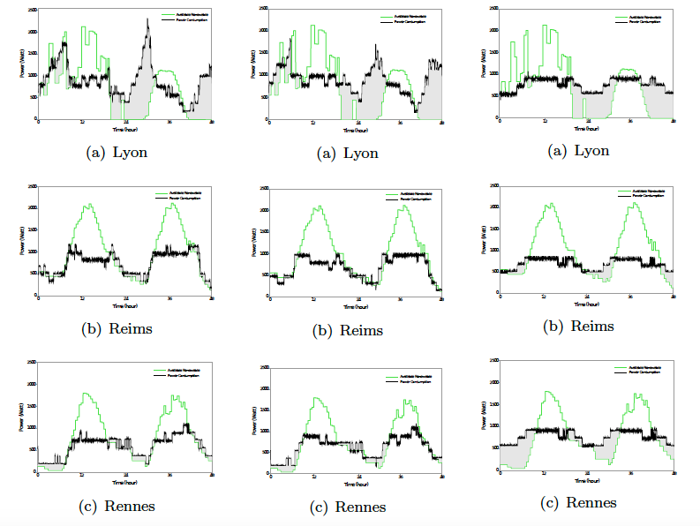
Results
GreenLB
Capping
Round Robin

Slide 22
Results
Site | Metric | RR | Capping | GreenLB
Lyon | Power Consumption (kWh) Brown Consumption (kWh) Cost (€) | 36.3 13.3 1.71 | 42.9 19.0 2.31 | 41.2 16.9 2.01
Reims | Power Consumption (kWh) Brown Consumption (kWh) Cost (€) | 32.5 2.1 0.42 | 32.5 1.1 0.15 | 35.4 1.9 0.27
Rennes | Power Consumption (kWh) Brown Consumption (kWh) Cost (€) | 36.4 9.3 1.23 | 29.7 2.9 0.39 | 28.3 2.6 0.35
Total | Power Consumption (kWh) Brown Consumption (kWh) Cost (€) | 105 25.7 3.36 | 105 23.0 2.85 | 105 21.4 2.63

Slide 23
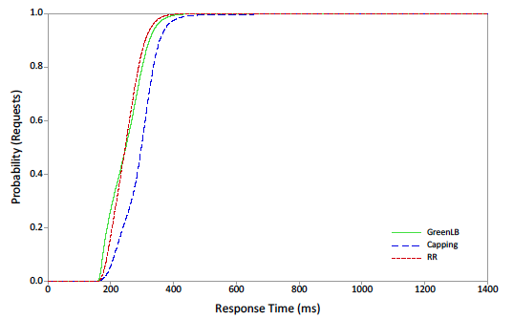
Results
CDF of average response time

Slide 24
Summary
A cost and energy efficient load balancing algorithm is proposed
  Distributes web application requests among multiple data centres
A prototype was implemented and experimental studies in a real testbed were performed
  Real traces of web requests for English Wikipedia
  Meteorological data in the location of each data centre to model solar and wind power generation
It reduces cost by 22% and brown energy by 17% in comparison to a simple round robin policy
It reduces cost by 8% and brown energy by 7% in comparison to a method by researchers from Rutgers and Princeton University

Slide 25
Future Works
Geographical load balancing for other types of workloads/applications
  Bag of tasks, scientific workflows, map-reduce
Demand response and capping the brown power consumption
  To promote carbon neutrality
“Sticky load balancing” policies
  When a client and an application server connection is established, all subsequent requests from this session are redirected to the same server
  Network proximity of the user

Slide 26
THANK YOU
Questions?

