Slide 1

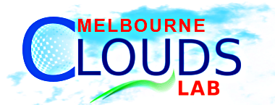
Cloud Computing and Cloud Networking
Dr. Adel Nadjaran Toosi
Cloud Computing and Distributed Systems (CLOUDS) Laboratory,
School of Computing and Information Systems
The University of Melbourne, Australia
Email: anadjaran@unimelb.edu.au
Homepage: https://adelnadjarantoosi.info/

Slide 2
Biography
Research Fellow, University of Melbourne, 2015-2018
I am joining Monash University as a Lecturer in May 2018.
PhD, Computer Science and Software Engineering, 2010-2014
  CLOUDS lab, Computing and Information Systems, University of Melbourne
  Thesis: “On the Economics of Infrastructure as a Service Cloud Providers: Pricing, Markets, and Profit Maximization”
Research Interests
  Cloud Computing, Software-Defined Networking (SDN), Energy Efficiency and Green Computing, Soft Computing and Machine Learning
  Focused on Resource Provisioning and Scheduling in Distributed Systems
Current Research
  Traffic engineering for energy efficient consolidation of virtual machines in SDN-enabled clouds

Slide 3
Agenda
What is cloud computing?
Inside a cloud data centre
Cloud networking
Demo
Conclusion

Slide 4
What is cloud computing?
An IT paradigm that enables access to shared pools of configurable system resources in form of services that can be rapidly provisioned with minimal management effort, often over the Internet.
  Allowing businesses to outsource their IT facilities to cloud providers
  Avoid expensive up-front investments of establishing their own infrastructure

Slide 5
Essential characteristics
  On-demand delivery of IT services
  Get more (or less) resources when you want, without interacting with other people
Broad network access
  Everything happens via the Internet
Resource pooling
  Huge amount of resources that are assigned to different users at different times
Rapid elasticity
  Get more (or less) resources in seconds
Measured service
  Long-held dream of computing as a utility
  Customers pay for what they use

Slide 6
Why Clouds?
Classical Computing
  Buy & Own
    Hardware,
    System Software,
    Applications often to meet peak needs.
  Install, Configure, Test, Verify
  Manage
  ..
  Finally, use it
  $$$$....$(High CapEx)
Cloud Computing
  Subscribe
  Use
    Automation and reusable components
  Pay for what you use, no upfront investment
Every 18 months?

Slide 7
Cloud Services
Infrastructure as a Service
  Choose number of virtual machines, operating system, memory, cores, and storage
  Install and configure all the software you want, as if it was a new server you just bought
  Don’t worry in finding where to put the servers, in installing air cons and fixing the hardware when it breaks
Platform as a Service
  Develop an app, and submit the code to the cloud, which deploys it
  Don’t worry about configuring Apache, Tomcat, Memcache, etc.
  Don’t worry in growing the infrastructure if your app becomes popular
Software as a Service
  Just use the application on line
  Don’t worry buying a license, installing, configuring, and updating the apps

Slide 8
Deployment Models
Public/Internet Clouds
Private/Enterprise Clouds
Hybrid/Mixed Clouds

Slide 9
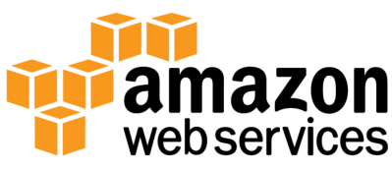

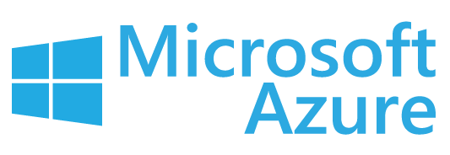




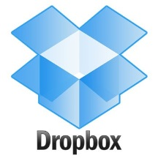

Popular Cases
Public Cloud Providers
Aggregators
Users
  Netflix (uses AWS)
  Snapchat (uses Google)
  Dropbox (used to be using AWS)
  AccuWeather (uses Azure)

Slide 10
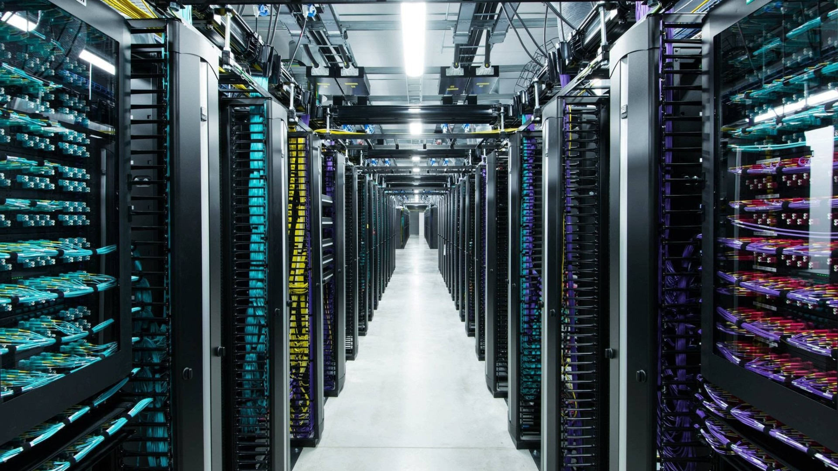
Inside a cloud data centre
http://bcsocialcredit.com/server-schrank/tolle-server-schrank-cropped-serverschrank/

Slide 11
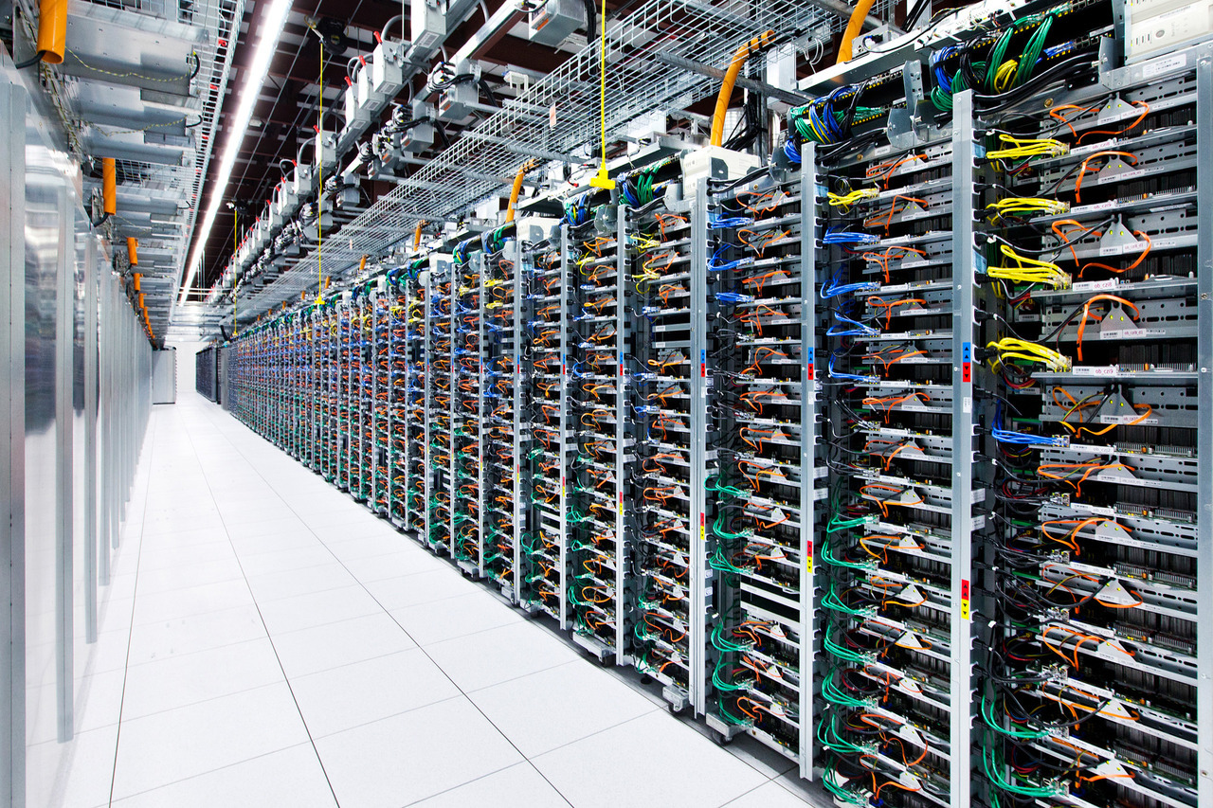
The rear of racks in
Google's Oklahoma Data Center
http://blogs.msdn.com/b/gshahine/archive/2009/11/22/3-days-at-microsoft-s-pdc-09.aspx

Slide 12
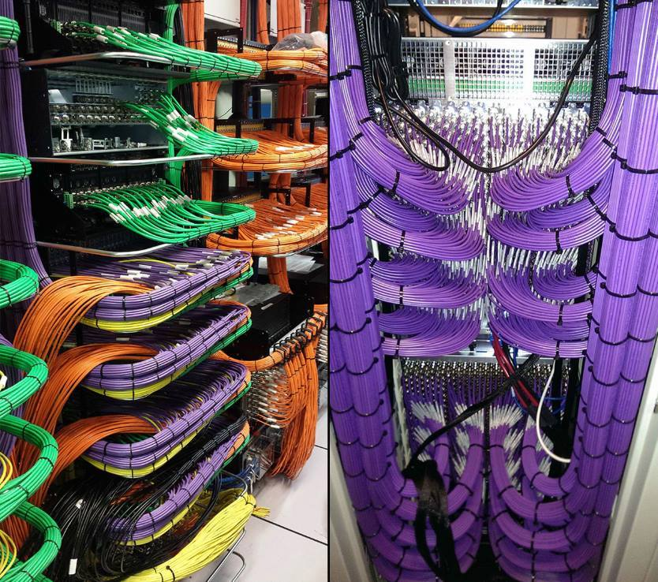
More…

Slide 13
Cloud networking

Slide 14
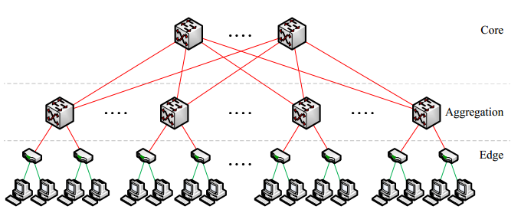
Massive size: tens of thousands of hosts + thousands of switches
Specialized hardware (middleboxes) implementing networking functions
  NAT, load balancing, WAN optimization, firewall…
Specialized communication protocols for top tiers
Communication patterns between hosts change frequently

Slide 15
Software-Defined Networking
Separation of control plane from data forwarding plane
Platform is decoupled from infrastructure
Centralized controller, network-wide control by controller SW that performs routing and traffic engineering
Traditional Networking
Software-Defined Networking
Control Plane
Controller Software
Control Protocol
Data Forwarding Plane
Credit: Jungmin Son

Slide 16
Benefits
Enables dynamic configuration of networking
Real-time responsiveness to traffic demands
Programmable network
Load balancing by network
Open opportunities for innovation
OpenFlow
  De facto standard interface for SDN controllers
  Describes an open interaction protocol in SDN that allows the controller to communicate with the forwarding plane

Slide 17
Network Function Virtualization (NFV)
Migration of network functions to the software layer
Enables better interoperability of equipments and more advanced network functions
Virtualized Network Function (VNF)
  deployable elements of NFV

Slide 18
Cloud Computing in 5 minutes
https://www.youtube.com/watch?v=QJncFirhjPg

Slide 19
Demo
Nectar Cloud
  provides cloud computing services to Australian researchers
Virtual Machine
  is an operating system (OS) or application environment that is installed on software, which imitates dedicated hardware.
  The end user has the same experience on a virtual machine as they would have on dedicated hardware.
Web Server

Slide 20
Conclusion
New business model for ICT services
The core of the cloud are data centres with thousands of hosts and network devices
Advances in the technology are enabling software-defined networks and virtualization of networking functions

Slide 21
THANK YOU
Questions?

