Slide 1

A Fuzzy Logic-based Controller for
Cost and Energy Efficient Load Balancing in
Geo-Distributed Data Centers
Adel Nadjaran Toosi and Rajkumar Buyya
Cloud Computing and Distributed Systems (CLOUDS) Laboratory,
Department of Computing and Information Systems
The University of Melbourne, Australia
Adel Nadjaran Toosi
Email: anadjaran@unimelb.edu.au

Slide 2
Outline
Introduction
  Large energy consumption in data centers
  Renewable energy sources
  Challenges of using renewable energy
Geographical load balancing
Optimal Offline Algorithm and its intractability
Fuzzy Logic-based Load Balancing
Performance Evaluation
  Experimental Setup
  Results
Conclusions

Slide 3
Large Energy Consumption
Data centers used for hosting cloud applications consume large amount of electricity
  High operational cost for the cloud providers
  High carbon footprint on the environment.
According to the US Natural Resources Defense Council, (www.nrdc.org):
  US data centers alone consumed 91 billion kilowatt-hours of electricity, equivalent to two-year power consumption of all households in New York city
  This is projected to be responsible for the emission of nearly 50 million tons of carbon pollution per annum in 2020.

Slide 4
Renewable Energy
Cloud service providers are working hard:
  To reduce their energy consumption
  Their dependence on power generated from fossil fuels (i.e., Brown energy)
Using renewable energy
  Direct investments in on-site green power generation
    Companies such as Google, Microsoft and Amazon
“Amazon Web Services (AWS) is building a wind farm that will be operational by end-2016 that generates 40 percent of its electrical usage from renewable energy sources”

Slide 5
Challenge
Intermittency and unpredictability of renewable energy sources
  Powering data centers entirely with renewable energy sources is difficult.
Sources of energy for data centers:
  Grid power or brown energy
  Renewable energy sources or green energy
Challenge:
  To minimize brown energy usage
  To maximize renewable energy utilization

Slide 6
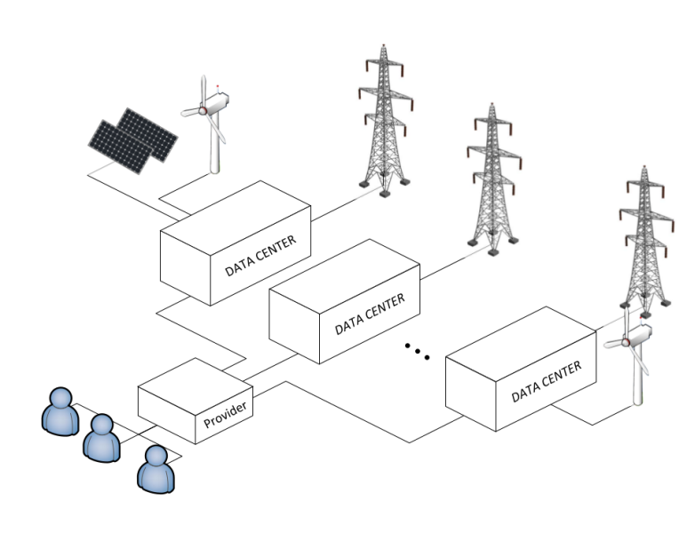
Geographical Load Balancing (GLB)
Geographical load balancing (GLB) potentials:
  Follow the renewables:
    Reducing brown energy usage
    Maximizing renewable energy utilization
GLB approach benefits cloud providers but it raises an interesting, and challenging question:
“with limited or even no a priori knowledge of the future workload, and dynamic and unpredictable nature of renewable energy sources, how does one allocate requests to each data center such that the total cost of power consumption is minimized and the overall renewable energy utilization is maximized?”

Slide 7
Optimal Offline Algorithm
We assume the following information are known to a certain time window:
  Future knowledge of renewable energy availability
  Workload (i.e., number of requests, arriving time and duration of requests)
We characterized the optimal offline GLB
We showed that the optimal strategy is computationally intractable.
  Formal discussion can be found in the paper, we give a simple informal example.

Slide 8
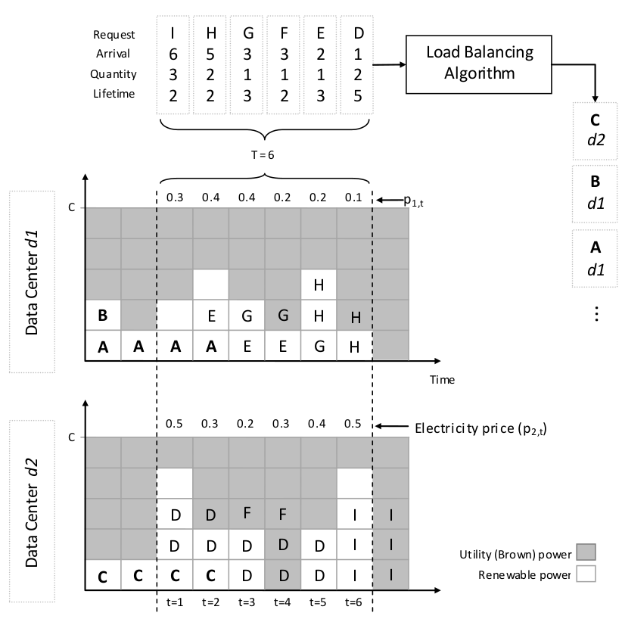
Example: Offline GLB Problem

Slide 9
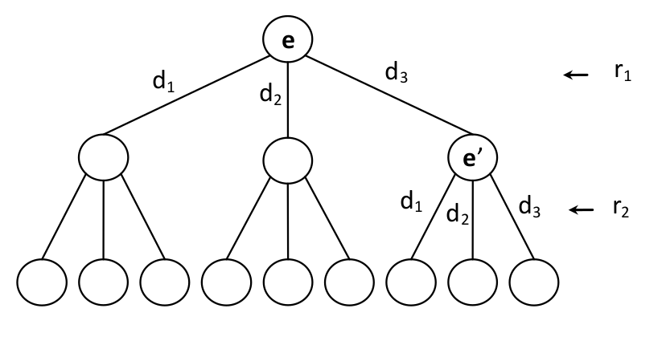
Time Complexity
A decision tree by branching
factor n upto m levels.
  n: number of data centers
  m: number of requests
A path from the root to a leaf of the
tree that generates the lowest cost
determines the optimal solution.
This leads to the O(n^{m}) different state variables.
Offers an exponential time complexitry given a bounded number of data centers.
The complexity can be improved using techniques such as branch and bound.
  It does not reduce the worst-case time complexity.
If the lifetime of requests is bounded and is considerably smaller than the window, we can improve time complexity using a dynamic programming technique.

Slide 10
Fuzzy Logic-based Load Balancing (FLB)
We present a fuzzy logic-based load balancing algorithm that only uses recent data history to tackle the geographical load balancing problem.
Why fuzzy logic?
  Fuzzy logic is conceptually easy to understand and mathematical concepts behind fuzzy reasoning, even though subtle, are very simple.
  Fuzzy logic systems are good at dealing with uncertainty and lack of perfect information.
  Fuzzy logic reasoning is among the best techniques, for solving non-linear systems with an arbitrary complexity and large number of inputs.

Slide 11
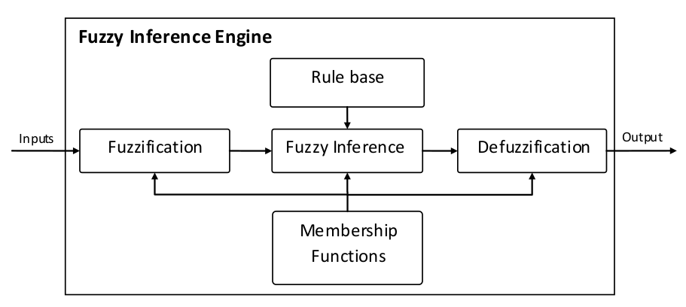
A Typical Fuzzy Inference System
Sample fuzzy rule:
if height is very high and weight is very low then healthiness is low

Slide 12
Fuzzy Logic-based Load Balancing
(Inputs and Output)
Input values computed within a window of sizeW in the recent history for Datacenter i:
  The utilization of renewable energy sources (U_{i}): is a value in the range [0, 1] and is computed as the ratio of the number of used to the total number of available renewable power units.
  Amount of brown energy consumption (B_{i}): is a value in the range [0, +∞) and is computed as the ratio of the total number of units of brown power units used to the total number of available renewable power units.
  Average price of electricity in the location (F_{i}): is the average price for an unit of power.
Output (Varies between 0 and 1)
  specifies the suitability of each data center for routing the request, where 0 shows the lowest suitability and 1 shows the highest suitability.

Slide 13
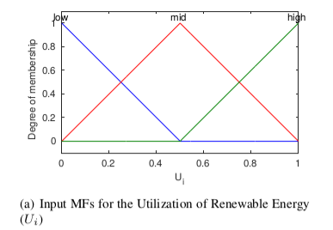
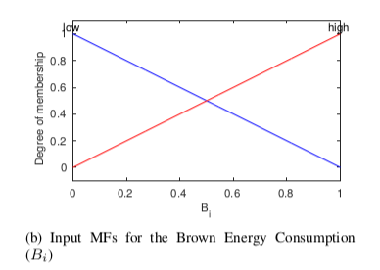
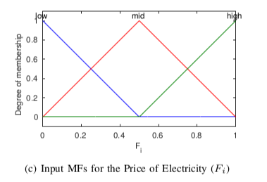
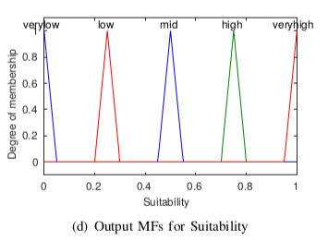
Fuzzy Logic-based Load Balancing (Membership Functions)

Slide 14
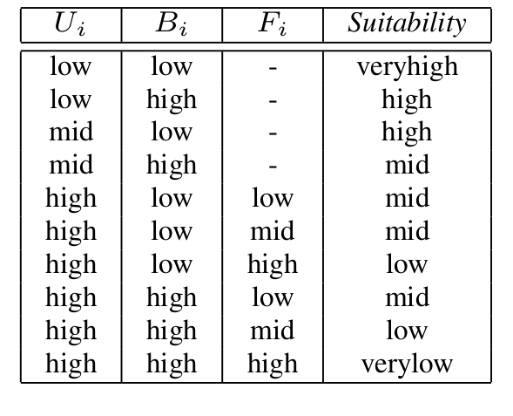
Fuzzy Logic-based Load Balancing
(Fuzzy Rules)

Slide 15
Performance Evaluation
We conduct experiments based on simulation to study the performance of fuzzy logic-based load balancing (FLB).
  CloudSim, a discrete-event Cloud simulator.
Our aim is to understand the renewable energy utilization and cost performance of FLB in realistic settings.
In order to achieve our goal, we consider a case study based on real-world traces for the workload, renewable availability, and electricity prices.

Slide 16
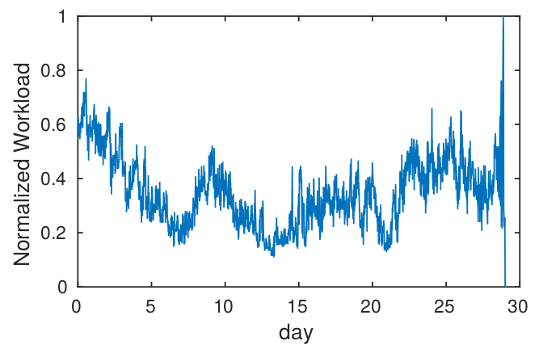
Experimental Setup
(Workload Setup)
Traces of Google cluster-usage
  Google cluster of 12K physical servers
  933 users
  Over a time period of 29 days
  Devised Scheduling algorithm

Slide 17
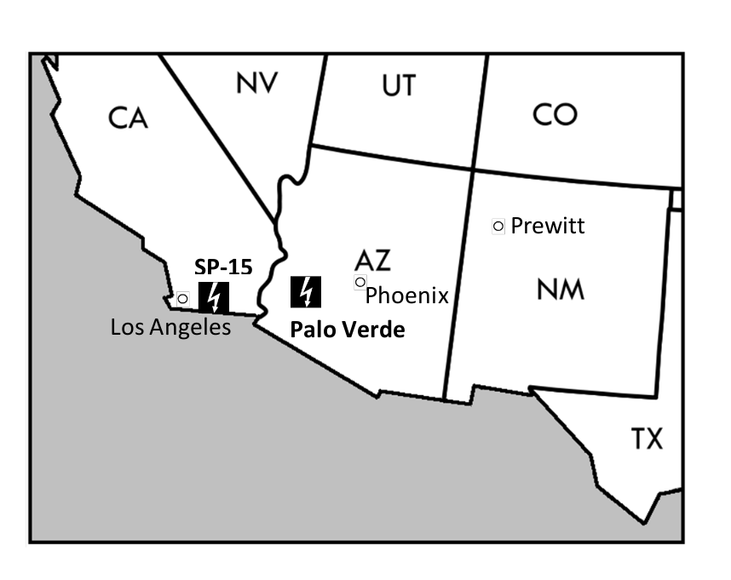
Experimental Setup
(Configuration of data centers)

Slide 18
Experimental Setup
(Renewables and Electricity prices)
Renewable Energy
  Meteorological data traces database of National Renewable Energy Laboratory (NREL)
  Wind turbines (GE 1.5MW wind turbine with efficiency of 40%) and solar panels (500m² with efficiency of 30%)
  The model proposed by Fripp and Wiser is employed where the wind speed, the air temperature, and the air pressure measurements in the location of each data center fed into the model.
Electricity prices
  Wholesale electricity price information for each hub is collected from the website of Energy Information Administration (EIA)

Slide 19
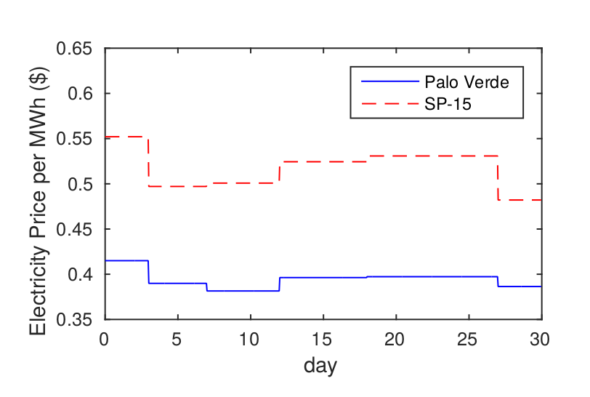
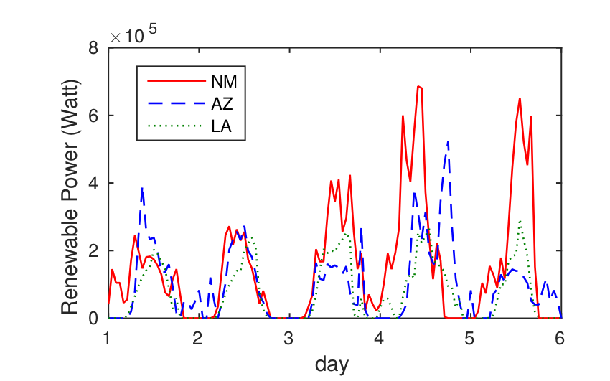
Experimental Setup
(Renewables and Electricity prices)
Wholesale electricity market price for the hubs
Renewable power generation for five days.

Slide 20
Benchmark Algorithms:
Future-Aware Best Fit (FABEF): it routes each request to a data center leading to the lowest cost of the request accommodation irrespective of upcoming requests.
Round Robin (RR): It routes requests to data centers in circular order with null information about the status of data centers.
Highest Available Renewable First (HAREF): It routes requests to the data center with the highest amount of available renewable energy at the current time slot.

Slide 21
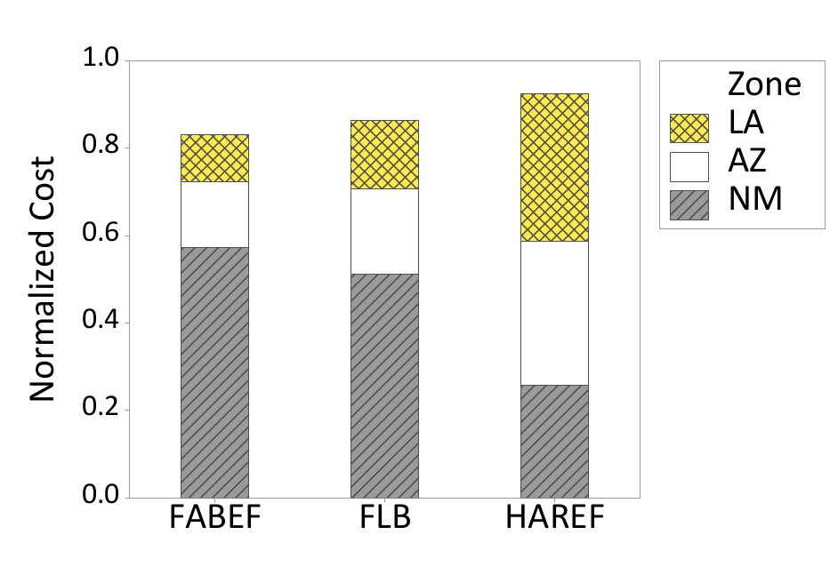
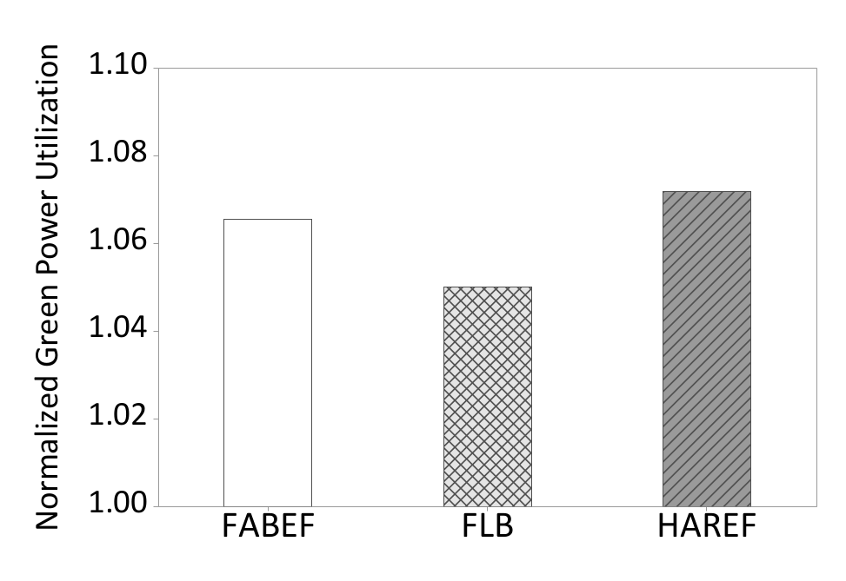
Results
The total cost of different algorithms normalized to the outcome of the RR algorithm.
The green power utilization of different algorithms normalized to the outcome of the RR algorithm.

Slide 22
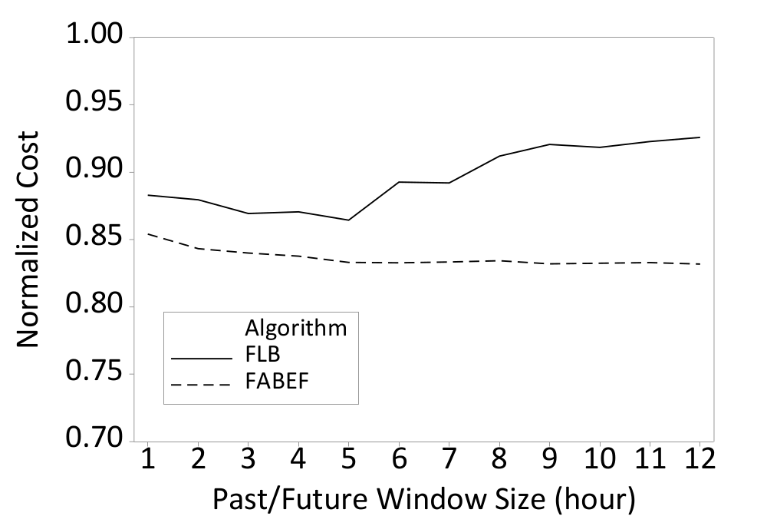
Results
Effect of window size on the total cost performance of FLB and
FABEF normalized to the outcome of the RR algorithm.

Slide 23
Conclusions
We also showed that optimal offline geographical load balancing is hard to achieve even if the perfect future knowledge about upcoming requests and their characteristics (i.e., arrival, size and lifetime), availability of renewable energy sources, and electricity price are known in advance.
We proposed a fuzzy logic-based algorithm for cost and energy efficient load balancing among multiple data centers of a cloud service provider.
Our evaluation using simulation of a case study designed according to real-world traces of workload, renewable energy sources, and electricity market prices showed that our proposed method is able to significantly reduce the cost of the cloud provider.

Slide 24
THANK YOU
Questions?

