Slide 1


Financial Option Market Model
for Federated Cloud Environments
Adel Nadjaran Toosi*, Ruppa K. Thulasiram, and Rajkumar Buyya*
* Cloud Computing and Distributed Systems (CLOUDS) Laboratory,
Department of Computing and Information Systems
The University of Melbourne, Australia
 Department of Computer Science
University of Manitoba, Canada
Adel Nadjaran Toosi
Email: adeln@student.unimelb.edu.au

Slide 2
Outline
Infrastructure as a Service providers and pricing plans
  Reserved and On-demand
Problem definition
System Model
  Cloud Federation
  Spot market
  Option market
    Option pricing
  Policies
Performance Evaluation
  Experimental Setup
  Results
Conclusion and Future Work

Slide 3
IaaS providers and pricing plans
Infrastructure as a Service (IaaS)
  Offers storage and computational service in the form of Virtual Machine (VM) instances
Two well-known payment plans
  Subscription option (Reservation)
  Flat rate pay-as-you-go (On-demand)

Slide 4
Reserved capacity is not fully utilized!
Huge and unpredictable variation in the load over time for Cloud applications, e.g. web applications.
Economic advantage of using Reserved Instances in comparison with On-Demand Instances, even if they are not fully utilize
  Amazon EC2: Using Heavy Utilization Reserved Instances, you can save up to 54% for a 1-year term and 71% for a 3-year term vs. running On-Demand Instances.
  Reserved Instance Marketplace
All together :
The pattern of utilization at user side causes reserved instances not to be deployed at all times

Slide 5
Using Reserved Capacity for On-demand Requests
We are interested to explore the opportunity:
  Additional cash flow by releasing underutilized capacity of the reserved instances to the on-demand requests.
  If the unreserved part of the data center experiences high utilization, providers are able to accommodate on-demand requests on the underutilized reserved capacity of the data center.
Risk of SLA violation!
Cloud cooperation is a possible solution

Slide 6
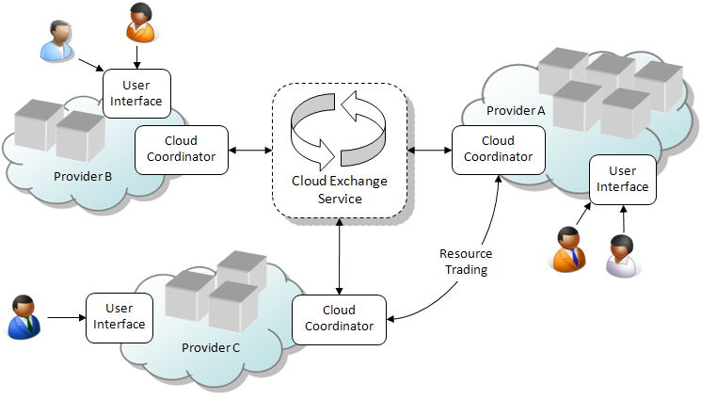
Cloud Federation Model
Hedge against the mentioned risk by letting providers increase their resources dynamically.
Federation of Clouds:
  To trade resources in a market helps providers to enhance their profit, resource utilization, and QoS

Slide 7
Risks in Cloud Federation Market
Two more risks:
  a risk of being unable to acquire required resources in the market.
    Short selling resources without having a good knowledge of usage loads and hence violating the QoS.
  Future price variations in the federation market using past price history
A financial option-based market model is introduced for a federation of Cloud providers
  which helps providers increase their profit and mitigate the risks (risks of violating QoS or paying extra money).

Slide 8
Financial Option Contract
A financial option is a contract for a future.
Transaction between two parties:
  Holder and seller of the contract.
A financial option gives the holder the right, but not the obligation, to buy (or to sell) an underlying asset at a certain price, called the strike price (exercise price), within a certain period of time, called maturity date (expiration date).
The seller is obligated to fulfill the transaction.
As a compensation the seller collects an upfront payment at the beginning of the contract, called premium.

Slide 9
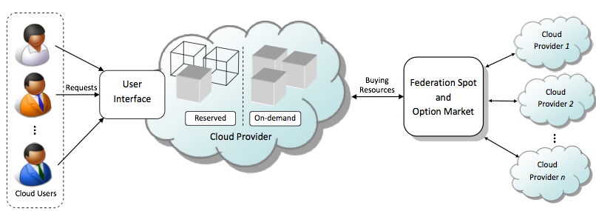
The System Model

Slide 10
Pricing Plans
Requests can be submitted either for reserved or on-demand service and charges will be applied accordingly.
1) On-demand plan:
  Allows customers to pay for compute capacity by its usage without longterm commitment.
  A fixed rate per usage time, e.g. hourly
  Request can be rejected by the provider.
  Customers can retain machines as long as they require them.
2) Reserved plan:
  Customers pay an upfront fee, called reservation fee.
  In return receive a discount on the usage for the VMs.
  The reserved capacity is always available when it is required.

Slide 11
Capacity Segmentation
Two different strategies are assumed to to support aforementioned plans:
  Data center maximum capacity in unit of VMs of the similar type is n
1) Isolated pools:
  Two different pools of servers (nodes in data center) for instances of each plan is considered in isolation of each other.
  If the entire reservation size requires r instances, the on-demand pool is capable of accommodating n - r instances at most.
2) Shared pool:
  On-demand VMs requests are offered to use physical nodes of the reserved capacity if on-demand capacity is fully utilized.
  Entire reservation size is r, and m reserved VMs are running then accommodating n - m on-demand requests is possible.
Shared pool strategy suffers from the risk of violating availability of the reserved instances.

Slide 12
Cloud Federation Spot and Option Market
The federation spot market:
  Federated Clouds trade their resources with each other for immediate delivery.
  Different types of underlying market mechanism is possible:
    Combinatorial Double Auctions, Commodity Exchanges, Reverse Dutch Auctions, …
Option market on top of the spot market.
  Our option market is general and modeled independently from the underlying spot market mechanism.
  The only outcome of the spot market which is required by the model is the spot price at which resources are offered
    (History of prices).
  We do not specify a particular spot market mechanism,
  Abstract Cloud Federation spot market in out experiments.

Slide 13
Risks
A Market model based on the financial option on top of the spot market for a federation of Cloud providers.
  Price fluctuation in the market and high cost of outsourcing, and
  Not being able to acquire resources,
    leads to rejection of the reserved requests.
Benefits: The provider is able to:
  Enhance its profit by deploying a shared pool of physical nodes
  Guarantee the availability of the reserved instances
    and avoids buying resources at a price that is higher than the one charged to its own customers.
  let the contract expire without responsibility to buy unnecessary resources (Ignoring premium).
    The important advantage of buying options in comparison to other future agreements.

Slide 14
The Option Market
A provider buys option contracts as a backup capacity for the reserved resources used by on-demand instances
To gain the right to acquire resource from the seller provider, as need arises.
  The seller is obligated to fulfill the request, risk of not acquiring resources is removed.
  Buying option contract protects provider against high variation of the market price.

Slide 15




When to buy option?
User Interface
Reserved
1
Cloud Coordinator
2
3
Cloud Exchange Service
Option Contract

Slide 16
Option Market
The main element in an option market is the option.
There are two types of option:
  call and put.
    A call option gives its holder the right to buy the underlying asset at a specific price (strike price) by a certain time (expiration date).
    A put option gives the holder the right to sell the asset at a specific price over a given period of time.
The option can either be exercised at:
  Expiration date (European option),
  or any time during its life (American option).
In our model the provider buys an option:
  To acquire the right to outsource reserved requests to hedge against the risks
  and it needs to exercise the option any time in the future according to the load and upcoming reserved requests,
The American call option is the most appropriate for our work.

Slide 17
Option Example (European)
Suppose that a market participant purchases a call option in $2:
  Strike price of $28
  Expiration date in two months.
Two months later, the spot price goes to $35, in this case, he/she exercises the option and gains the advantage of (35 - 28) - 2 = $5.
If the spot price stays below the strike price, the option holder might buy at the spot price and allow the option to be expired.
  In this case, the $2 premium paid at the beginning of the option contract is lost.

Slide 18
Option Pricing
An option contract is defined by a tuple (P, K, T), where
  P is the price of buying the option (Premium),
  K is the strike price,
  and T is the expiration date.

Slide 19
Strike Price (K)
Given that the price per time unit for the reserved instances is R,
  The provider buys an option with a strike price lower than R to secure its future profitability.
  As long as the spot market price, S, is lower than R, the provider submits a request for buying an option with strike price K = S, otherwise K = R.

Slide 20
Expiration Date (T)
The provider is oblivious to the duration of the VM and its future load, so we consider T as a fixed value, e.g. one month.
We investigate the impact of the time to maturity of the options on the model in our study.
Optimization strategies regarding buying option with the best expiration date requires load prediction strategies.
It can be considered as an extension of this work.

Slide 21
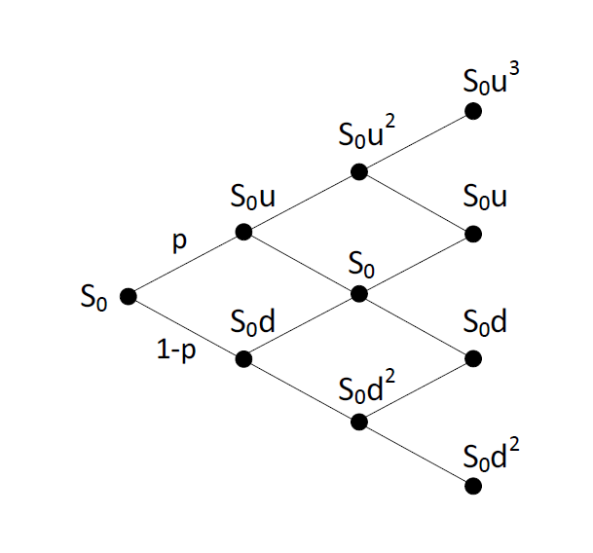
Option Price (P)
Popular Technique: Binomial lattice or tree.
  Consider the current spot market price is S₀.
  S₀ goes to S₀u with probability of p and to S₀d with probability 1-p at each time step ΔT.
  Let T = n.ΔT, where T is the option expiration date,
  A lattice of spot price movement for n = 3:

Slide 22
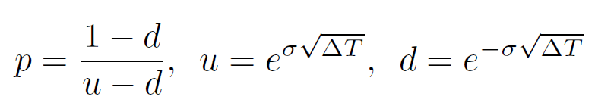
Option Price (P) (Cont.)
A call option is worth max(S_{T} – K, 0), where S_{T} is the spot market price for underlying asset at time T.
Assuming risk neutral world, the value at each node at time T - ΔT is computed according
The expected payoff value at time T and the risk-free interest rate, r, for the time period ΔT.
In this study we assumed r = 0.
Going backward using the above procedure, the option value, P, can be obtained at time zero.
Factors u, d and p play crucial role in option pricing:
  where σ is called volatility (a measure of uncertainty about future price)
  we calculate volatility according to the historical data by method provided in
  J. Hull, Options, futures and other derivatives 2009.

Slide 23
Policies
Baseline In-house Isolated Pool Policy (IIP)
  Provider works independently, without participating in the federation.
  Isolated pools of physical nodes for on-demand and reserved instances .
Baseline Federated Isolated Pool Policy (FIP)
  If the provider is not able to serve on-demand requests locally it outsource them through federation spot market.
  To be always cost-effective, if the spot price in the federation market is higher than the local on-demand price then the provider rejects the on-demand request.
  The pool of physical nodes for reserved and on-demand instances are isolated to prevent rejection of reserved requests.
Federated Shared Pool Option-Enabled Policy (FSPO)
  The provider accommodates excess on-demand requests in the underutilized reserved capacity.
  The provider buys an option whenever he accommodates on-demand requests in the reserved capacity.
  If a reserved request comes in and the provider is not able to serve it locally, the option is exercised and the reserved request is outsourced at the strike price of the option.

Slide 24
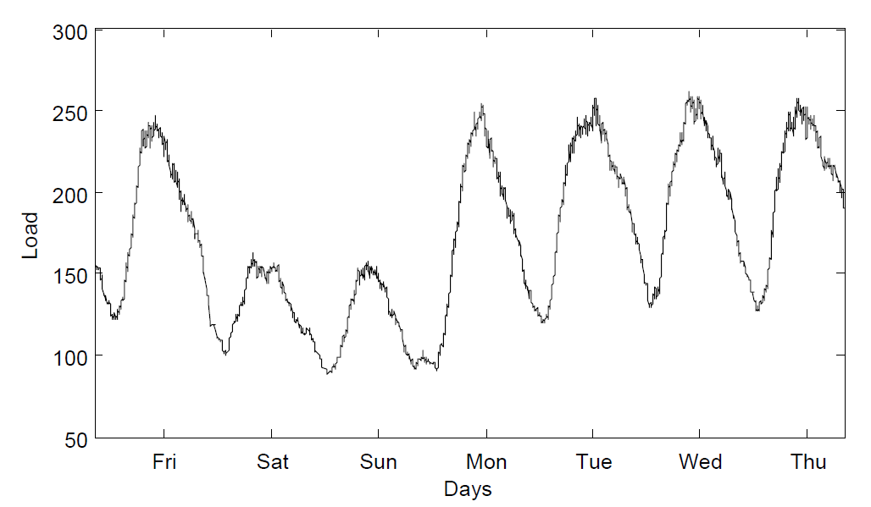
Performance Evaluation
Exprimental Setup
  Workload Setup
    lack of publicly available traces of real-world IaaS Cloud requests,
    VM request created based on the pair (S, D)
      S is the arrival time of the request
        Daily Cycle (with different load for weekdays and weakened)
        Detail in the paper
      D is the holding time of the instance by the user.
        D is taken to be a Pareto distributed random variable

Slide 25
Simulation Setup
The experiments developed using the CloudSim, a discrete event Cloud simulator.
VM configuration is inspired by Amazon Elastic Compute Cloud
The pricing is also adopted from the Amazon EC2 (the US east region)
  The provider charges their customers based on hourly usage
  At the cost of $0.085 and $0.030 per hour for on-demand and reserved VMs, respectively.
The provider capacity is set equal to the maximum number of simultaneously runnable VMs.
  The provider capacity is set to 200 VMs.
  The reserved capacity is set to 100 VMs in all the experiments.

Slide 26
Simulation Setup (Cont.)
Federation spot market
  Prices are generated according to the statistical model for fluctuation of the spot instances in the Amazon EC2 spot market by Javadi et al.
    Correlation between generated spot prices and the price of on-demand and reserved instances makes the evaluation of our model more significant.
    The statistical model provides more flexibility to investigate our proposed market
      we can modify the parameters e.g. to increase the volatility.
Option pricing is done by the previously described method.
  The depth of the binomial tree to calculate the option value is 30
length of a simulation period is 6 months.
Each experiment is carried out 30 times and the mean value of the results are reported.

Slide 27
Performance Metrics
Provider's profit:
    P = R_{O} + R_{R} – C_{out,O} – C_{out,R} – C_{option} – C_{p}
    R_{O} : Revenue of the on-demand instances
    R_{R} : Revenue of the Reserved instances
    C_{out,O} : Cost of buying resources to outsource on-demand instances.
    C_{out,R} : Cost of buying resources to outsource Reserved instances.
    C_{option} : Cost of buying options
    C_{p} : Data Center cost (operational and none-operational
      Assumed as a constant value for all policies.
  Number of rejected reserved requests

Slide 28
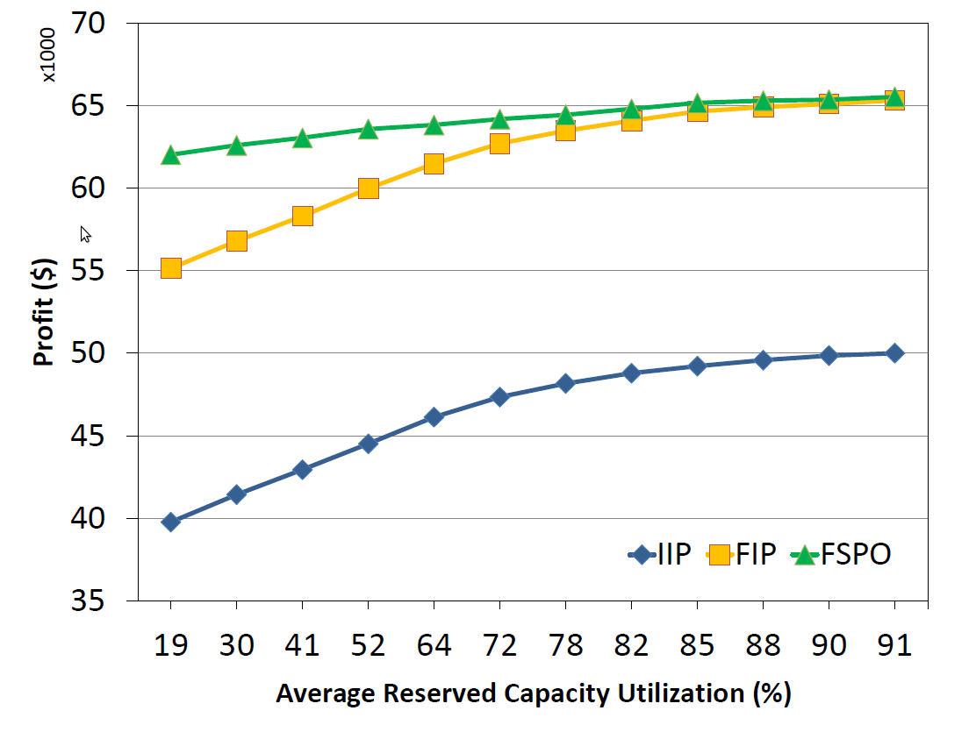
Reserved Capacity Utilization Effect
The capacity of the data center is 200 VMs,
The reserved capacity is 100 VMs,
The maturity time of the options is 30 days,
The number of on-demand requests per weekdays and weekends is 700 and 350, respectively.

Slide 29
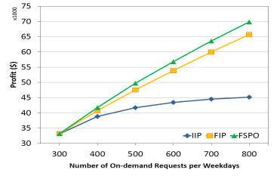
Effect of On-demand Load
The same configuration of the previous experiment while utilization of the reserved capacity is fixed at 52%.
The number of on-demand requests is varied from 300 to 800 per day for Weekdays and half of that for weekends

Slide 30
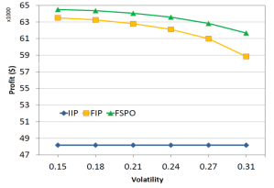
Effect of Volatility
To generate a highly volatile prices in the spot market,
We increased the standard deviation of the proposed distributions,
Prices below $0.025 were ignored.
The capacity of the data center is 200 VMs, the reserved capacity is 100 VMs.
The maturity time of the options is 30 days, and the number of on-demand requests per weekdays and weekends is 700 and 350.
The utilization of the reserved capacity is 64%.

Slide 31
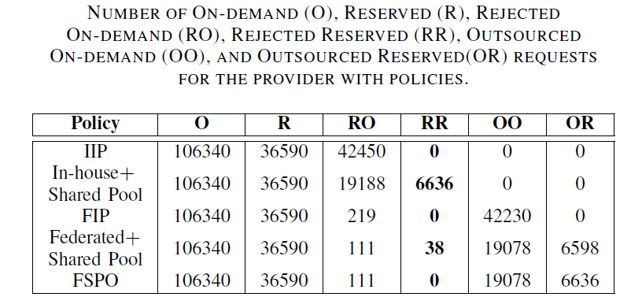
Number of Request Rejections

Slide 32
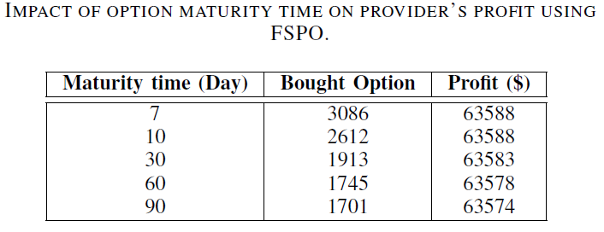
Effect of Maturity Time

Slide 33
Conclusions and Future Directions
Mechanism to guarantee resources to reserved users whenever they need them, while keeping resources loaded all the time is of value.
We proposed a financial option model for a federation of Cloud providers to address the above situation.
  by trading option contracts that allows resources from other service providers to be exploited for future in the Cloud federation.
Experimental results showed that
  The provider’s profit will be increased by using our model under-utilized reserved capacity.
  Availability of the reserved customers is guaranteed.
  The model therefore contributes to obtaining a trust and goodwill from the provider’s client base.
We did not consider strategies regarding selling options.
Put options that will give providers the right to sell resources at their will

Slide 34
THANK YOU
Questions?

