Slide 1
Research Methods in Software and Systems Engineering
Aldeida Aleti and Adel N. Toosi

Slide 2
Software Engineering Research process
Research question
Research results
Research validation

Slide 3
Types of research questions
FEASIBILITY
CHARACTERIZATION
METHOD/MEANS
GENERALIZATION
DISCRIMINATION
Does X exist, and what is it?
Is it possible to do X at all?
What are the characteristics of X?
What exactly do we mean by X?
What are the varieties of X, and how are they related?
How can we do X?
What is a better way to do X?
How can we automate doing X?
Is X always true of Y?
Given X, what will Y be?
How do I decide whether X or Y?

Slide 4
Example: Software Architecture Research Questions
FEASIBILITY
CHARACTERIZATION
METHOD/MEANS
GENERALIZATION
DISCRIMINATION
Is it possible to automatically generate code
from an architectural specification?
What are the important concepts for
modeling software architectures?
How can we exploit domain knowledge to
improve software development?
What patterns capture and explain a
significant set of architectural constructs?
How can a designer make tradeoff choices
among architectural alternatives?

Slide 5
Research Results
QUALITATIVE & DESCRIPTIVE
MODELS
TECHNIQUES
SYSTEM
EMPIRICAL MODELS
ANALYTICAL MODELS
Report interesting observations
Generalize from (real-life) examples
Structure a problem area; ask good questions
Invent new ways to do some tasks, including
implementation techniques
Develop ways to select from alternatives
Embody result in a system, using the system
both for insight and as carrier of results
Develop empirical predictive models from
observed data
Develop structural models that permit formal
analysis

Slide 6
Example: SA research results
QUALITATIVE & DESCRIPTIVE
MODELS
TECHNIQUES SYSTEM
EMPIRICAL MODELS
ANALYTICAL MODELS
Early architectural models
Architectural patterns
Domain-specific software architectures
UML to support object-oriented design
Architectural languages
Communication metrics as indicator of impact
on project complexity
Formal specification of higher-level
architecture for simulation

Slide 7
Research Validation
PERSUASION
IMPLEMENTATION
EVALUATION
ANALYSIS
Formal model
Empirical model
EXPERIENCE
Qualitative model
Decision criteria
Empirical model
I thought hard about this, and I believe…
Here is a prototype of a system that…
Given these criteria, the object rates as…
Given the facts, here are consequences…
Rigorous derivation and proof
Data on use in controlled situation
Report on use in practice
Narrative
Comparison of systems in actual use
Data, usually statistical, on practice

Slide 8
Example: Automated testing (AT) research validation
PERSUASION
IMPLEMENTATION
EVALUATION
ANALYSIS
Formal model
Empirical model
EXPERIENCE
Qualitative model
Decision criteria
Empirical model
Early automated testing, random testing
Implementation of AT on an industrial system
Comparison of search-based software testing with random testing
Algorithm selection for Automated Software Testing
User studies with industry experts on the usefulness of automated software testing

Slide 9
Building blocks for SE research
Question
Results
Validation
Feasibility
Qualitative model
Persuasion
Characterisation
Technique
Implementation
Methods/means
System
Evaluation
Generalisation
Empirical model
Analysis
Selection
Analytical model
Experience

Slide 10
A common good plan
Question
Results
Validation
Feasibility
Qualitative model
Persuasion
Characterisation
Technique
Implementation
Can X be done better?
Build Y
Measure Y, compare to X
Generalisation
Empirical model
Analysis
Selection
Analytical model
Experience

Slide 11
A common, but bad plan
Question
Results
Validation
Feasibility
Qualitative model
Persuasion
Characterisation
Technique
Implementation
Methods/means
System
Evaluation
Generalisation
Empirical model
Analysis
Selection
Analytical model
Experience

Slide 12
Two other good plans
Question
Results
Validation
Can X be done at all?
Qualitative model
Look it works
Characterisation
Technique
Implementation
Methods/means
Build Y that does X
Evaluation
Is X always true of Y?
Empirical model
Check proof
Selection
Formally model Y, prove X
Experience

Slide 13
What do program committees look for?
Interesting, novel, exciting results that significantly enhance our ability
to develop and maintain software
to know the quality of the software we develop
to recognize general principles about software
or to analyze properties of software
You should explain your result in such a way that someone else could use your ideas

Slide 14
What is new here?
Use verbs that shows RESULTS, not only efforts
I completely and generally solved … (unless you actually did)
I worked on (studied, investigated, sought, explored) skedaddling
I worked on improving (contributed to, participated in, helped with) skedaddling
I showed the feasibility of predicting software defects with machine learning. I significantly improved the accuracy of detecting software defects (or proved, demonstrated, created, established, found, developed)
I automated the generation of software tests. With a novel application of search techniques, I achieved a 10% increase in coverage and a 15% improvement in detecting bugs over the standard method.
Awful
Bad
Poor
Good
Better

Slide 15
What has been done before? How is your work different or better?
Awful The skedaddling problem has attracted much attention [2, 3, 4, 5, 7].
Bad Trer [4] and Amil [6] worked on skedaddling.
Poor Trer [4] addressed skedaddling by jumping, while Amil [6] took a skipping
approach.
Good Trer’s jumping approach to skedaddling [4] achieved 60% coverage [8]. Amil [6]
achieved 80% by skipping, but only for light-free cases [34].
Better Trer’s jumping approach to Skedaddling [4] achieved 60% coverage [8]. Amil [6]
achieved 80% by skipping, but only for light-free cases [34]. We modified the
jumping approach to use the agility representation of skipping and achieved 90%
coverage while relaxing restrictions so that only running is prohibited.

Slide 16
Distributed Systems
Distributed System definitions - many and varying:
A system in which hardware or software components located at networked computers communicate and coordinate their actions only by passing message [Coulouris]
A collection of independent computers that appears to its users as a single coherent system [Tanenbaum]
Computer Networks vs Distributed Systems:
A Computer Network: Is a collection of spatially separated, interconnected computers that exchange messages based on specific protocols. Computers are addressed by IP addresses.
A Distributed System: Multiple computers on the network working together as a system. The spatial separation of computers and communication aspects are hidden from users.

Slide 17
Distributed system challenges
Heterogeneity
Openness
Security
Scalability
Failure Handling
Concurrency
Transparency
Quality of Service

Slide 18
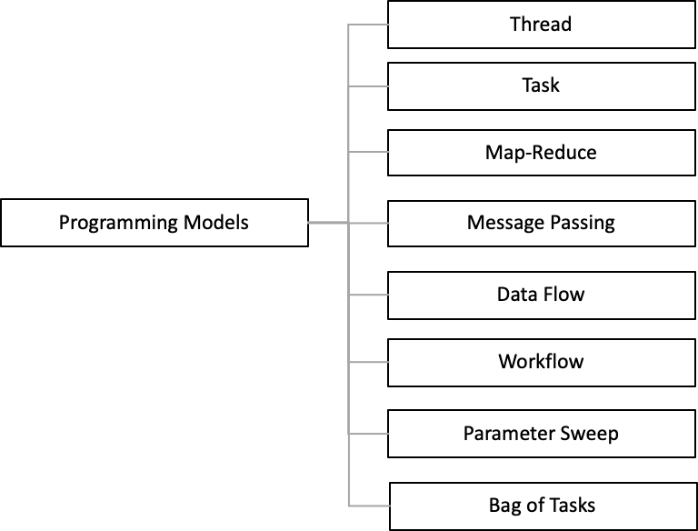
Application Programming Models In Distributed Systems

Slide 19



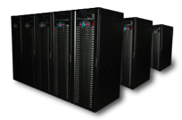

Platforms
Cluster
Grid
Cloud
Peer-to-Peer Systems
Supercomputers
Mobile Computing
Sensor Networks
Internet of things
Edge and Fog Computing
Content delivery networks (CDN)
Software Defined Networks (SDN)
…

Slide 20
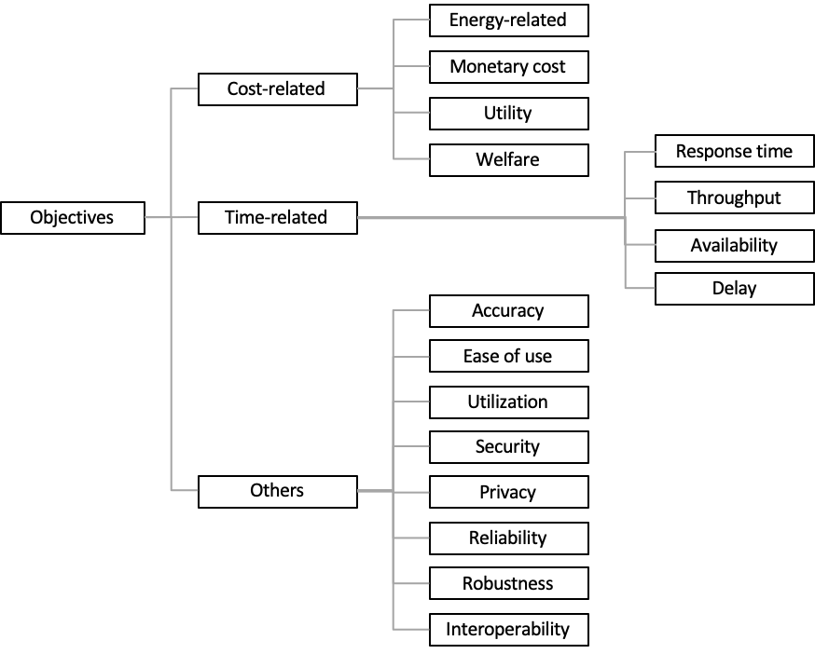
Objectives

Slide 21
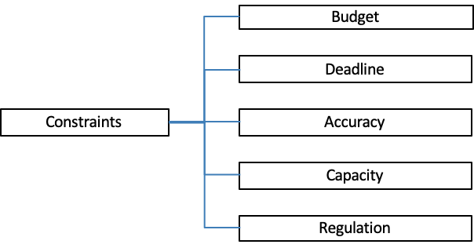
Constraints

Slide 22
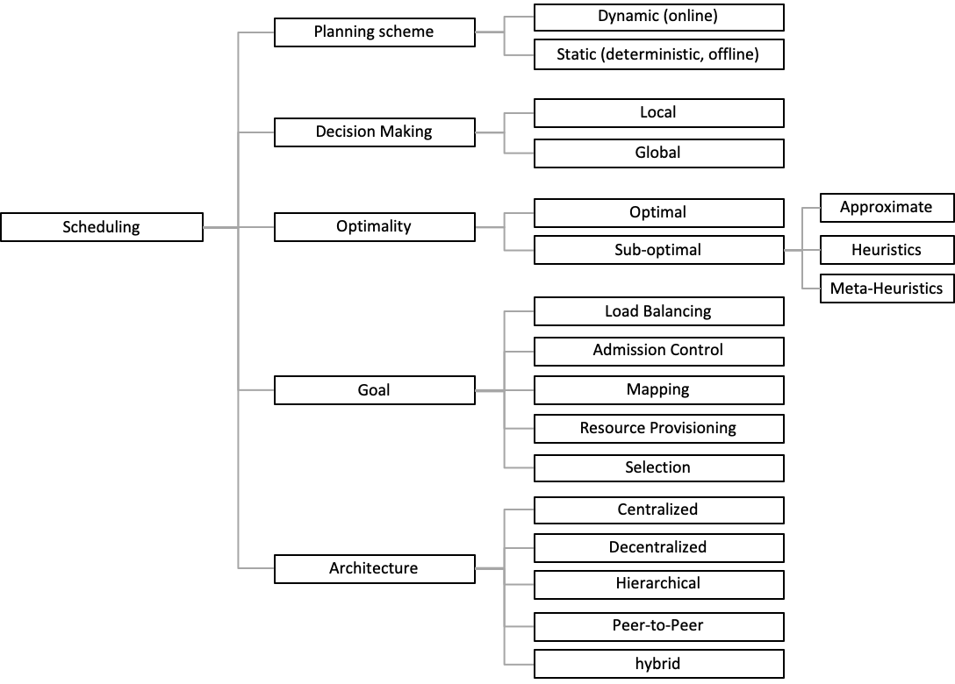
Scheduling: One of the challenging areas of research in DS

Slide 23
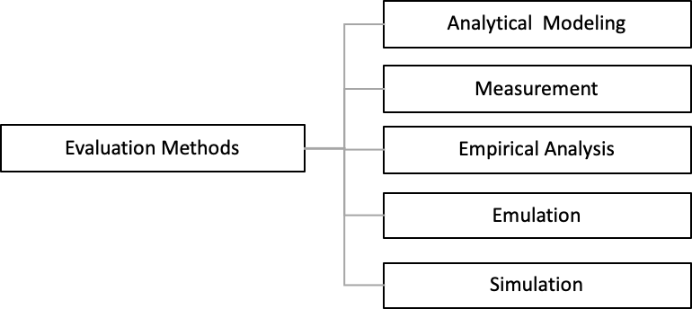
Evaluations Methods

Slide 24
Common Mistakes in Performance Evaluation
No Goals/Biased Goal
Unsystematic Approach
Analysis without understanding the problem
Incorrect Performance Metrics
Unrepresentative workload
Wrong Evaluation Technique
Overlooking Important Parameters
Ignoring significant factors
  Sensitivity analysis
Inappropriate Experimental Design
  Full factorial design
Inappropriate level of detail
No analysis/Erroneous Analysis
Ignoring Errors in Input
Improper Treatment of Outliers
Notes:
Parameters that are varies in the study are called Factors.
Sensitivity analysis is a model that determines how target variables are affected based on changes in other variables known as input variables. This model is also referred to as what-if or simulation analysis.
Factorial design is a type of research methodology that allows for the investigation of the main and interaction effects between two or more independent variables and on one or more outcome variable(s).

Slide 25
Common Mistakes in Performance Evaluation (Cont.)
Too complex Analysis
Assuming No change in the Future
Ignoring Social Aspects
  Weak presentation leads to rejection of the high-quality analyses
Ignoring Variability
  If the variability is high the mean alone is misleading.
Improper Presentation of Results
Ignoring or Omitting Assumptions and limitations Variability
Jain, Raj. The Art Of Computer Systems Performance Analysis: Techniques For Experimental Measurement, Simulation, And Modeling. john wiley & sons.
Please find more complete slides here: http://adelnadjarantoosi.info/ppt/common.pptx

Slide 26
How to write a research paper in DS domain
Problem
  Short Background (If necessary)
  Scope
    Application model, e.g., Map-reduce
    Platform, e.g., Cluster
  Objective, e.g., Cost and Energy Consumption
  Constraints, e.g., Capacity and Available Renewable Energy
Methodology
  E.g., Online scheduling using meta-heuristics
Evaluation Method
  Analytical proofs, Simulation, Emulation, Real Implementation
Results/Findings
Conclusion/Implications

Slide 27
A sample of good abstract
Problem:
  In this paper, we present BlinkDB, a massively parallel, approximate query engine for running interactive SQL queries on large volumes of data. BlinkDB allows users to trade-off query accuracy for response time, enabling interactive queries over massive data by running queries on data samples and presenting results annotated with meaningful error bars.
Methodology:
  To achieve this, BlinkDB uses two key ideas: 1) an adaptive optimization framework that builds and maintains a set of multi-dimensional stratified samples from original data over time, and 2) a dynamic sample selection strategy that selects an appropriately sized sample based on a query’s accuracy or response time requirements.
Evaluation:
  We evaluate BlinkDB against the well-known TPC-H benchmarks and a real-world analytic workload derived from Conviva Inc., a company that manages video distribution over the Internet. Our experiments on a node cluster show
Results and Conclusions:
  that BlinkDB can answer queries on upto 17TBs of data in less than seconds(over 200× faster than Hive),with in an error of 2-10%.
Agarwal, S., Mozafari, B., Panda, A., Milner, H., Madden, S. and Stoica, I., 2013, April. BlinkDB: queries with bounded errors and bounded response times on very large data. In Proceedings of the 8th ACM European Conference on Computer Systems (pp. 29-42).

Slide 28
Summary
Software Engineering Research process
  Research Question, Research Results, and Research Validation
Three Evaluation Technique:
  Measurement
  Simulation
  Analytical Modeling
Common mistakes in performance evaluation
  Sensitivity analysis
  Factorial design

