Slide 1
Acinonyx: Dynamic Flow Scheduling for Virtual Machine Migration in SDN-enabled Clouds
The 16th IEEE International Symposium on
Parallel and Distributed Processing with Applications
Adel Nadjaran Toosi
Faculty of Information Technology
Monash University
Email: adel.n.toosi [AT] monash.edu
Homepage: http://adelnadjarantoosi.info
Rajkumar Buyya
CLOUDS Laboratory
School of Computing and Information Systems
The University of Melbourne

Slide 2
Outline
Virtualization and Live VM Migration
SDN and SND-enabled Cloud Data Centres
Research Question
ACINONYX
  Dynamic Flow Scheduling for VM migration
System Architecture
Performance Evaluation
  with a Prototype and a real-world testbed
Summary and future directions
Notes:
Intro
High energy consumption in data centers
Renewable energy sources
Challenges of using renewable energy

Slide 3
Virtualization
Virtualization
  Critical building block of the operation and maintenance in cloud data centres
Virtual Machine (VM)
  A substitute for a real machine
  Allowing for multiple OS (isolated from one another), on the same physical machine.
Live VM migration
  Relocating running VMs between servers with no or minimum impact on the VM’s availability.
  hardware maintenance, load balancing and consolidation, energy saving, and disaster recovery.

Slide 4
VM Migration Impacts on the Network
Live VM migration
  Transfer from Source to Destination
    VM’s CPU state
    All memory pages
    Disks
Adverse Impacts on network
  Elephant flows over the network links
  Causing network congestion for other applications
Focus of this work
  The selection of network paths for VM migration to avoid network congestion.
  Is possible to reduce live VM migration time and network overhead by dynamically scheduling flows in a cloud data centre?

Slide 5
Software-Defined Networking
Separation of control plane from data forwarding plane
Platform is decoupled from infrastructure
Centralized controller, network-wide control by controller SW that performs routing and traffic engineering
Traditional Networking
Software-Defined Networking
Control Plane
Controller Software
Control Protocol
Data Forwarding Plane
Credit: Jungmin Son

Slide 6
SDN Benefits
Programmable network
Enables dynamic configuration of networking
Open opportunities for innovation

Slide 7
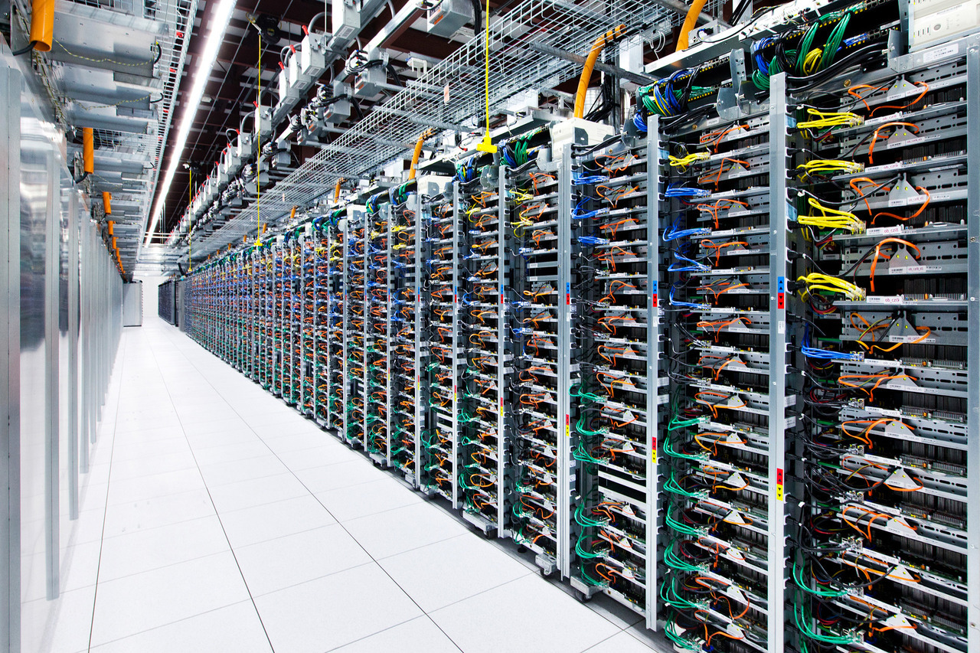
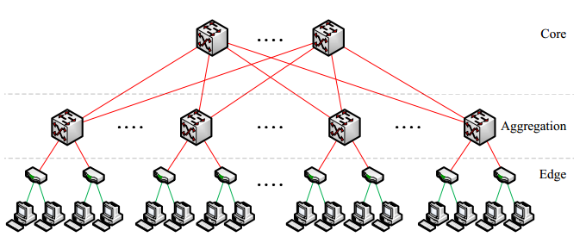
Data Centre Network
Network topology
  Fat tree, VL2, PortLand, and Bcube
  Specialized hardware (middleboxes) implementing networking functions
  NAT, load balancing, WAN optimization, firewall…
Specialized communication protocols for top tiers
Communication patterns between hosts change frequently

Slide 8
Dynamic Flow Scheduling for Virtual Machine Migration
“Is it possible to reduce live VM migration time and overhead by dynamically scheduling flows in a cloud data center with multiple paths available between a given pair of physical hosts?”

Slide 9
ACINONYX: Dynamic Flow Scheduling
Notes:
Acinonyx is a genus within the cat family with the only living species of the Cheetah (Acinonyx Jubatus) who is close to extinction.
We selected this title to
1) raise awareness for this beautiful and endangered animal and 2) race towards the minimization of VM migration time like a cheetah

Slide 10
System Architecture

Slide 11
Performance Evaluation
Real-world testbed for SDN-enabled cloud computing
8 heterogeneous servers
Fat-tree topology
Raspberry Pis (Pi 3 Model B) with Open vSwitch (OVS) as Switch
OpenStack (Ocata release) as cloud platform
OpenDaylight (ODL) as SDN controller

Slide 12
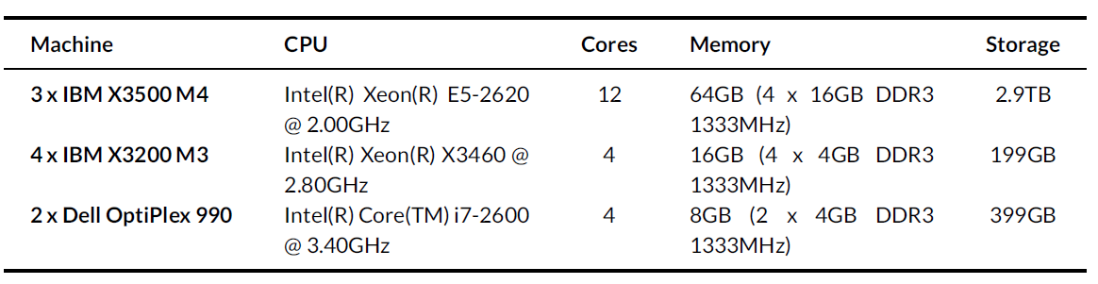
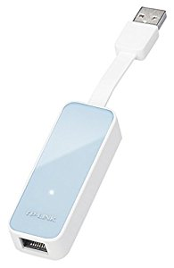
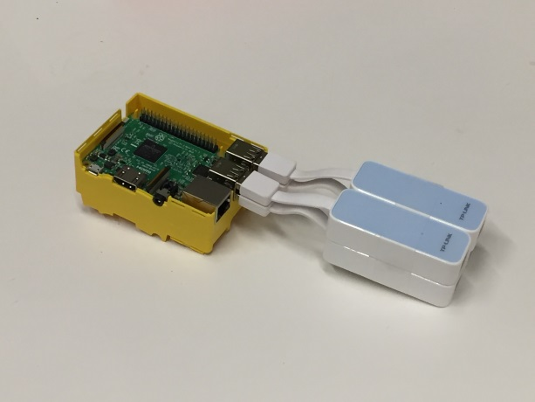
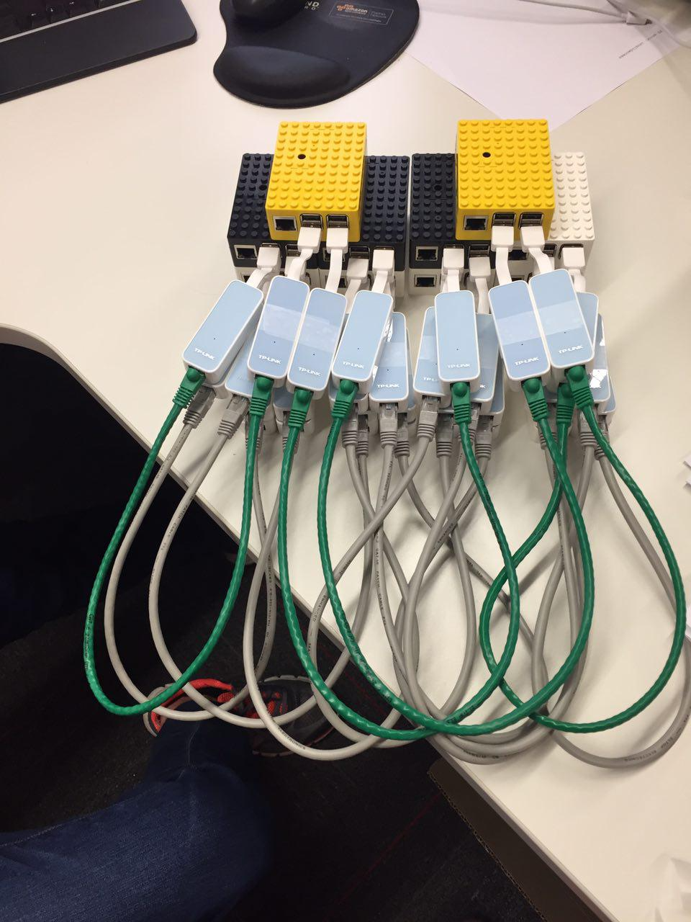
Hardware
USB 2.0 to 100Mbps
Ethernet adapters
Raspberry Pis
(Pi 3 MODEL B)

Slide 13
Testbed

Slide 14
More Photos

Slide 15
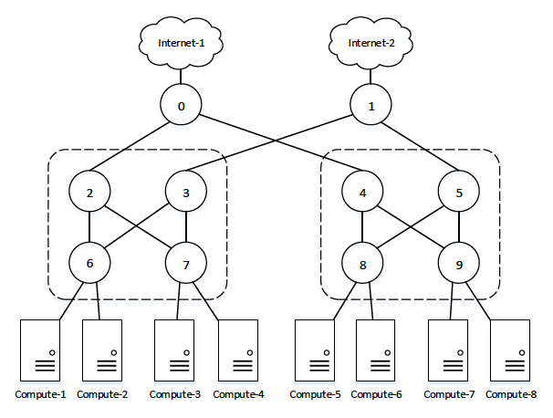
Traffic Generation and Routing
Iperf3 tool

Slide 16
Experimental Results (EXP-1)
A live VM migration in OpenStack
  m1.small VM with Ubuntu-16.04 image
  from Compute-1 to Compute-7
Results:

Slide 17
The impact of the Sleeping Interval

Slide 18
The impact of Switching Ratio Factor

Slide 19
Multiple Migrations
m1.small VMs,
  One from Compute-2 to Compute-7 and
  One from Compute-3 to Compute-8.

Slide 20
Live VM migration is frequently used in cloud data centers
Proposed a dynamic flow scheduling for live VM migration in SDN-enabled cloud data centers
Showed live VM migration time can be reduced up to 10% compared to existing static routing
Demonstrated the feasibility by building a working prototype over a practical testbed.

Slide 21
Future work
To explore the impact Acynonix on the flows of applications running in the migrating VM.
To extend our approach for efficient flow scheduling of combined multiple migrations.
Study the performance under the deployment of real-world applications exhibiting various network traffic characteristics
  stream processing, data analytics, web applications, scientific workflows

Slide 22
THANK YOU
Questions?

