Slide 1

Leveraging Computational Reuse for Cost- and QoS-Efﬁcient Task Scheduling in Clouds
Adel Nadjaran Toosi
Faculty of Information Technology
Monash University
Chavit Denninnart, Mohsen Amini Salehi and Xiangbo Li
High Performance Cloud Computing Lab .
School of Computing and Informatics
University of Louisiana Lafayette
13 Nov 2018

Slide 2
Introduction
Cloud based computing system generally contains back-end scheduler and multiple worker nodes.
Resources are not truly limitless
  Cost limitation, etc.
System can get oversubscribed

Slide 3
Introduction
Resources are not truly limitless
  Cost limitation, etc.
System can get oversubscribed
Tasks have their deadlines to meet otherwise QoE will suffer
Identical or similar task exist
  Merge task to reduce computation
Notes:
Carelessly merge or re-order tasks also make tasks missing their deadlines

Slide 4
Motivation
We are motivated by Video Streaming system that process videos on demand.
  Not all of multiple versions of the same video in different codec and settings are preprocessed
  Have preprocess segments of popular videos in popular setting ready to use
  Process on the fly for rarely access videos and rarely access settings

Slide 5
Background: Video Transcoding
Video Processing
  Transcoding
    converting a video file from one format to another.
  Type of tasks in our scenario
      Bit rate adjustment
      Spatial resolution reduction
      Temporal resolution reduction (Frame rate)
      Video compression standard conversion

Slide 6
Background: Video Transcoding
Video
  Sequences
    Segment header
    GOPS
      I frames
      P frames
      B frames
        Macro blocks
Each transcoding tasks are in GOPs levels
Notes:
Viedo is too coarse,
Frame is too small-grames

Slide 7
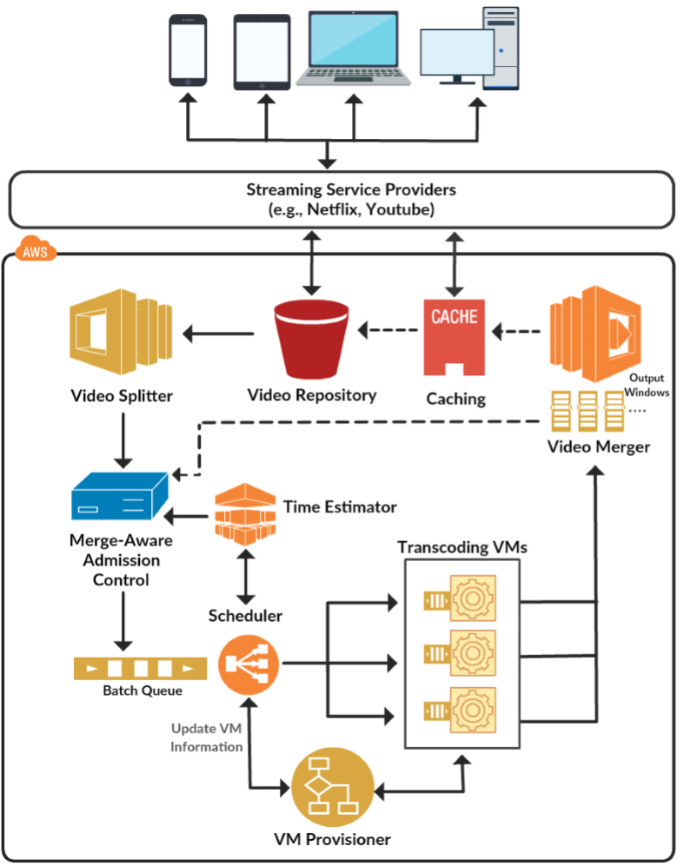
Background: CVSE
Notes:
Cloud-based Video Streaming Engine

Slide 8
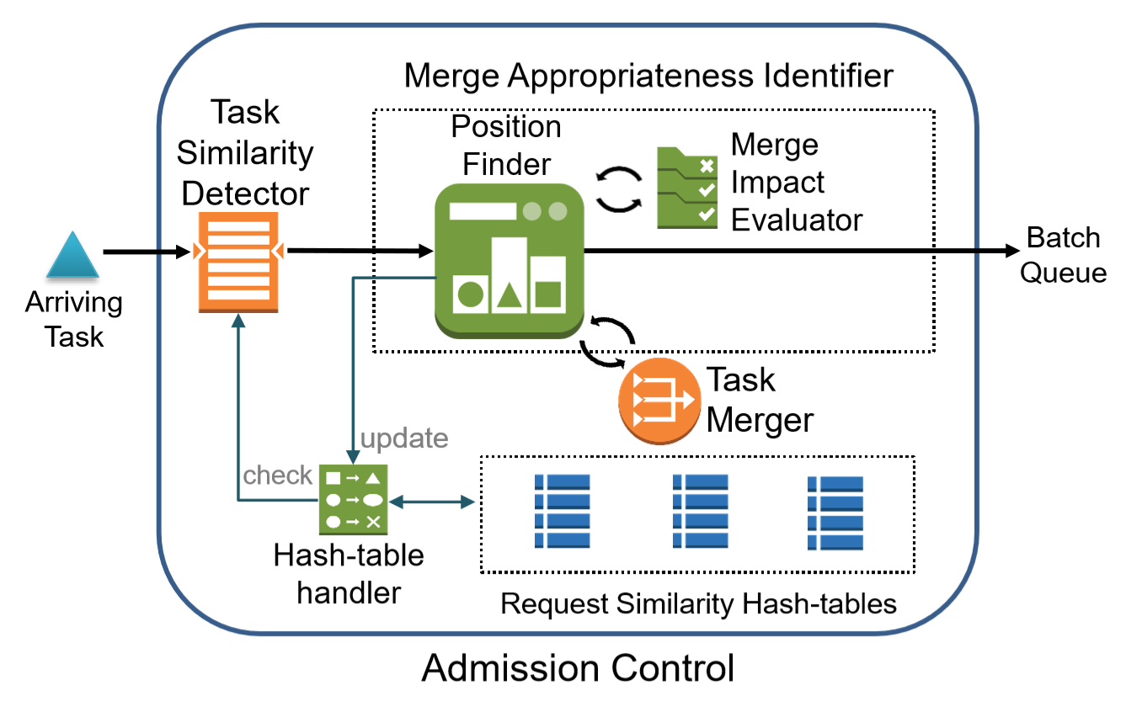
Module Architecture

Slide 9
System Model and Problem Definition
We assume a homogeneous computing system
Caching system co-exist but not aware by our system
  Already cached video segment do not become a transcoding task
System get oversubscribed without scaling up/out our resources to cope with workload
  The system may get oversubscribed during peak hours.
  Users may have limited budget, limited available resource scaling
The question is:
“How to reduce oversubscription?”

Slide 10
Contribution of This Work
Proposing an efficient way of identifying potentially merge-able tasks.
Determining appropriateness and potential side-effects of merging tasks
Analyzing the performance of the task aggregation mechanism on the viewers’ QoE and time of deploying cloud resources (VMs)

Slide 11
Similarity Levels
Task Level Similarity
  Same GOP, same process, same parameters
    Deduplicated out, no extra overhead for merged task
Operation Level Similarity
  Same GOP, same Process
Data Level Similarity
  Same GOP
Notes:
Operation level: Ffmpeg -I inputfile –r resolution1 output1 resolutions2 output2

Slide 12
Steps
Find mergeable pairs
Determine merge appropriateness
Task aggregation
Notes:
Focus on first two
Not task aggregation: it is application-specific. We have impeleted for on-demand vi

Slide 13
Mergeable Tasks Detection
Have three hash tables with keys of all tasks in the queue
  Per similarity Level
  Value of hash entry point to task object
Merge tasks upon arrival to admission control
  create 3 keys from request signature to check for identical existing hash values.

Slide 14
Mergeable Tasks Detection
Search the key in hash tables in levels from maximum reusability to least reusability, Task -> Operational -> Data
  If the hash entry exist, we found a merge candidate
  O(1)
Hash table maintaining:
  removing entry from hash table when they are executed
  Update hash table when we merge a task

Slide 15
Merge Appropriateness Evaluation
Only Operational- and Data-level similarity
Aggregated task become one object for the scheduling system
Aggregated task still take longer than each individual task to execute, therefore can cause original task in the queue or task following it to miss deadline

Slide 16
Merge Appropriateness Evaluation
Procedure:
  Two scenarios will be checked:
    candidate tasks are merged
    another where candidate tasks stay separated (i.e. not aggregated).
  Estimate completion time of each task
    Merging imposes additional deadline misses over non-merged scenario.
      DO NOT MERGE
    Merging does not cause additional deadline misses.
      MERGE

Slide 17
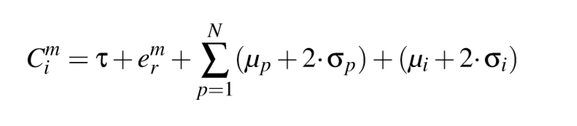
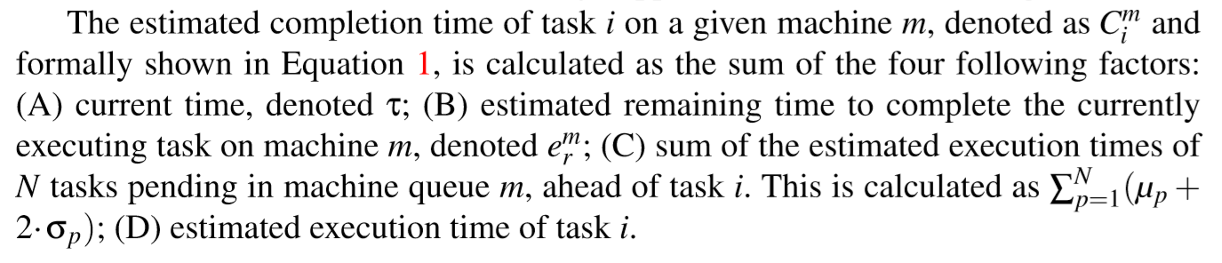
Merge Appropriateness Evaluation

Slide 18
Experimental Setup
CVSE run in simulation mode
  Simulate 8 VMs, VM scaling turned off
  Do real scheduling, but not actually transcoding
  Sampling transcoding time with mean and SD gathered from benchmark the transcoding operations on g2.2xlarge Amazon on each individual GOPs
  Compare between system with merging and without task merging
  Experiment on three scheduling policies
    FCFS
    EDF
    Max Urgency (MU)
Notes:
8 threads, scaling off
Max urgency means sorted based on the latest time they can be stared and meet the dealine

Slide 19
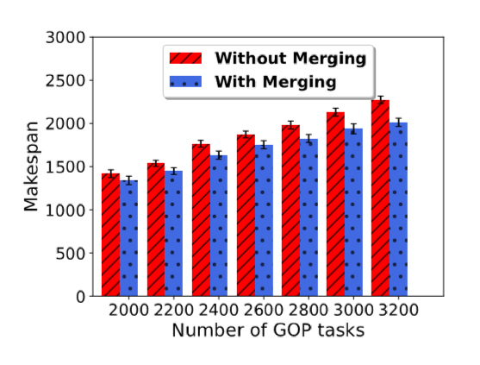
Experimental Results
14% Saving
less amount of VM time for the same amount of work
Notes:
14% saving
Makespan in Seconds

Slide 20
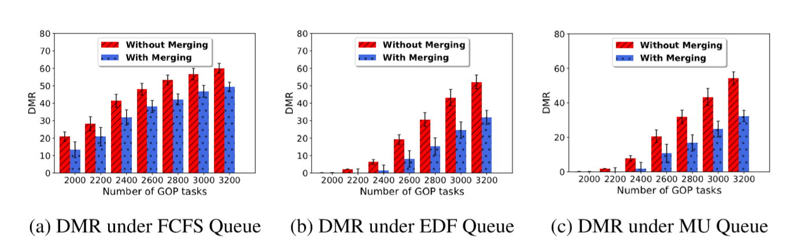
Experimental Results
Deadline miss rate-> Viewer’s QoE violation
Less deadline miss rate -> better average QoE
Notes:
DMR = Dealine Miss Rate

Slide 21
Conclusions
Cumulative execution time reduction results in deadline miss rate reduction
Detect candidate task in O(1)
We saved more than 14% off of execution time and dramatically reduce deadline miss rate

Slide 22
Future Works
Scalable merge aggressiveness factor
  Scale between aggregate tasks more aggressively to save more overall computing power, or be conservative and do not cause deadline violation to involved tasks
Heterogeneous machine system
Workflow Scenarios
  using Directed Acyclic Graph to perform additional computational reuse

Slide 23
Thank you
Questions?

