Slide 1
A Fuzzy-based Auto-scaler for Web Applications in Cloud Computing Environments
ICSOC 2018
Adel Nadjaran Toosi
Faculty of Information Technology
Monash University
Email: adel.n.toosi [at] monash.edu
Homepage: http://adelnadjarantoosi.info

Slide 2
Outline
Auto-scaling
Why is it hard?
Motivation and objectives
Our proposed Fuzzy Auto-scaler
Performance Evaluation
  System Overview
  Experimental Setup
  Results
Conclusions and Future Directions

Slide 3
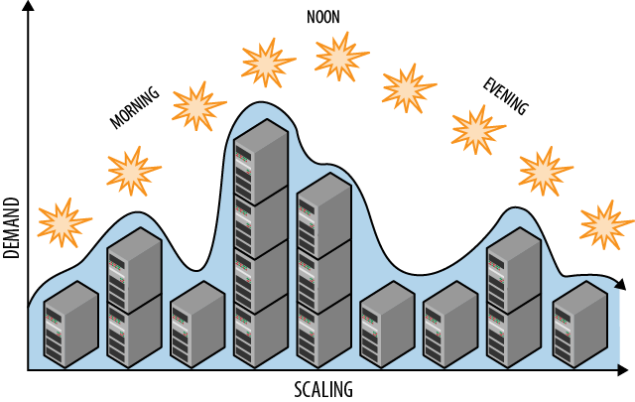
What is auto-scaling?
Dynamically adding and removing cloud resources to match the load
Monitor, Analysis, Plan, Execution loop
Maintain SLA (Service Level Agreement)
https://www.safaribooksonline.com/library/view/cloud-architecture-patterns/9781449357979/ch04.html
Notes:
Auto-scaler can help us automatically adding or remove virtual machines depends on the incoming traffic of your web application.
Its goal is to minimize our cost and maximize our SLA satisfaction
SLA stands for service level agreement which is our service target performance
Auto-scaler generally goes through 4 steps.
First, it monitors application related metrics, and then it will analyse the observed metrics and based on the analysis it will plan on how many virtual machines to remove or add. The final step is simply executing this scaling plan via cloud provider’s API.

Slide 4

Cloud Computing
Main features exhorting web application providers to host their application in Clouds
  Pay-as-you-go,
  Elasticity, and on-demand nature of cloud resources
  Huge pool of computational resources with infinite resource provisioning
Notes:
Cloud is a pool of Computers that people can use them and get charged based on the usage.
The on-demand feature of cloud can be very attractive for small and medium companies which might not have enough money to pay upfront for buying servers. Also, cloud resource can provide an illusion of infinite computational resources since its size is relatively larger than we need.

Slide 5
Why is auto-scaling hard?
Incoming load varies -> Hard to know when to scale
The auto-scaling methods
  Reactive
    Certain metrics (e.g., CPU utilization) exceed a threshold
    Only use recently observed metrics
  Proactive
    Predicting the load using historical data
    Difficult to tune and complex
    Do not perform well for highly dynamic and unforeseen workloads.
Different applications have different indicator metrics (system/service stats)
Takes time to start and configure new virtual machines (around minutes)
Notes:
For a web application, especially for the one which is getting popular, the incoming load patterns varies often, so it is hard to tell when to scale
Different web application consumes different system resources, so it is hard to find good metrics which could accurately reflect the capacity of the virtual machines which is used to host your web application.
Provisioning new virtual machines take a long time to configure and boot up, so for every scaling step we should perform it wisely otherwise we will continuingly violate our SLA.

Slide 6
Motivation and Objectives
Motivation
There is still not an ideal auto-scaler
Reactive approaches are the most common approaches (often threshold based)
What are the optimal threshold values for auto-scaling?
Dynamic thresholds
Objective
An improved reactive auto-scaler can be used by general web applications
  Minimizes cost while meeting SLA requirements
  Dynamic upper threshold
  Dynamic cloud resource provisioning
Notes:
simplicity and the adequate performance
What motivates us to explore auto-scaling methods.
Cloud computing is growing so fast, and there is still not an idea auto-scaler can help us to use cloud resource effectively.
We aim to improve the traditional reactive auto-scaler which use the static threshold to trigger scaling and static value to provision new virtual machines by using fuzzy logic to make it adaptive.

Slide 7
The proposed auto-scaler
Uses Fuzzy logic
  Implement scaling rules
  Dynamically adds and removes VMs
  Dynamically adjusts the scaling threshold
    Response Time, Cluster Size
Metrics
  CPU Load
  Response Time
  Cluster size

Slide 8
What is fuzzy logic
Not just about true or false
Degree of truth -> continuous value between 0.0 and 1.0
Linguistic terms ‘if CPU is HIGH then CLOSE SOME PROCESS
Human-like reasoning (vagueness).

Slide 9
Two fuzzy engines
One produces dynamic upper threshold -> trigger adding VMs
Input: Response Time, Cluster Size
Output: Upper threshold in proportion of SLA
Rules: Gradually increase upper threshold when cluster size gets larger
One produces the cluster size -> how many VMs to add
Input: CPU Load, Cluster Size
Output: Cluster size in proportion of maximum number of virtual machines
Rules: Conservative when cluster size is small and nearly reached maximum
Notes:
The fuzzy rules are that, when cluster size increased, it should have higher upper-threshold to tolerate more fluctuation of the response time in order to avoid unnecessary resource provisioning.
The second fuzzy logic produce the dynamic number for provisioning new virtual machines
The inputs are CPU Load and Cluster Size
The idea is that when cluster size is small, the metric observed is generally heavily overloaded or not accurate,
so we should be conservative when performing scaling with those metrics. When the cluster size is near the maximum cluster size, should add in less virtual machines to prevent it from exhausting all of the resources.

Slide 10
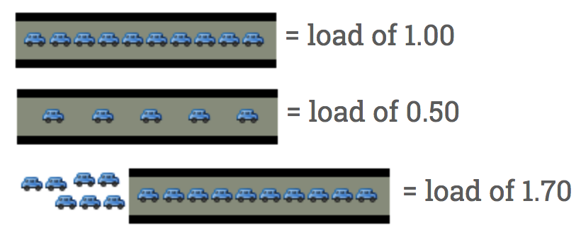
What is CPU Load?
Uptime command
Not CPU Utilization
Linux based system it is average usage of the system resource
Originally only measure demand of CPU, but now it includes IO
Ideally CPU Load = 1 when the resources are fully utilized
http://blog.scoutapp.com/articles/2009/07/31/understanding-load-averages
Notes:
CPU Load shows the demand of your CPU, it is not CPU Utilization which only shows how busy is your CPU.
See the following road analogy that if the road is fully occupied by cars it is 100% CPU load,
If the road is half used then it is 50% CPU load
If the load is fully used and there are some cars waiting to enter the road the CPU Load will show value beyond 100%.
CPU Load is also evolved to show the IO demands, so we think it is a useful metric to estimate the cloud resource we need when doing auto-scaling.

Slide 11
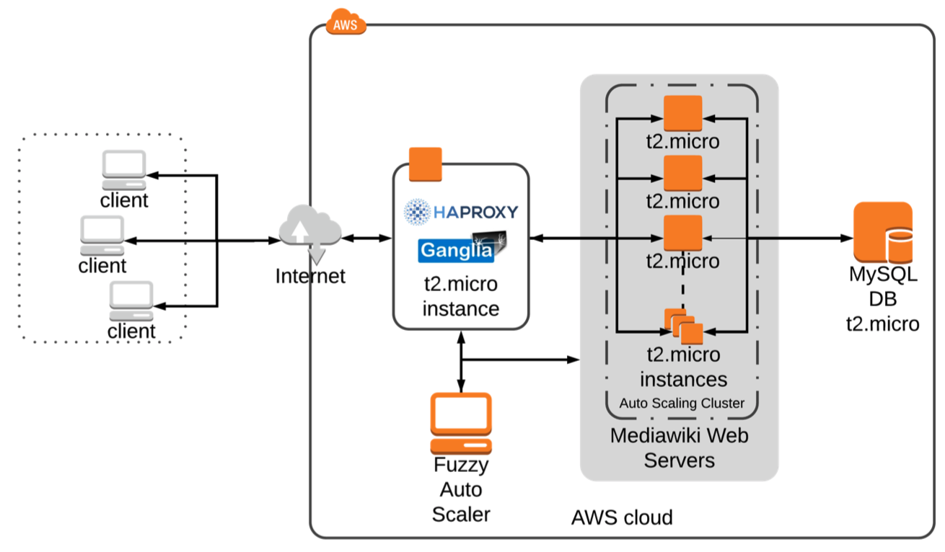
System Overview
Notes:
We only use T2.micro instance from AWS since it is free in the first year.
Our aim is to automatically add or removing mediawiki web servers.
Mediawiki as our web application.

Slide 12
Experimental Setup
SLA = 200ms, 90%
30 minutes
Wikipedia trace fired by Wikijector
Notes:
Max 10 virtual machines
SLA or the goal of our website is to keep request 200ms.
Our experiment time is 30 minutes that is because the t2.micro instance has restriction of using full CPU power after 30 minutes.

Slide 13
Experiment - Auto-scalers
Three Auto-scaler
Amazon native Auto-scaler
Amazon emulated Auto-scaler
  100ms Response time as upper threshold
  add or remove static number of VMs
Fuzzy based Auto-scaler
  Dynamic response time upper threshold
  Dynamic number of provisioning
Notes:
We compare three auto-scalers
First two use AWS reactive scaling methods.
The second one does it locally without calling the scaling API. So it is called Amazon emulated auto-scaler
They all have an upper threshold at 100ms response time, and they can only remove or add a static number of virtual machines.
Then we have our own fuzzy logic based auto-scaler

Slide 14
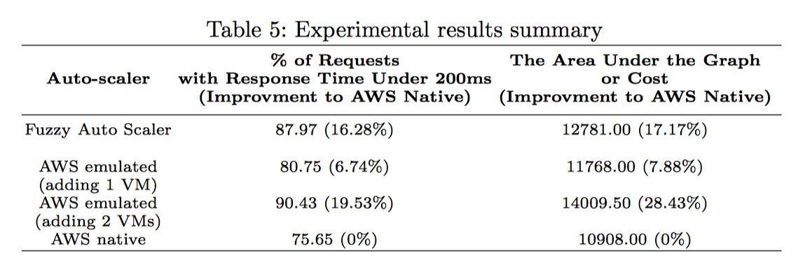
Experimental Results
Auto-scaler | % of request with response time under 200ms (Improvement to AWS Native) | The Area Under the Graph/Cost (Increase to AWS Native)
Fuzzy Auto-Scaler | 87.97 (16.28%) | 12781.00 (17.17%)
AWS emulated (adding 1 VM) | 80.75 (6.74%) | 11768.00 (7.88%)
AWS emulated (adding 2 VMs) | 90.43 (19.53%) | 14009.50 (28.43%)
AWS Native | 75.65 (0%) | 10908.00 (0%)
Notes:
Firstly, we can see the increase of response time satisfaction will cause the cost to go up since you need more virtual machines to handle the increasing number of web requests. The aim is to increase SLA with effective use of cloud resource.
In here we use AWS native auto scaler which is the one directly calling the AWS scaling API as our baseline since it performs the worst.
In here we can see when emulated adding 1 virtual machine it only increase 6.74% of SLA, when it adds two each time it goes up to 19.53% which outperforms our fuzzy logic auto-scaler which increase SLA by 16.28%
However, AWS emulated virtual machines (adding 2 VMs) doesn’t use cloud resource effectively.

Slide 15
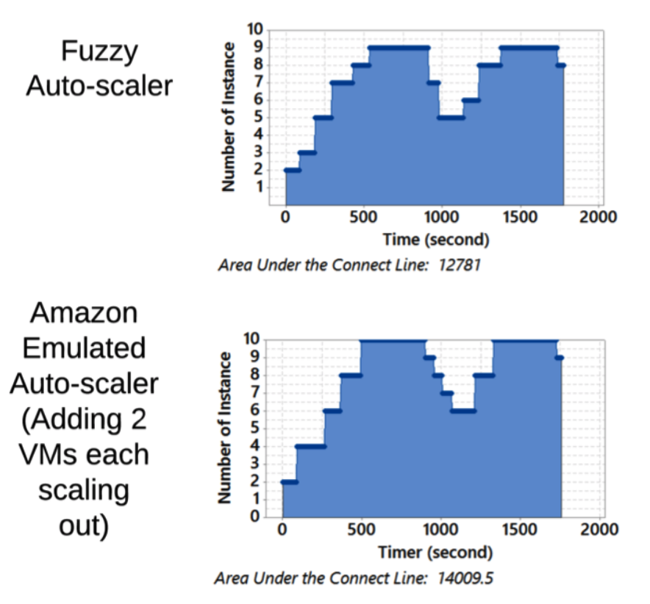
Experiment Result - Dynamic Provisioning
Notes:
Number virtual machines versus time in seconds
Emulated Amazon Auto-scaler reached a maximum of 10 virtual machines two times, whereas Fuzzy auto-scaler only reach 9 virtual machines without breaking the 200ms target.
A static number of adding virtual machines could be overkill sometimes, you have no other choice but always 2 virtual machines with amazon emulated auto-scaler.

Slide 16
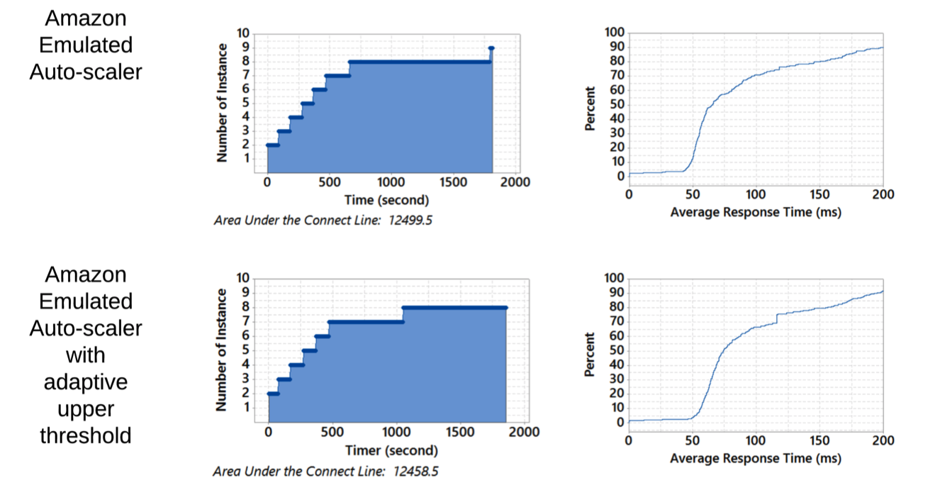
Experiment Result - Dynamic Upper threshold
Notes:
Since the previous trace file goes up and down too quickly, the effect of the dynamic upper threshold is not clear
However, during the long run of the web application, you will experience many small fluctuations of the response time.
So this Wikipedia trace mimic the slow increase and slow decrease of the incoming load.
These two auto-scalers are same except the bottom one uses dynamic upper threshold
The adaptive upper threshold keeps the cluster at 7 longer than the top one
Imagine, if we run this MediaWiki for weeks and the auto-scaler’s dynamic upper-threshold will help you to save a lot of costs.

Slide 17
Conclusion and future work
Fuzzy logic is an effective method in auto-scaling.
Adaptiveness of the scaling methods is important.
Scaling Thresholds should be dynamically adjusted.
We will explore techniques to determine the best candidate VMs for scaling-in.
The auto-scaling of session-based web applications, where users have sticky sessions needs more attention since it requires session migration.
More in-depth investigation of the correlation between metrics
Notes:
The experiment results show that
Fuzzy logic is a decent method that could improve the traditional reactive auto-scaler which uses static upper threshold and provisioning the static number of virtual machines.
Adaptivity is important to build a good auto-scaler, that we need to add or remove virtual machines by considering the current state of the cluster.
Single static scaling method does not work well in most of the time.
In the future, we hope we can support all cloud platforms so that we can compare the price of virtual machines during scaling.

Slide 18
Thank You!
Questions?

