Slide 1

The Answer to the Ultimate Question of Distributed Systems
An Overview of Application Programming/Composition, Scheduling, Execution, and Performance Evaluation Models
Adel Nadjaran Toosi
Reproducing and abstracting materials in these slides for teaching and educational purposes with credit is permitted. All other rights reserved 2015. please check with the author for publishing.
Notes:
The hitchhiker’s guide to the galaxy a humorous British radio program written by Douglas Adams, which later become a book and TV program.
It is a science fiction story about an Englishman Arthur Dent who gets on a spaceship just before the earth is destroyed.
A group of hyper-intelligent beings demand to learn the Answer to the Ultimate Question of Life, The Universe, and Everything from the supercomputer, Deep Thought, specially built for this purpose. It takes Deep Thought 7½ million years to compute and check the answer.

Slide 2
Outline
Execution models
Programming models
Scheduling
Platform
Objectives
Evaluation Methods
Constraints (Parameters)
We conclude with an abstract!!

Slide 3
Execution Models In Distributed Systems
Batch Processing
Interactive Processing (Online Processing)
Execution Models
Stream Processing
Real-time Processing
Parallel Processing

Slide 4
Batch Processing
Batch Processing: allows users to submit series of programs (jobs) and they will be executed to completion without further user input and manual intervention.
  Is Hadoop a batch processing framework?
    In better words, Hadoop is an open source distributed processing framework.
    Hadoop Map-Reduce is best suited for batch processing.
  Spark and Storm can be used for real time and stream processing.
  Strom is Hadoop of real-time processing.
Bag of Tasks
HPC jobs
HTC jobs
Batch Processing
Scientific Workflows
Parameter Sweep Tasks
Map-Reduce Tasks
Graph Processing
Notes:
-Spark is well-suited to machine learning algorithms has multi-stage in-memory primitives.
-One key difference between these two technologies is that Spark performs Data-Parallel computations while Storm performs Task-Parallel computations.
-Parameter sweep applications execute the same piece of code multiple times with unique sets of input parameters.
-HPC tasks need large amounts of computing power for short periods of time, whereas High Throughput Computing tasks also require large amounts of computing, but for much longer times (months and years, rather than hours and days).

Slide 5
Interactive (Online) Processing
Interactive Processing: Interactive computing refers to application which accepts input from humans, e.g., Web applications, Massively Multiplayer Online (MMO) games.
Online Processing: Another term for Interactive processing.
  Interactive or online processing requires a user to supply an input.
  Bar code scanning, online analytical processing (OLAP), online transaction processing (OLTP)
Notes:
OLAP computer-based technique of analyzing data to look for insights
OLTP facilitates and manages transaction-oriented applications typically for data entry and retrieval transaction processing.

Slide 6
Stream Processing
Stream Processing: record-by-record analysis of machine data in motion, e.g., Sensor Networks analytics, Internet of things applications, Online video processing.
Characteristics
  Compute Intensity
  Data Parallelism
  Data Locality
Spark is a batch processing system at heart, but Spark Streaming is a stream processing system.
Notes:
-Compute Intensity, the number of arithmetic operations per I/O or global memory reference. In many signal processing applications today it is well over 50:1 and increasing with algorithmic complexity.
-Data Parallelism exists in a kernel if the same function is applied to all records of an input stream and a number of records can be processed simultaneously without waiting for results from previous records.
-Data Locality is a specific type of temporal locality common in signal and media processing applications where data is produced once, read once or twice later in the application, and never read again.

Slide 7
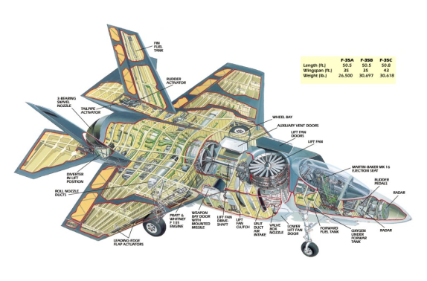

Real-time Processing
Real-time Processing: real time data processing involves a continual input, process and output of data. Data must be processed in a small time period (or near real time).
  Hard real-time
    Nuclear systems, avionics
  Firm real time
    Sound system
  Soft real-time
    Weather stations
Real-time Processing vs. Stream Processing: There are no compulsory time limitations in stream processing while small guaranteed deadline is compulsory in real-time processing
  Storm is a stream or real-time processing system?
  Other examples: airline ticket reservations, stock market, Fly-by-wire, antilock brakes, Videoconference applications, VoIP
Notes:
Soft real-time: Failure to meet a deadline is considered neither application nor system failure
OLAP is an approach to answering multi-dimensional analytical (MDA) queries swiftly
Real time processing is a subset of interactive or online processing. Online means that there is some kind of interactivity involved, but doesn't enforce limits in latency.

Slide 8
Parallel Processing
Parallel Processing: is the processing of program instructions by dividing them among multiple processors with the objective of running a program in less time.
  Concurrent computing vs. Parallel Processing
    It is possible to have parallelism without concurrency (such as bit-level parallelism)
    Concurrent and parallel programming are different. for instance, you can have two threads (or processes) executing concurrently on the same core through context switching. When the two threads (or processes) are executed on two different cores (or processors), you have parallelism.
  Speed-up and Amdahl's law : If α is the fraction of running time a program spends on non-parallelizable parts, then the maximum speed-up with parallelization of the program is ,
  where P being the number of processors used.
  Examples: Parallel programs in MPI and OpenMP.
bit-level
Parallel Processing
instruction level
task parallelism
Notes:
A program consists of several parallelizable parts and several non-parallelizable (sequential) parts.

Slide 9
Other types
Data Warehouse
Transaction Processing
?

Slide 10
Application Programming Models In Distributed Systems
Thread
Task
Map-Reduce
Programming Models
Message Passing
Data Flow
Workflow
Parameter Sweep
Bag of Tasks

Slide 11

Scheduling
Scheduling is the process of arranging, controlling and optimizing work and workloads by assigning them to resources.
Three main components of any scheduling problem:
  Consumer, e.g. processes, threads, cloud clients.
  Resource, e.g., CPU, I/O, VMs
  Policy
Allocation vs. Scheduling!!!
  Often implicit distinction between the terms
  in the literature, but, in general, it can be
  said that:
    Allocation is from resources’ point of view, while Scheduling is form consumers’ point of view.

Slide 12
Scheduling
Planning scheme
Dynamic (online)
Static (deterministic, offline)
Local
Decision Making
Global
Optimal
Approximate
Scheduling
Optimality
Sub-optimal
Heuristics
Meta-Heuristics
Load Balancing
Admission Control
Goal
Mapping
Resource Provisioning
Selection
Centralized
Decentralized
Architecture
Hierarchical
Peer-to-Peer
hybrid
Notes:
Local or global scheduling: current task or entire workload. e.g., workflow
----- Meeting Notes (14/10/15 16:45) -----
stages

Slide 13

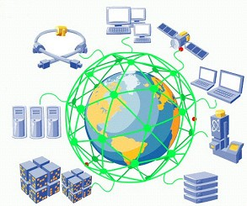

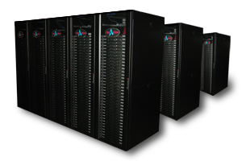

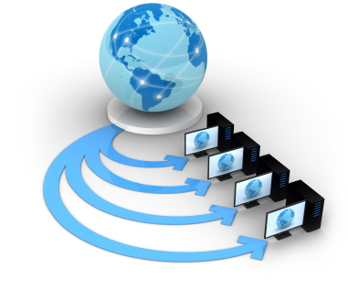
Platforms
Cluster
Grid
Cloud
Peer-to-Peer Systems
Super Computers
Mobile Computing
Sensor Networks
Internet of things
Content delivery networks (CDN)
Software Defined Networks (SDN)
…

Slide 14
Objectives
Energy-related
Monetary cost
Cost-related
Utility
Welfare
Response time
Objectives
Time-related
Throughput
Availability
Delay
Accuracy
Ease of use
Utilization
Security
Others
Privacy
Reliability
Robustness
Interoperability
Notes:
----- Meeting Notes (14/10/15 16:45) -----
functional non-functional

Slide 15
Evaluation Methods
Analytical Modeling
Measurement
Evaluation Methods
Empirical Analysis
Emulation
Simulation

Slide 16
Constraints (Parameters)
Budget
Deadline
Parameters
Accuracy
Capacity
Regulation

Slide 17
How to write your abstract!!
Problem
  Short Background (If necessary)
  Scope
    Application model, e.g., Map-reduce
    Platform, e.g., Cluster
  Objective, e.g., Cost and Energy Consumption
  Constraints, e.g., Capacity and Available Renewable Energy
Methodology
  E.g., Online scheduling using meta-heuristics
  Evaluation Method
    Analytical proofs, Simulation, Emulation, Real Implementation
Results/Findings
  Conclusion/Implications
Notes:
----- Meeting Notes (14/10/15 16:45) -----
motivate

Slide 18
BlinkDB: Queries with Bounded Errors and Bounded Response Times on Very Large Data
Problem:
In this paper, we present BlinkDB, a massively parallel, approximate query engine for running interactive SQL queries on large volumes of data. BlinkDB allows users to trade-off query accuracy for response time, enabling interactive queries over massive data by running queries on data samples and presenting results annotated with meaningful error bars.
Methodology:
To achieve this, BlinkDB uses two key ideas: 1) an adaptive optimization framework that builds and maintains a set of multi-dimensional stratified samples from original data over time, and 2) a dynamic sample selection strategy that selects an appropriately sized sample based on a query’s accuracy or response time requirements.
Evaluation:
We evaluate BlinkDB against the well-known TPC-H benchmarks and a real-world analytic workload derived from Conviva Inc., a company that manages video distribution over the Internet. Our experiments on a node cluster show
Results and Conclusions:
that BlinkDB can answer queries on upto 17TBs of data in less than seconds(over 200× faster than Hive),with in an error of 2-10%.
Notes:
Proceedings of the 8th ACM European Conference on Computer Systems. ACM, 2013
Researchers from Berkley and MIT

Slide 19
The answer is 41.
Any other questions?
Notes:
The answer, which turns out to be 42. Deep Thought points out that the answer seems meaningless because the beings who instructed it never actually knew what the Question was.

